Slide 1

Kickoff Meeting With KeHE
Prepared for : Blake @ KeHE
Prepared by : Cody & Ryan @ Journeyfront
Prepared on : May 25, 2023

Slide 2


Agenda
1. Introductions
2. Journeyfront Overview
3. Getting Started
4. Next Steps

Slide 3
Key Objectives Today
Looking forward to today’s conversation. The goal of today’s call is to align on our partnership, and discuss some of the highlights we’ve seen in our work together. Then, we will talk through the next steps for our partnership, and what we’d like to achieve with you over the next {Quarter/Year}, as well as some trends we’re seeing from your peers. If everything looks good, we can then discuss next steps. Does that sound good?

Slide 4




See Appendix for more photos, need a photo of Cody
Your Journeyfront Implementation Team
Daniel Ash
CEO/Co-Founder
Cody Jolley
Director of Customer Success
Scott Branigan
Account Executive
Hector Guillermo
Data Scientist
Responsibility
-
-
-
Daniel@journeyfront.com
Responsibility
-
-
-
Cody@journeyfront.com
Responsibility
-
-
-
Scott@journeyfront.com
Responsibility
-
-
-
Hector@journeyfront.com

Slide 5
Agenda
1. Introductions
2. Journeyfront Overview
3. Getting Started
4. Next Steps

Slide 6
What Is Hiring Accuracy?
- 2 colors of check mark (for the tools they have and the ones we are proposing)
Hiring people that meet your expectations in the following 3 areas:
Performance
Retention
Culture Fit

Slide 7


- Next 3 slides is a quick demo, they want a bank of quick demo slides in the appendix
The Journeyfront Solution
Accuracy for Applicant Screening
Accuracy for Applicant Interviews

Slide 8
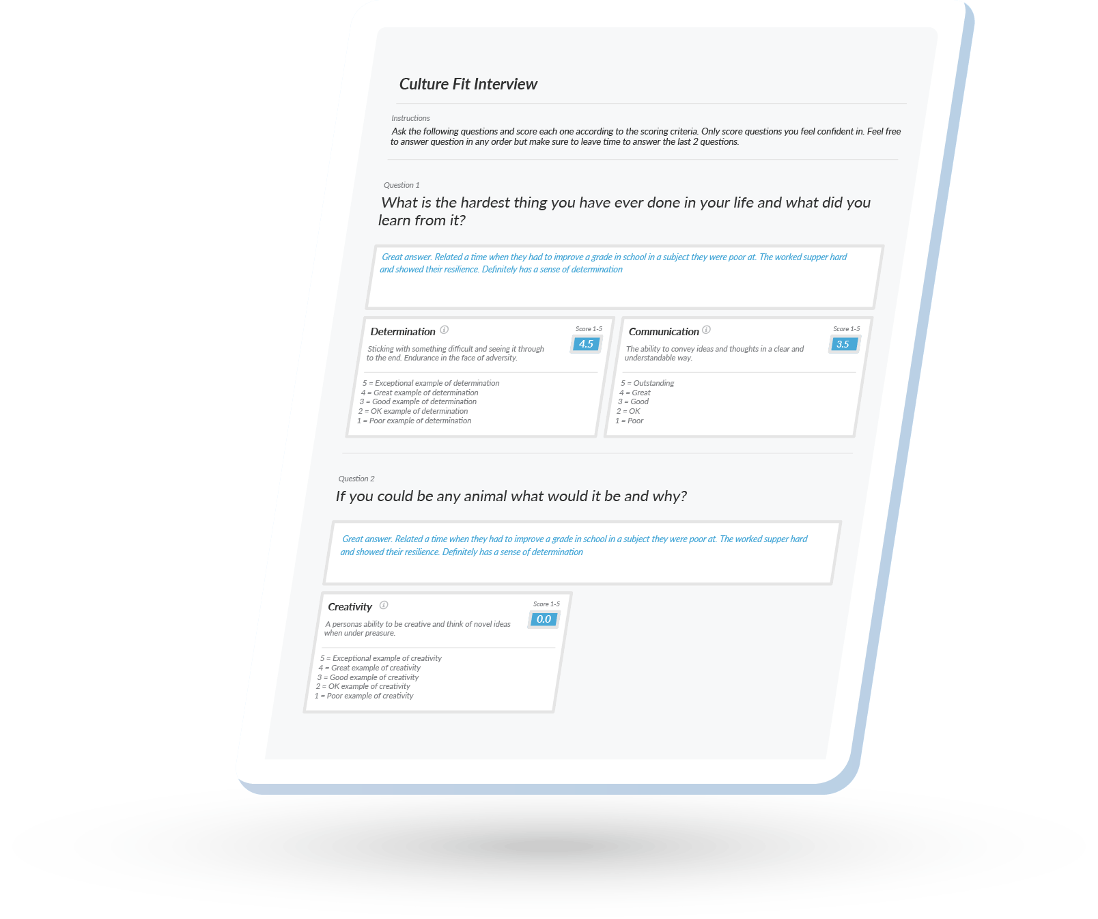
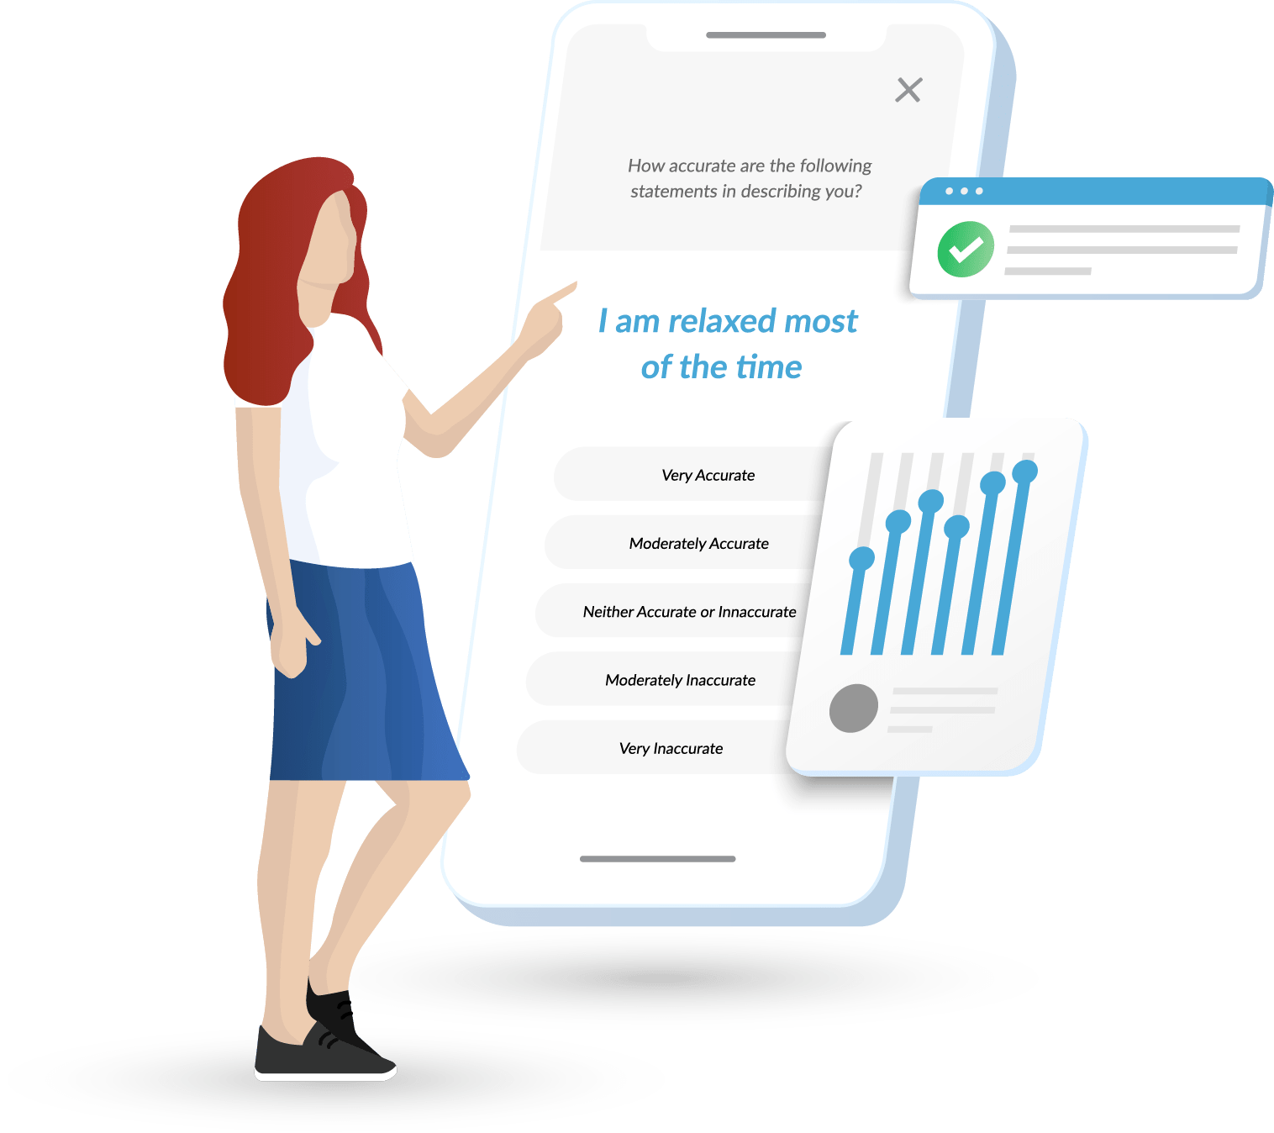

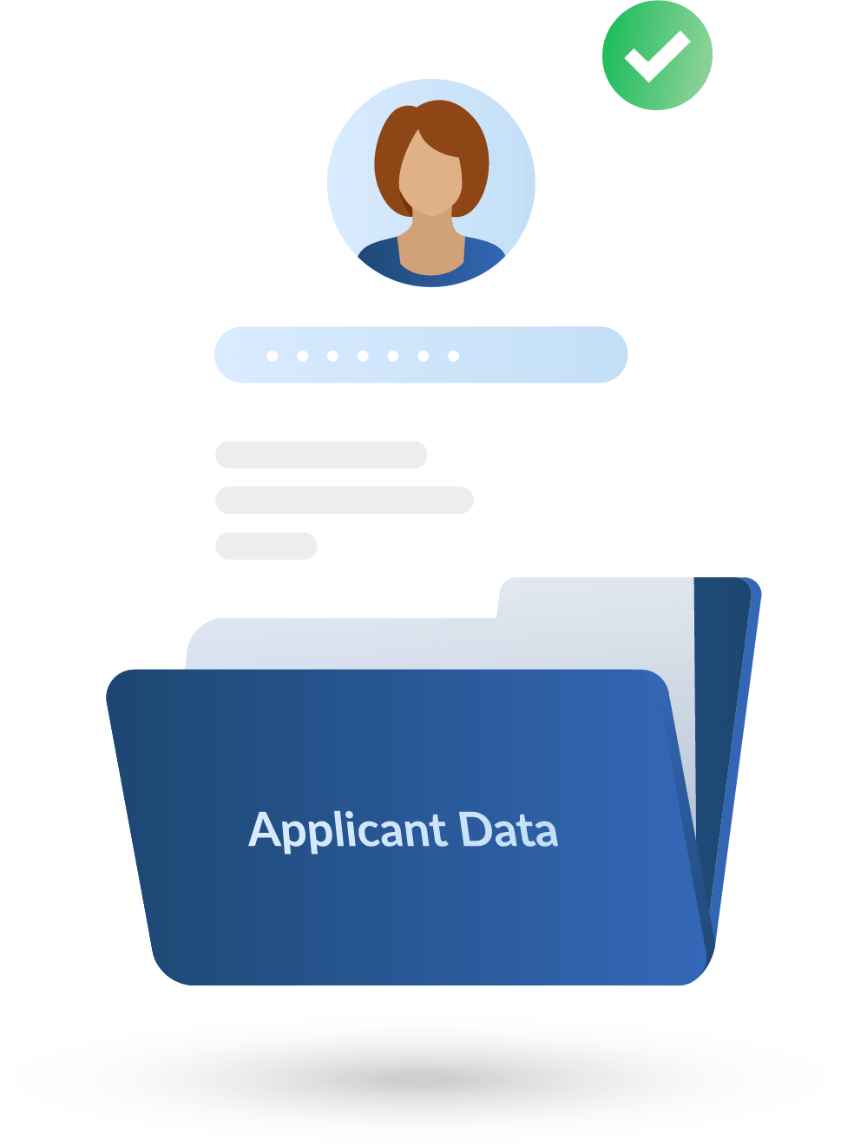
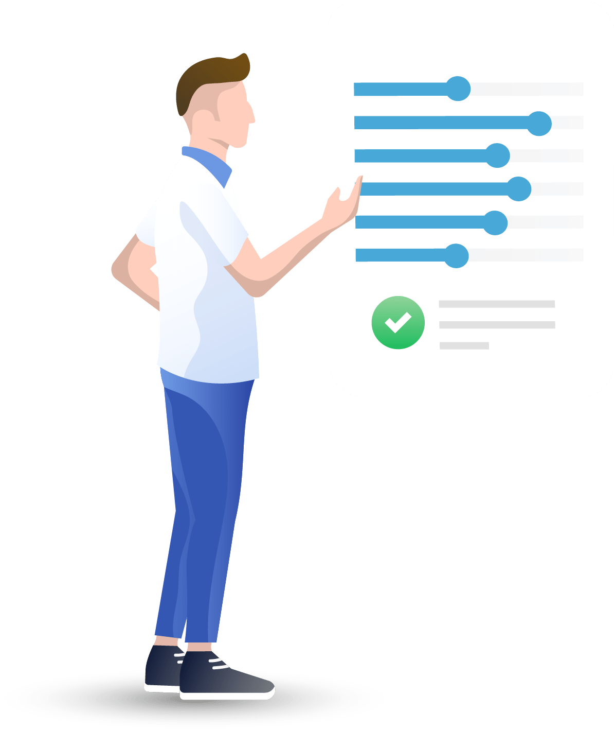
3
Candidates Take Assessments
1
2
4
Assess
Employees
Create
Predictive Models
Predict
Outcomes
5
Track Outcomes
+ Employee, Performance & Satisfaction Data

Slide 9
3
Candidates Take Assessments
1
2
4
Assess
Employees
Optimize
Predictive Models
Predict
Outcomes
5
Track Outcomes
+ Employee, Performance & Satisfaction Data

Slide 10
Agenda
1. Introductions
2. Journeyfront Overview
3. Getting Started
4. Next Steps

Slide 11
How can we help you accomplish your goals?
Question | Response
What interview guides are we creating? | 2 Executive Searches; 2 Non-Executive Searches
What are main hiring challenges/goals for the department(s? | Efficiency of scorecards - inputting and sending to external clients
Optimization

Slide 12
Current Hiring Process
Question | Response
How often are you hiring for this role?
What’s the volume of the hiring cohorts?
When do you have to fill the next position? If active when is the next important date?
What are your current hiring steps?
Optimization

Slide 13
Responsibilities
Role | Responsibilities | Name / Position
Partnership Lead (Your Side) | Responsible for Partnership’s Success
Implementation | Collecting Employee Import Data Sending Employee Assessment Link Compiling Existing Documentation For Current Screening Plans
Executing Hiring Process | Screening candidates Interviewing Deciding
Post Hire Tracking?? | Providing employee termination data for Providing employee performance/KPI’s to assess or improve hiring accuracy
Optimization

Slide 14
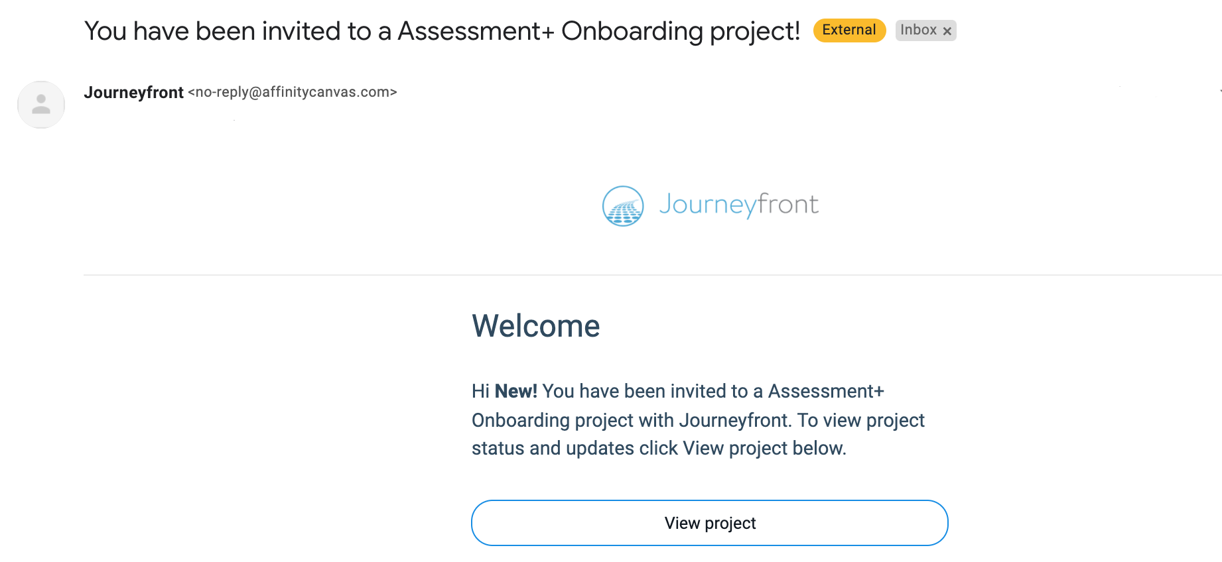
Invite Email

Slide 15
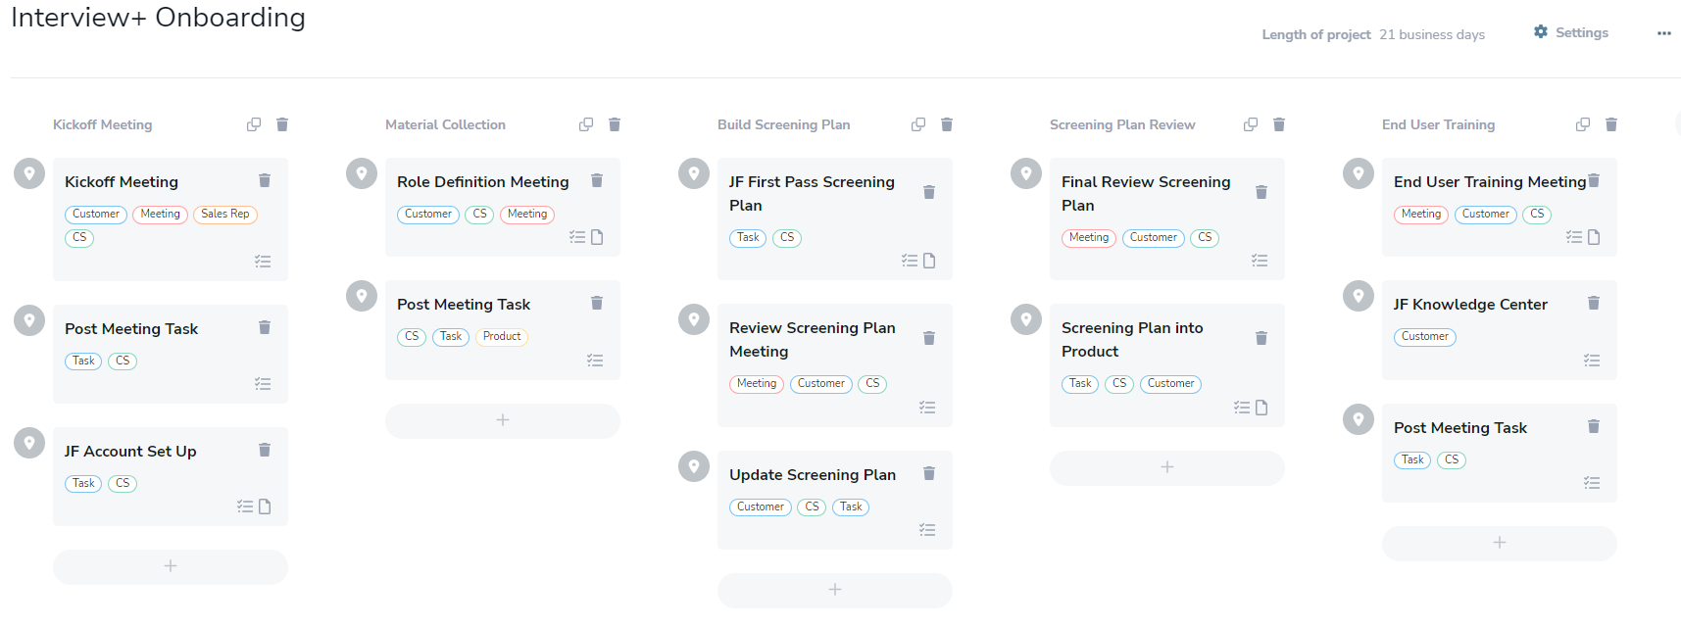
Journeyfront Onboarding Project

Slide 16
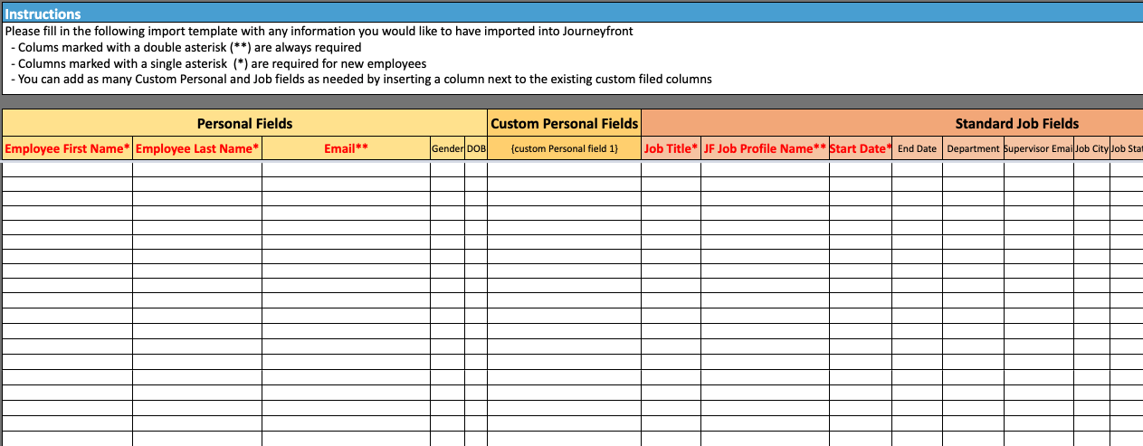
Employee Import File
Did you want me to recreate this table?
Note: This is a guide; you can also use your own file provided it’s formatted similarly—rows are employees, and columns are key fields.
Please fill in the following import template with any information you would like to have imported into Journeyfront

Slide 17
Agenda
1. Introductions
2. Journeyfront Overview
3. Getting Started
4. Next Steps

Slide 18


Next Steps
1
EOD we’ll do “X”
2
EOW we’ll do “x”
3
EOW we’ll do “x”
4
EOW we’ll do “x”

Slide 19
Appendix

Slide 20
















in appendix, give them red cross & green checks
And / or a graphic icon pack
You can change the colors of these

Slide 21











Headshot of everyone

Slide 22
JF Colors
2023-06
20E0B2
3CB1E5
D62CFF
F21D8D
00C9CB
8C68F2
ED00C7

Slide 23
Dot patterns

Slide 24



Slide 25




Slide 26


Slide 27
Old / Extra Slides

Slide 28



Your Journeyfront Implementation Team
Daniel Ash
LEAD SALES CONTACT
Goals:
        Seamless Handoff
        Ensure Long Term Success of Partnership
Responsibility:
Coordinate initial communication
Clarify contract scope
Cody Jolley
LEAD CUSTOMER SUCCESS CONTACT
Goals:
        Value Realization
        Product Adoption
Responsibility:
Provide 24/7 customer support
Manage all projects and goals
Valerie Garret
IMPLEMENTATION CONTACT
Goals:
Smooth Implementation Process
Responsibility:
Industry guidance and best practices
Assist in onboarding, training, and support as needed
Email: daniel@journeyfront.com
Email: cody@journeyfront.com
Email: valeriegarrett@journeyfront.com

Slide 29
Proposal Outline
Item 1 | 1
Item 2 | 3
Item 3 | 5
Item 4 | 7
Item 5 | 8
Item 6 | 9
Item 7 | 10
Item 8 | 11

Slide 30
Demo / product slides

Slide 31
Who is Journeyfront?

Slide 32


Data Driven Hiring Tools for Faster and More Accurate Hiring

Slide 33
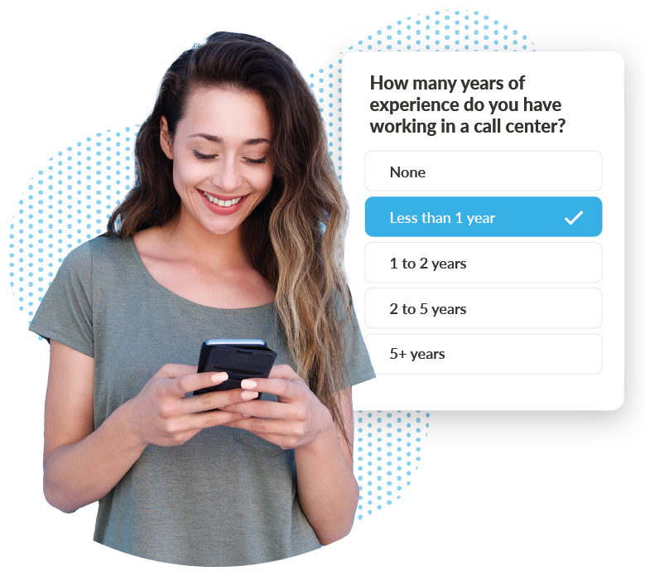
PRODUCT
Automated Screening

Slide 34

PRODUCT
Digital Interviews

Slide 35
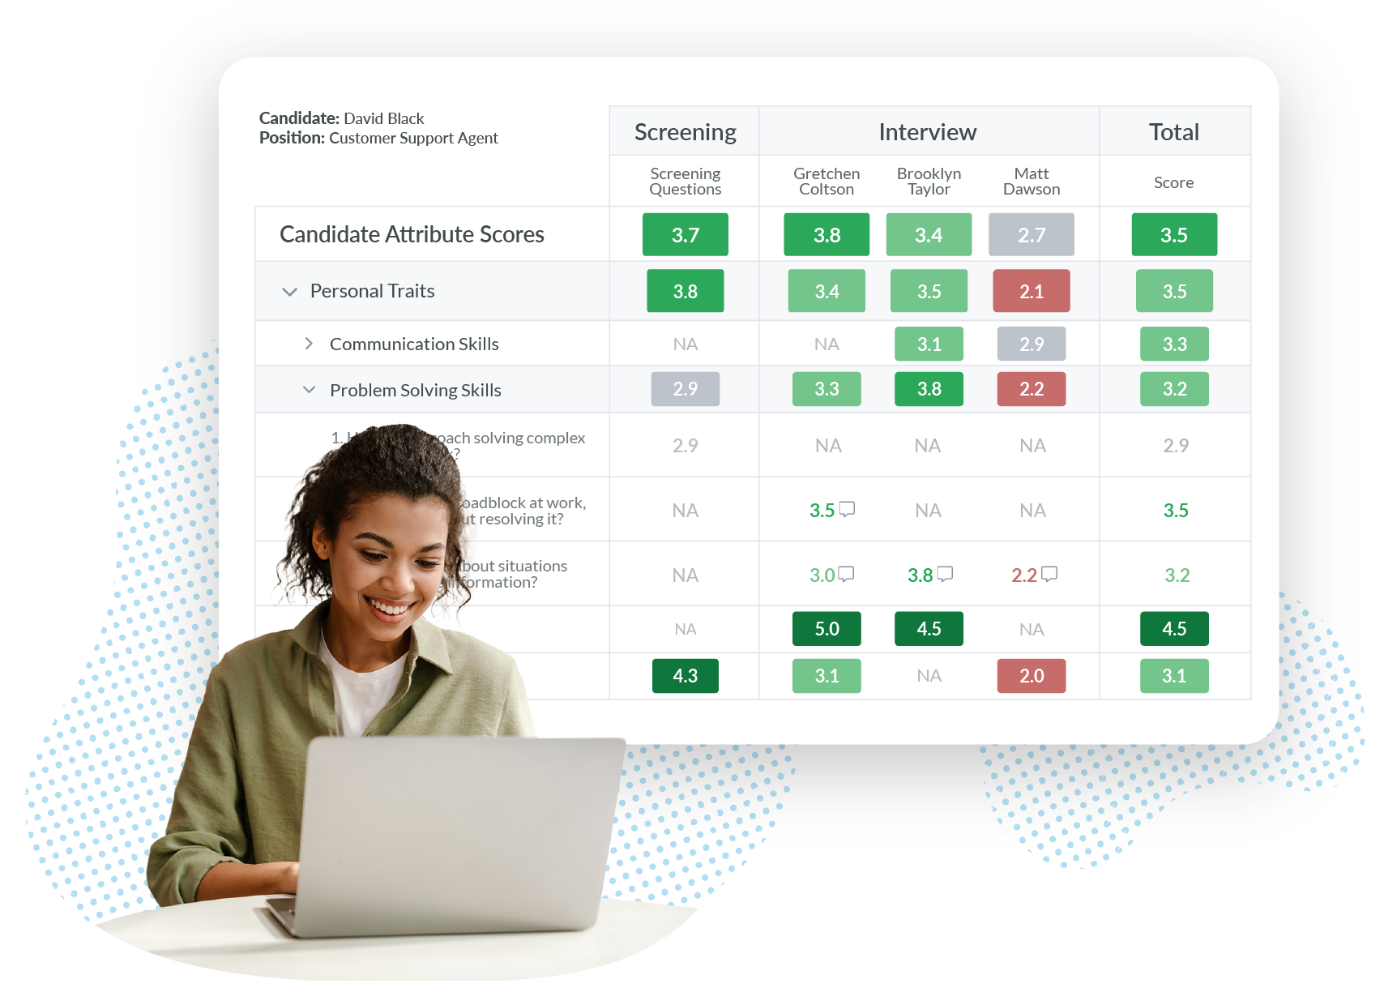
PRODUCT
Hiring Scorecards

Slide 36
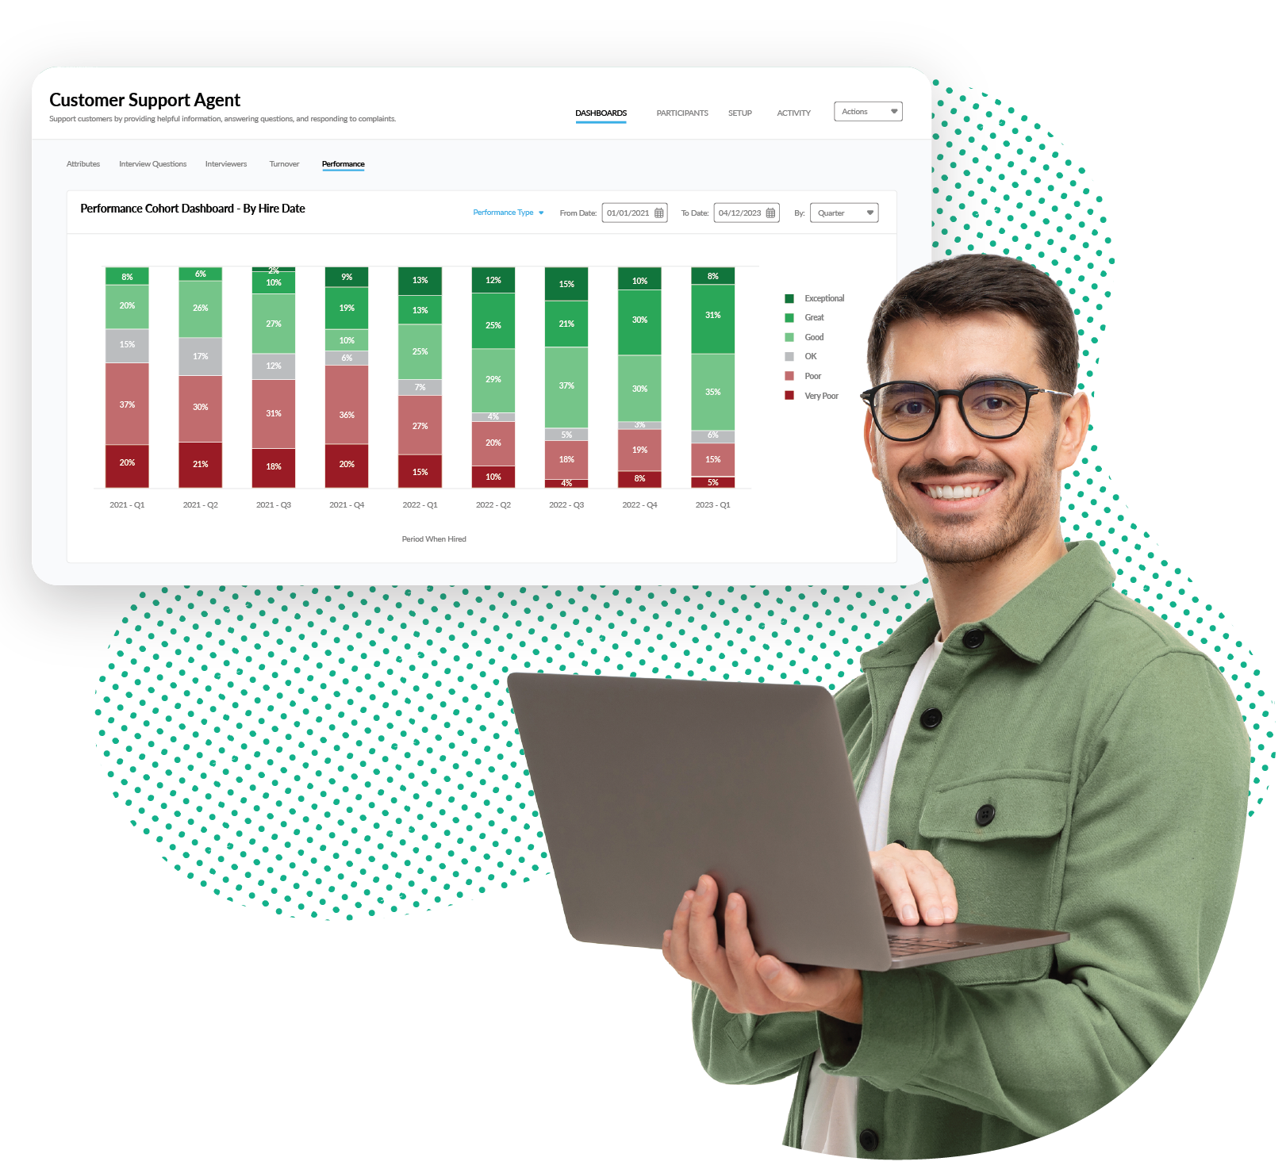
PRODUCT
Tracking & Optimization

Slide 37

SOLUTIONS
Turnover Reduction

Slide 38

SOLUTIONS
Process Improvement

Slide 39

SOLUTIONS
Performance Improvement

Slide 40

It All Starts With Hiring Accuracy
PERFORMANCE
A great hire will create 3-5+ times more value than bad hire for your company – despite have the same job, boss, onboarding, training, etc.
Great performance starts with hiring right.
RETENTION
It’s estimated 80% of turnover is due to bad hiring decisions (HBR).
Short term turnover (turnover within the first year) is especially attributable to hiring mistakes. Great hires stay longer.
CULTURE FIT
Companies that take a hands-off approach to culture end up with something that’s at best, painfully average and at worst, destructive.
To have a great culture, a company must define who they are and want to be – and then hire people that align with those realities/goals.
DIVERSITY
The influence of bias in hiring prevents a more diverse workforce.
Research shows that the most effective way to reduce hiring bias is to take it out of the process vs. trying to take it out of the people doing the hiring.

Slide 41
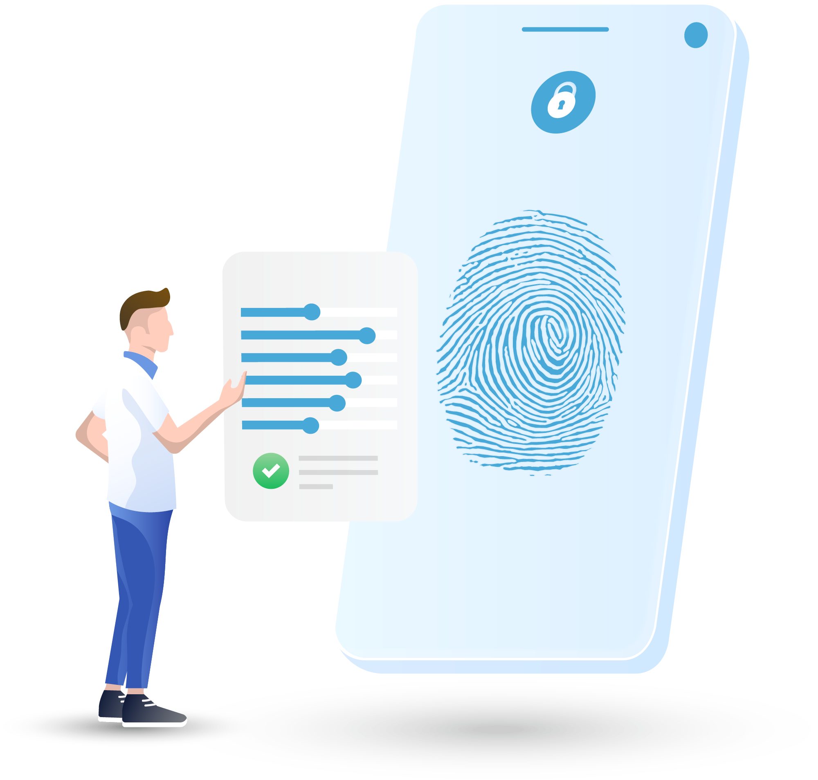

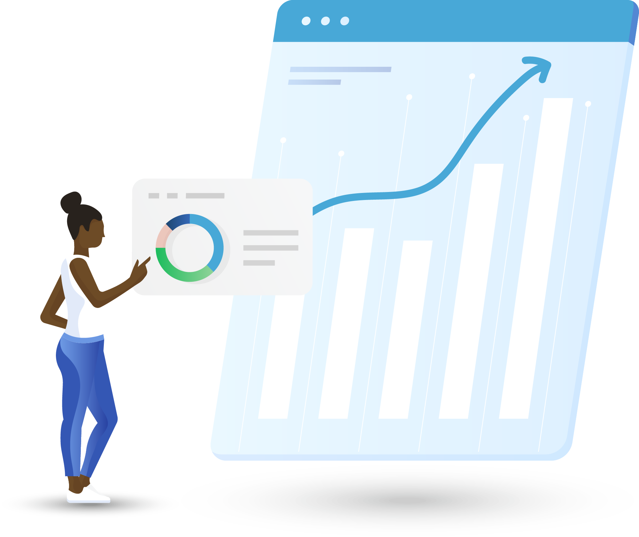
What Makes Journeyfront so Accurate?
Custom To You
Custom always fits better. Every company and job is different, so we use your employee data to identify what success looks like in each one of those roles. No matter what you want to measure, or how you want to measure it, we can help you do it.
Centralize All Your Data
More data means more accuracy. We help you collect and optimize all your data, from initial application to the final interview to ensure you have all the data available to make the most accurate hiring decisions.
Continuous Improvement
If you can't measure it, you can't improve it. Our closed-loop feedback process connects your pre-hire data with your post-hire outcomes, which allows you to know exactly what’s working in your hiring process as you continuously improve.

Slide 42
Journeyfront is the entire Hiring Accuracy toolkit
Pre-
Assessment
Job
Simulation
Phone
Screen
Interviews
Work
Samples
Reference
Calls
Discussion & Selection
Discussion & Selection
Candidate
Application
Tracking & Optimizing
Assessment+
Interview+
Included in Both
Completed by candidate & auto-scored.
Mobile friendly & customizable (length & content).
Candidate Application
Deploys custom screening questions related to job fit for the role–work/academic background, job eligibility, salary expectations, etc.
Pre-Assessment
Measures interests, values, personality traits, & competencies most predictive of performance, retention, & job satisfaction in your roles.
Capable of measuring custom attributes.
Job Simulations
Measures candidate response to job-related video or image simulations.
Phone Screen > Interviews > Work Samples > References
Scoring guides for employees (digital or print out).
Access as a link or from Journeyfront / your ATS.
Mobile friendly.
100% customizable .
Scoring guides with interview instructions, attributes of focus (with definitions), scoring rubrics, interview questions / work samples, etc.
Capture and aggregate interviewer feedback across interview participants or interview steps (both qualitative and quantitative).
Input your own screening process and/or let Journeyfront recommend additional effective ways to screen for the traits that matter most.
Discussion & Selection
Aggregate all candidate insights in one place.
View scores by step, attribute or interviewer (including notes), etc.
Auto-rank candidates & compare side by side.
Custom weighting for steps/attributes as needed.
Tracking & Optimization
Track hiring accuracy (performance, turnover, and job satisfaction by hiring cohort).
Use machine learning/AI to identify patterns between candidate data collected and post-hire performance, turnover & job satisfaction data.
Use data to continually optimize your hiring formula.

Slide 43
Journeyfront is the Entire Hiring Accuracy toolkit
Candidate Application
Assessments
Job Previews
Phone
Screens
Interviews
Work
Samples
Discussion & Selection
Skills Tests
Phone Screens
Interviews
Discussion & Selection
Tracking & Optimization
Candidate Application:
Auto-sort applicants using custom screening questions.
Predictive Behavioral Assessments:
Predict candidate performance & retention using insights collected from employee data.
Job Previews & Simulations:
Demonstrate the job for candidates, allowing them to self-select in or out based on fit.
Skills Tests
Measure job knowledge & other key job skills using customized skills tests.
Phone Screen > Interviews:
Optimize and capture interview feedback with digital hiring guides and scoring rubrics.
Discussion & Selection:
Optimize the hiring decision by aggregating all candidate insights into customizable scorecards – view scores by attributes measured, screening steps, interviewers, etc.
Tracking & Optimization:
Track quality of hire by hiring cohort (performance & turnover). Use machine learning/AI to identify ways to optimize your hiring formula over time.

Slide 44
Journeyfront is the Entire Hiring Accuracy toolkit
Candidate
Application
Predictive Assessments
Job
Previews
Phone
Screens
Discussion & Selection
Job
Simulations
Skills
Tests*
Interview Tools
Discussion & Selection
Tracking & Optimization
Candidate Application:
Auto-sort and score applicants using custom screening questions.
Predictive Behavioral Assessments:
Predict candidate performance & retention using insights collected from employee data.
Job Previews
Let candidate preview the job; embed video into the application process about job duties, highs, lows, company culture/mission, etc.
Job Simulations & Skills Tests
Measure job knowledge & other key job skills using customized skills tests.
Includes language assessment(s)
Interview Tools (Phone Screens, Interviews, Reference Calls, Work Samples)
Optimize and capture feedback from recruiters/hiring managers with digital customizable scoring guides and rubrics.
Discussion & Selection:
Optimize the hiring decision by aggregating all candidate insights into customizable scorecards – view scores by attributes measured, screening steps, interviewers, etc.
Tracking & Optimization:
Track quality of hire by hiring cohort (performance & turnover). Use machine learning/AI to identify ways to optimize your hiring formula over time.

Slide 45
Journeyfront is the Entire Hiring Accuracy Toolkit
Candidate Application
Assessments & Skills Tests
Job Previews & Simulations
Phone
Screens
Interviews
Work
Samples
Reference
Calls
Discussion & Selection
Tracking & Optimization
Candidate Application:
Auto-sort applicants using custom screening questions.
Predictive Assessments:
Predict candidate job fit by measuring the attributes that matter in your roles, including custom measures.
Job Simulations / Skills Test:
Assess candidate skills using custom video simulations, coding tests, writing tests, etc.
Phone Screen > Interviews:
Integrate and enhance your screening/interview process with digital hiring guides, all accessible from your ATS.
Work Samples > Reference Calls:
Insert customized work samples and reference calls into your hiring process with custom scoring guides and rubrics.
Discussion & Selection:
Visualize the decision-making process with customized candidate scorecards – view candidate scores by attributes measured, screening steps, interviewers, etc.
Tracking & Optimization:
Track quality of hire by hiring cohort and use machine learning/AI to identify ways to optimize your hiring formula over time.

Slide 46
More Accurate Hiring Decisions
How is Journeyfront different from Talent+?
Notes:
Why is it important to use your own data – every co is different
More data is better
Gets better over time- we use more data

Slide 47
Why is Journeyfront more accurate than Typical Assessment Tools?
1
Your Company’s Data vs. Outside Data
Every company and position is different. Journeyfront captures what drives results at your company by using data tied to your company and positions, vs. typical assessment tools that rely primarily on outside datasets.
2
More Data to Make Better Decisions
Typical assessment tools do not consider other insights collected on candidates during the hiring process. Journeyfront helps collect and aggregate insights across the entirety of your process so you can make the most accurate decision possible.
3
Track and Improve Your Results Over Time
Tracking your results to figure out what’s working is the only way to get better. Journeyfront automatically connects your pre-hire data to post-hire outcomes like performance and turnover for increasing accuracy over time. This allows your customized assessment to increase in accuracy as you use it.
Notes:
Why is it important to use your own data – every co is different
More data is better
Gets better over time- we use more data

Slide 48
1. Your Company’s Data vs. Outside Data
What Talent+ Uses
What Journeyfront Uses
Outside Data
Your
Data
Your
Data
Outside
Data
Candidates screened based on insights derived primarily from outside dataset
Candidates screened based on insights derived primarily from your employee data
Why is it more accurate to use your data vs. outside data?
Because every company and position is different. The most accurate way to confidently hire people who will ‘perform and stay’ at your company is to screen candidates based on traits that you’ve identified lead to performance and turnover at your company — not data taken from an outside sample of the general population.
Your data is more accurate than outside data
Notes:
Why is it important to use your own data – every co is different
More data is better
Gets better over time- we use more data

Slide 49
1. Your Company’s Data vs. Outside Data
When Talent+ Does Tailor, It Typically Benchmarks Off of Only Your Top Performers; Having No Visibility to How Bottom Performers Scored Can Create False Positives
Journeyfront Measures Employees Across The Performance Spectrum and Uses Analytics to Identify What Differentiates Your Best From the Rest
Trend Line
5
5
?
Score
Score
1
1
Bottom Performers
Middle Performers
Top Performers
Bottom Performers
Middle Performers
Top Performers
Notes:
Why is it important to use your own data – every co is different
More data is better
Gets better over time- we use more data

Slide 50
2. More Data to Make Better Decisions
Where Talent+ Helps
Candidate Application
Assessment
Phone Screen
Interviews
Discussion & Selection
Where Journeyfront Helps
Candidate Application
Assessment
Phone Screen
Interviews
Discussion & Selection
Assessment data alone isn’t enough.
The insights generated from pre-employment assessments are limited in their ability to inform great hiring decisions. Think of all the other valuable information gathered on a candidate from resume reviews, phone screens, onsite interviews, work samples, etc. Journeyfront helps collect and aggregate information collected on a candidate across the entirety of the hiring process so you can make the most accurate decision possible.
More Data = More Accurate
Notes:
Why is it important to use your own data – every co is different
More data is better
Gets better over time- we use more data

Slide 51

3. Track and Improve Your Results Over Time
How Talent+ Tracks Accuracy to Improve
How Journeyfront Tracks Accuracy to Improve
It Doesn’t
Hiring Data
Hiring Outcomes
You can’t improve what you don’t measure.
Tracking your results to figure out what’s working and not working is the only way to get better. Like most typical assessments, Talent+ doesn’t track its recommendations against your post-hire results so you end up with general recommendations that stay the same.
Journeyfront connects the data collected in the hiring process (assessments, phone screens, interviews, reference calls, etc.) to the post hire outcomes of those you hired (job performance, culture fit, turnover) to help you continuously get smarter about who and how you hire.
What gets measured gets improved
Notes:
Why is it important to use your own data – every co is different
More data is better
Gets better over time- we use more data

Slide 52
JOURNEYFRONT OFFERINGS

Slide 53
STANDARD OFFERING
OPTIONAL ADD-ONS
SOFTWARE TOOLS
SOFTWARE TOOLS
SCREENING QUESTIONS
Efficiently screen and filter applicants based on job requirements using candidate screening questions.
VIDEO INTERVIEW
Record candidate audio or video responses to key questions during the application and score later at your convenience.
EMBEDDED COMPANY/JOB PREVIEWS
Embed video into the application process that shows candidates a preview of what they can expect from the job and self-select in or out based on perceived job fit.
DIGITAL INTERVIEW GUIDES
Build and use structured, digital interview guides to maximize interviewer effectiveness. Guide interviewers with topics to cover, example questions, scoring rubrics, and a place to leave notes and scores.
DIGITAL SCORECARDS
Aggregate all candidate insights into easy-to-use, customizable scorecards to increase the speed and accuracy of your hiring decisions.
ADVANCED CANDIDATE SORTING/FILTERING
Auto-filter and sort all applicants based on insights collected across the steps of the hiring process
HIRING FUNNEL REPORTING & ANALYTICS
All your hiring funnel data displayed across numerous dashboards to gather insights about your hiring funnel.
PERFORMANCE/TURNOVER TRACKING, REPORTING & ANALYTICS
Collect or import employee performance and turnover data and track patterns over time, including predictive insights.
HIRING OPTIMIZATION REPORTING & ANALYTICS
All your hiring data analyzed and reported against key post-hire outcomes (performance/turnover) to facilitate continuous data-driven improvements.
PREDICTIVE BEHAVIORAL ASSESSMENTS
Behavioral assessments designed to predict candidate job performance and retention based on insights continually found in employee/candidate data.
JOB SIMULATIONS
Measure candidate ability using job-relevant off the shelf or custom skills tests.
SKILLS TESTS
Measure candidate ability using job-relevant off the shelf or custom skills tests.
LANGUAGE PROFICIENCY TESTS
Evaluate speaking and writing proficiency skills in 10+ languages via automated language assessments; basic language assessments also available in other languages.
CAREER PATHWAYS TOOL
Match employees or candidates to job and career pathways within your company, improving job matching and internal mobility / retention.
ATS INTEGRATION
Integrate Journeyfront with your ATS for a seamless candidate and hiring team experience.
HRIS INTEGRATION
Integrate Journeyfront with your HRIS for candidate employee performance and turnover data collection.
SINGLE SIGN ON
Collect or import employee performance and turnover Integrate Journeyfront with your SSO provider to increase security and simplify system and user management.
PROFESSIONAL SERVICES
PROFESSIONAL SERVICES
DEDICATED CUSTOMER SUCCESS MANAGER
A dedicated Customer Success Manager to work with you from implementation on to ensure you're getting the most from the Journeyfront partnership.
ONGOING SUPPORT
Structured guidance and assistance in setting up your account and getting started with Journeyfront.
ONBOARDING
Dedicated account manager will provide structured guidance and assistance in setting up your account and getting started with Journeyfront.
LIVE TRAINING
Live trainings for your team on how to use and get the most value from the product, including client best practices.
SCREENING PLAN / INTERVIEW MIGRATION
A dedicated team to migrate your pre-existing screening plans (found in other systems, google docs, etc.) into your Journeyfront account for you.
CANDIDATE EVALUATION PLAN CREATION SERVICE
A team of Journeyfront experts to build screening plans on your behalf, based on your needs as well as hiring best practices and extensive client experience.
JOB PREVIEW VIDEO CREATION
A film crew to create video-based job previews on your behalf that help candidates know what to expect in the job. Includes scoping, filming and editing.
DATA IMPORTS & MANAGEMENT
Journeyfront data experts to manage data imports on your behalf to maintain key dashboards within your account from external systems if needed.
INSTRUMENT MONITORING & IMPROVEMENTS
A team of experts to monitor the effectiveness of your measurement tool(s) and improve measures as needed to drive key outcomes.
CUSTOM DASHBOARD CREATION SERVICES
A team of business intelligence experts and data engineers to build and add custom dashboards to your Journeyfront account to fit your unique needs.
CUSTOM ANALYSIS
A team of data experts to analyze your data and build reports and/or presentation(s) of findings, helping you tackle your unique hiring challenges or opportunities.
EXPERT GUIDANCE & CONSULTING
Extra help addressing your most significant hiring challenges or opportunities from our team of hiring and data experts. Includes custom analytics if/when needed.
Journeyfront, Inc. © 2023
Notes:
TURNOVER > SOFTWARE: Behavioral Assessment Pro, Realistic Job Preview Pro, Job Simulation Pro, Interview Pro, Screening Questions Pro, Integration Pro
PERFORMANCE > SOFTWARE: Skills Test Pro, Job Simulation Pro, Behavioral Assessment Pro, Interview Pro, Screening Questions Pro, Integration Pro
STRUCTURE/AUTOMATION > SOFTWARE: Interview Pro, Screening Questions Pro, Behavioral Assessments Pro, Integration Pro
STANDARD: PROFESSIONAL SERVICES: Set-up Pro, Job Analysis Pro, Data Management Pro, Customer Analytics Pro, Integration Pro, Real Time Monitoring
Available Add-ons:SOFTWARE > Language Test Pro, Realistic Job Preview Pro (Amanda - I know this is duplicative with what’s above. it’s fine, just add it and I’ll change later)
SERVICES> Customer Measurement Creation - A La Carte
AMANDA - IN STANDARD SOFTWARE - PLEASE ADD ‘Advanced Scorecards’, ‘Predictive Analytics’.

Slide 54
STANDARD OFFERING
Software Tools & Professional Services

Slide 55
STANDARD OFFERING
1
SOFTWARE TOOLS
SCREENING QUESTIONS
Efficiently screen and filter applicants based on job requirements using candidate screening questions.
VIDEO INTERVIEW
Record candidate audio or video responses to key questions during the application and score later at your convenience.
EMBEDDED COMPANY/JOB PREVIEWS
Embed video into the application process that shows candidates a preview of what they can expect from the job and self-select in or out based on perceived job fit.
DIGITAL INTERVIEW GUIDES
Build and use structured, digital interview guides to maximize interviewer effectiveness. Guide interviewers with topics to cover, example questions, scoring rubrics, and a place to leave notes and scores.
DIGITAL SCORECARDS
Aggregate all candidate insights into easy-to-use, customizable scorecards to increase the speed and accuracy of your hiring decisions.
ADVANCED CANDIDATE SORTING/FILTERING
Auto-filter and sort all applicants based on insights collected across the steps of the hiring process
HIRING FUNNEL REPORTING & ANALYTICS
All your hiring funnel data displayed across numerous dashboards to gather insights about your hiring funnel.
PERFORMANCE/TURNOVER TRACKING, REPORTING & ANALYTICS
Collect or import employee performance and turnover data and track patterns over time, including predictive insights.
HIRING OPTIMIZATION REPORTING & ANALYTICS
All your hiring data analyzed and reported against key post-hire outcomes (performance/turnover) to facilitate continuous data-driven improvements.
Notes:
TURNOVER > SOFTWARE: Behavioral Assessment Pro, Realistic Job Preview Pro, Job Simulation Pro, Interview Pro, Screening Questions Pro, Integration Pro
PERFORMANCE > SOFTWARE: Skills Test Pro, Job Simulation Pro, Behavioral Assessment Pro, Interview Pro, Screening Questions Pro, Integration Pro
STRUCTURE/AUTOMATION > SOFTWARE: Interview Pro, Screening Questions Pro, Behavioral Assessments Pro, Integration Pro
STANDARD: PROFESSIONAL SERVICES: Set-up Pro, Job Analysis Pro, Data Management Pro, Customer Analytics Pro, Integration Pro, Real Time Monitoring
Available Add-ons:SOFTWARE > Language Test Pro, Realistic Job Preview Pro (Amanda - I know this is duplicative with what’s above. it’s fine, just add it and I’ll change later)
SERVICES> Customer Measurement Creation - A La Carte
AMANDA - IN STANDARD SOFTWARE - PLEASE ADD ‘Advanced Scorecards’, ‘Predictive Analytics’.

Slide 56
STANDARD OFFERING
2
PROFESSIONAL SERVICES
DEDICATED CUSTOMER SUCCESS MANAGER
A dedicated Customer Success Manager to work with you from implementation on to ensure you're getting the most from the Journeyfront partnership.
ONBOARDING
Dedicated account manager will provide structured guidance and assistance in setting up your account and getting started with Journeyfront.
LIVE TRAINING
Live trainings for your team on how to use and get the most value from the product, including client best practices.
ONGOING SUPPORT
Structured guidance and assistance in setting up your account and getting started with Journeyfront.
Notes:
TURNOVER > SOFTWARE: Behavioral Assessment Pro, Realistic Job Preview Pro, Job Simulation Pro, Interview Pro, Screening Questions Pro, Integration Pro
PERFORMANCE > SOFTWARE: Skills Test Pro, Job Simulation Pro, Behavioral Assessment Pro, Interview Pro, Screening Questions Pro, Integration Pro
STRUCTURE/AUTOMATION > SOFTWARE: Interview Pro, Screening Questions Pro, Behavioral Assessments Pro, Integration Pro
STANDARD: PROFESSIONAL SERVICES: Set-up Pro, Job Analysis Pro, Data Management Pro, Customer Analytics Pro, Integration Pro, Real Time Monitoring
Available Add-ons:SOFTWARE > Language Test Pro, Realistic Job Preview Pro (Amanda - I know this is duplicative with what’s above. it’s fine, just add it and I’ll change later)
SERVICES> Customer Measurement Creation - A La Carte
AMANDA - IN STANDARD SOFTWARE - PLEASE ADD ‘Advanced Scorecards’, ‘Predictive Analytics’.

Slide 57
OPTIONAL ADD-ONS

Slide 58
OPTIONAL ADD-ONS
1
SOFTWARE TOOLS
PREDICTIVE BEHAVIORAL ASSESSMENTS
Behavioral assessments designed to predict candidate job performance and retention based on insights continually found in employee/candidate data.
JOB SIMULATIONS
Measure candidate ability using job-relevant off the shelf or custom skills tests.
SKILLS TESTS
Measure candidate ability using job-relevant off the shelf or custom skills tests.
LANGUAGE PROFICIENCY TESTS
Evaluate speaking and writing proficiency skills in 10+ languages via automated language assessments; basic language assessments also available in other languages.
CAREER PATHWAYS TOOL
Match employees or candidates to job and career pathways within your company, improving job matching and internal mobility / retention.
ATS INTEGRATION
Integrate Journeyfront with your ATS for a seamless candidate and hiring team experience.
HRIS INTEGRATION
Integrate Journeyfront with your HRIS for candidate employee performance and turnover data collection.
SINGLE SIGN ON
Collect or import employee performance and turnover Integrate Journeyfront with your SSO provider to increase security and simplify system and user management.
Notes:
TURNOVER > SOFTWARE: Behavioral Assessment Pro, Realistic Job Preview Pro, Job Simulation Pro, Interview Pro, Screening Questions Pro, Integration Pro
PERFORMANCE > SOFTWARE: Skills Test Pro, Job Simulation Pro, Behavioral Assessment Pro, Interview Pro, Screening Questions Pro, Integration Pro
STRUCTURE/AUTOMATION > SOFTWARE: Interview Pro, Screening Questions Pro, Behavioral Assessments Pro, Integration Pro
STANDARD: PROFESSIONAL SERVICES: Set-up Pro, Job Analysis Pro, Data Management Pro, Customer Analytics Pro, Integration Pro, Real Time Monitoring
Available Add-ons:SOFTWARE > Language Test Pro, Realistic Job Preview Pro (Amanda - I know this is duplicative with what’s above. it’s fine, just add it and I’ll change later)
SERVICES> Customer Measurement Creation - A La Carte
AMANDA - IN STANDARD SOFTWARE - PLEASE ADD ‘Advanced Scorecards’, ‘Predictive Analytics’.

Slide 59
OPTIONAL ADD-ONS
2
PROFESSIONAL SERVICES
SCREENING PLAN / INTERVIEW MIGRATION
A dedicated team to migrate your pre-existing screening plans (found in other systems, google docs, etc.) into your Journeyfront account for you.
CANDIDATE EVALUATION PLAN CREATION SERVICE
A team of Journeyfront experts to build screening plans on your behalf, based on your needs as well as hiring best practices and extensive client experience.
JOB PREVIEW VIDEO CREATION
A film crew to create video-based job previews on your behalf that help candidates know what to expect in the job. Includes scoping, filming and editing.
DATA IMPORTS & MANAGEMENT
Journeyfront data experts to manage data imports on your behalf to maintain key dashboards within your account from external systems if needed.
INSTRUMENT MONITORING & IMPROVEMENTS
A team of experts to monitor the effectiveness of your measurement tool(s) and improve measures as needed to drive key outcomes.
CUSTOM DASHBOARD CREATION SERVICES
A team of business intelligence experts and data engineers to build and add custom dashboards to your Journeyfront account to fit your unique needs.
CUSTOM ANALYSIS
A team of data experts to analyze your data and build reports and/or presentation(s) of findings, helping you tackle your unique hiring challenges or opportunities.
EXPERT GUIDANCE & CONSULTING
Extra help addressing your most significant hiring challenges or opportunities from our team of hiring and data experts. Includes custom analytics if/when needed.
Notes:
TURNOVER > SOFTWARE: Behavioral Assessment Pro, Realistic Job Preview Pro, Job Simulation Pro, Interview Pro, Screening Questions Pro, Integration Pro
PERFORMANCE > SOFTWARE: Skills Test Pro, Job Simulation Pro, Behavioral Assessment Pro, Interview Pro, Screening Questions Pro, Integration Pro
STRUCTURE/AUTOMATION > SOFTWARE: Interview Pro, Screening Questions Pro, Behavioral Assessments Pro, Integration Pro
STANDARD: PROFESSIONAL SERVICES: Set-up Pro, Job Analysis Pro, Data Management Pro, Customer Analytics Pro, Integration Pro, Real Time Monitoring
Available Add-ons:SOFTWARE > Language Test Pro, Realistic Job Preview Pro (Amanda - I know this is duplicative with what’s above. it’s fine, just add it and I’ll change later)
SERVICES> Customer Measurement Creation - A La Carte
AMANDA - IN STANDARD SOFTWARE - PLEASE ADD ‘Advanced Scorecards’, ‘Predictive Analytics’.

Slide 60
Product Overview

Slide 61

The Journeyfront Solution
Everything we do is built to help you make the most accurate hiring decisions every time you hire.
Assessment
Accuracy for Applicant Screening
Interview
Accuracy for Interviews

Slide 62


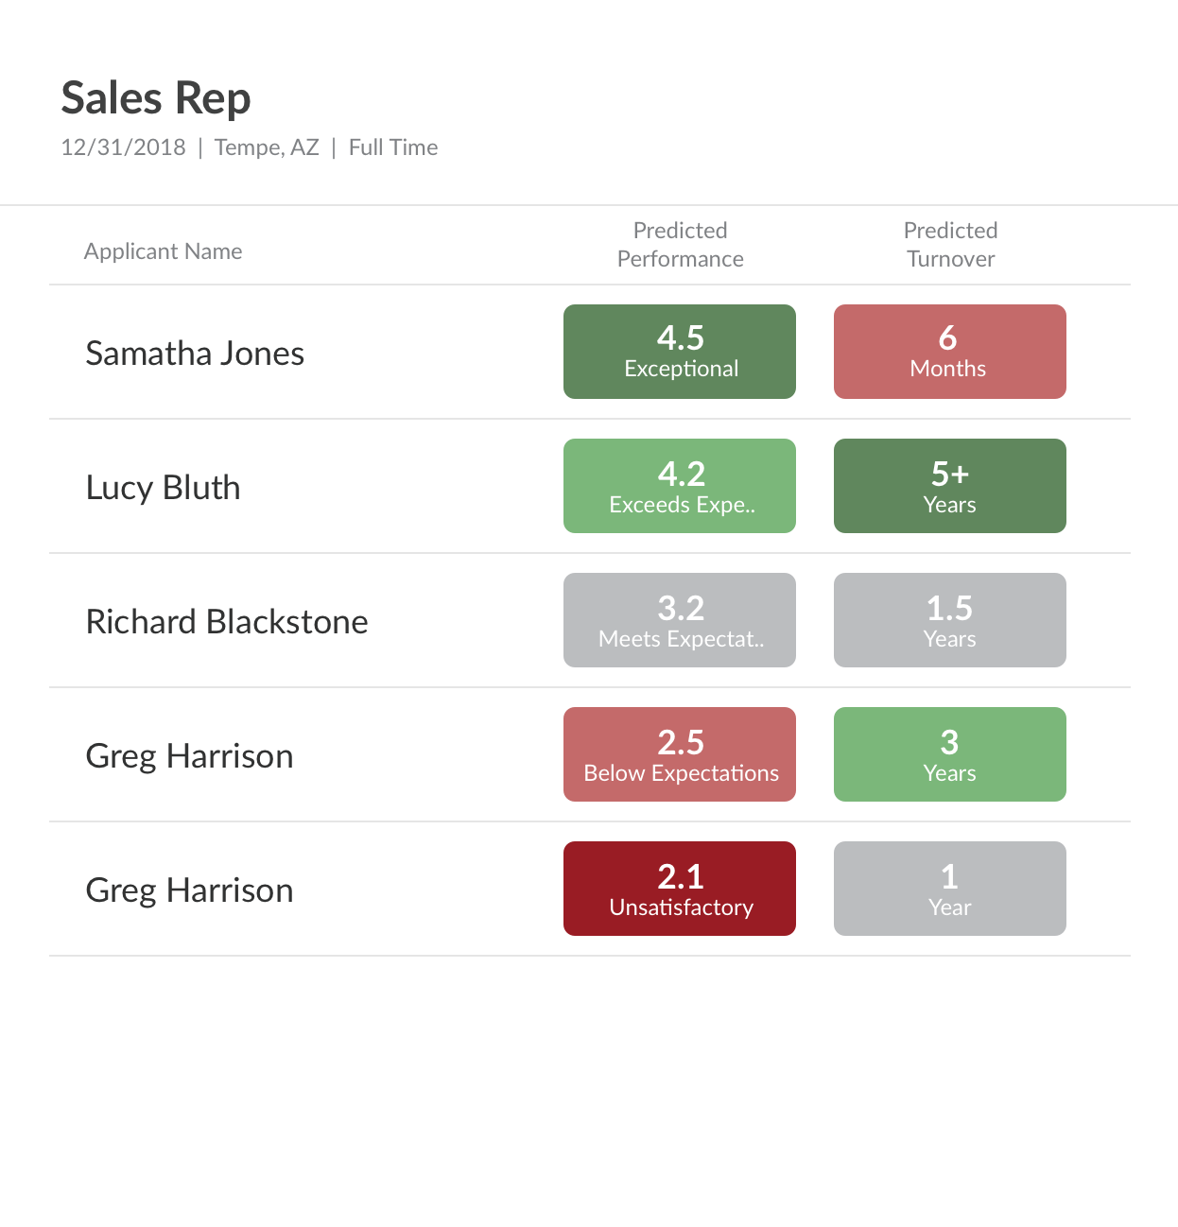
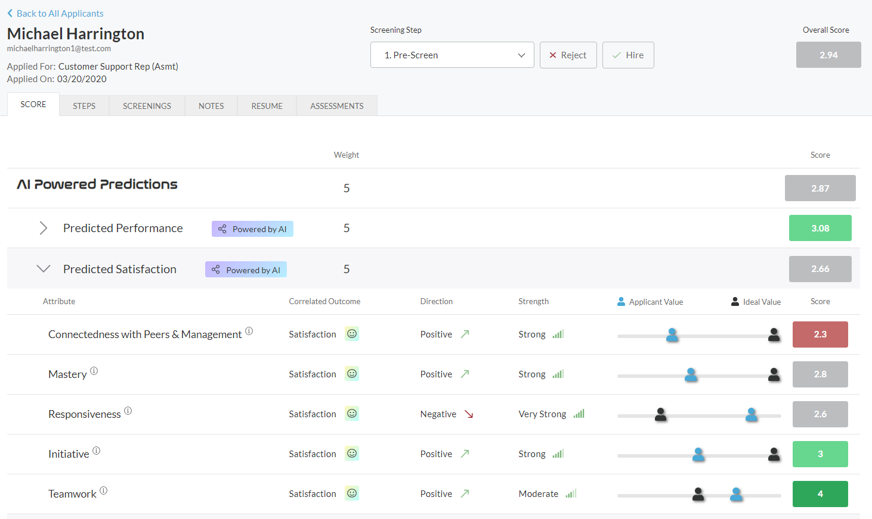
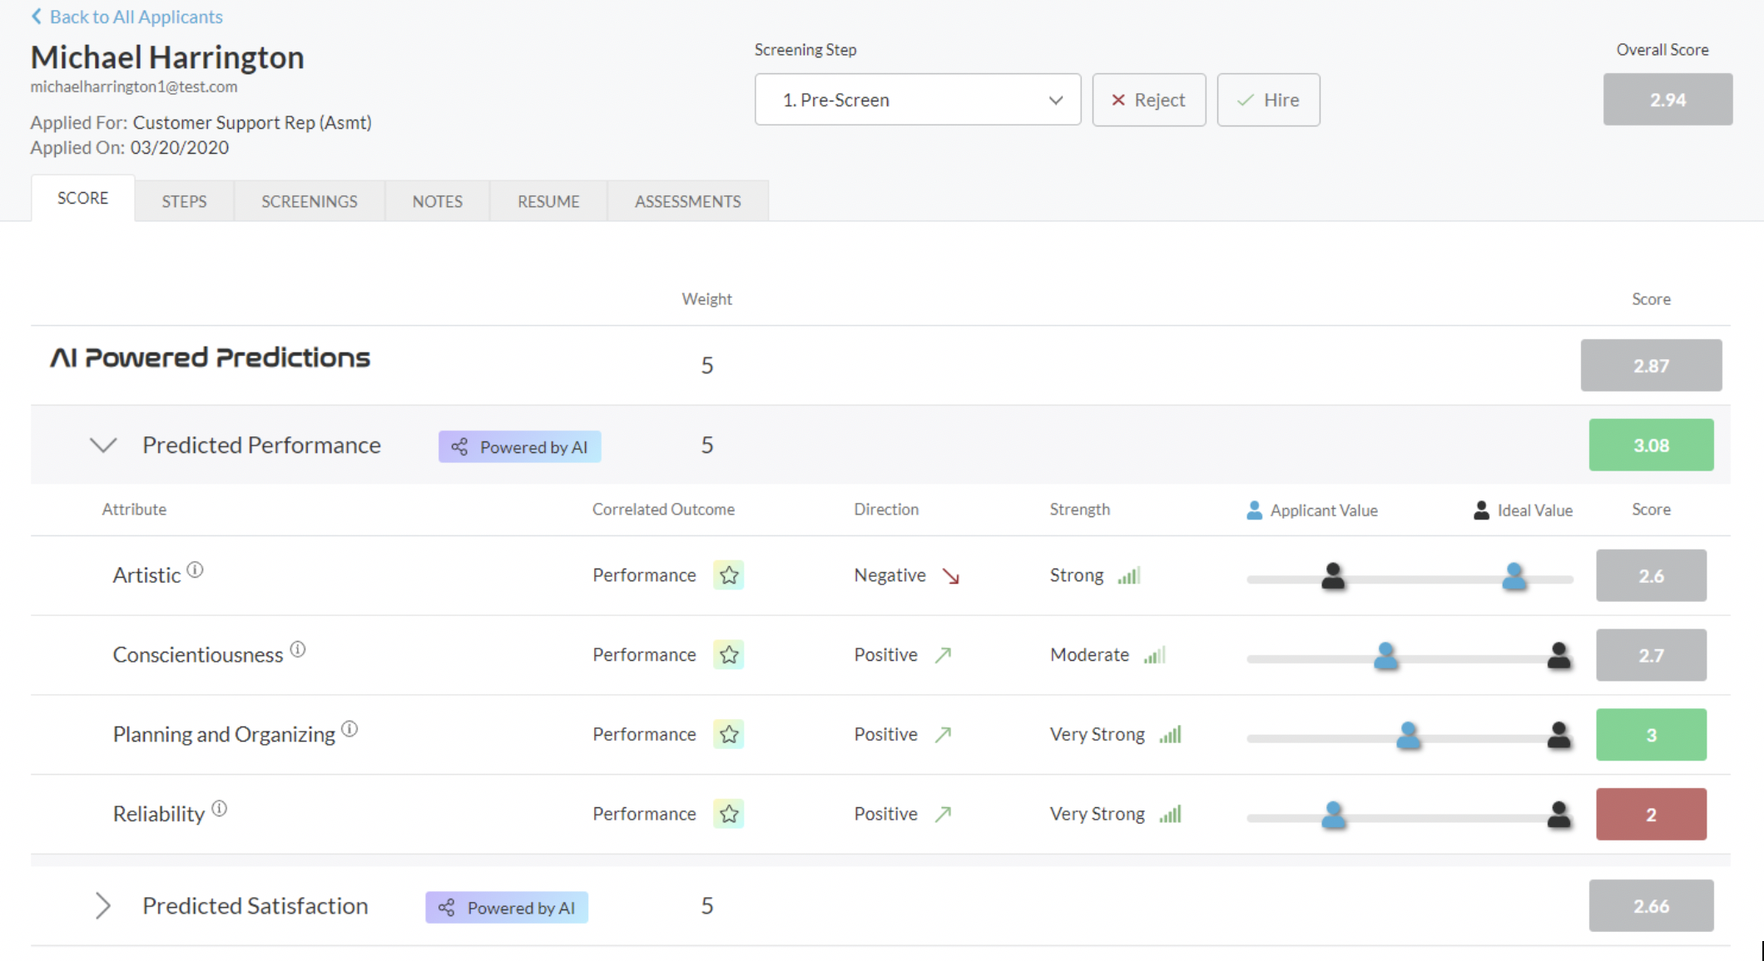
The World's Most Accurate Assessment Solution
Screen applicants at the top of your hiring funnel by identifying the unique traits that lead to high performance, retention and culture fit at your company.

Slide 63
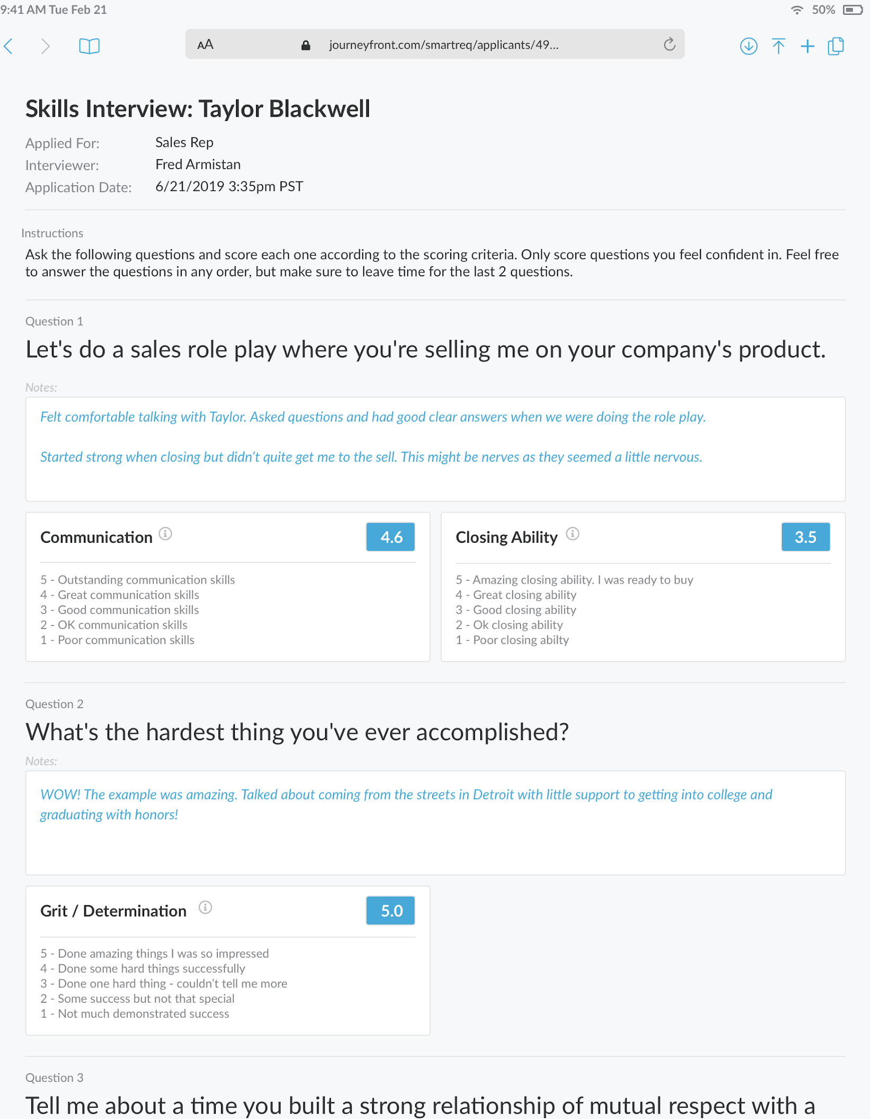
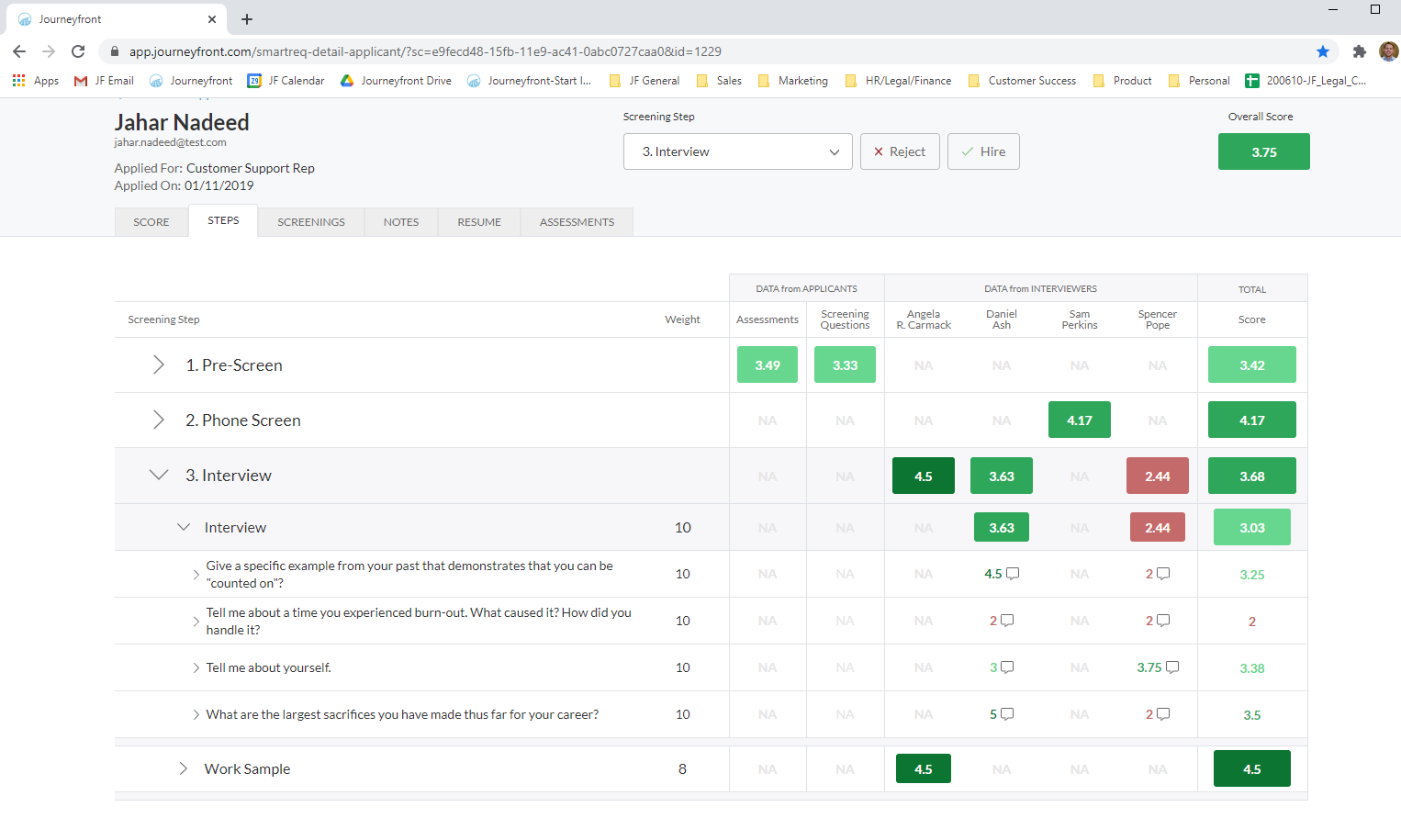
The World's Most Accurate Interview Solution
Get ultimate accuracy where it counts the most—the interview stage. Consolidate and visualize all the hiring information collected in order to ensure the most accurate hiring decision possible.

Slide 64
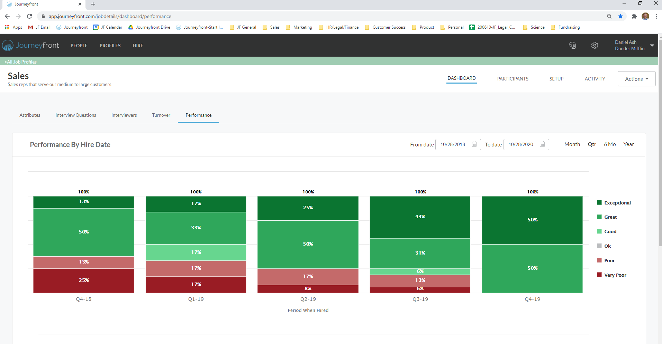
Track Hiring Accuracy by Hiring Cohorts
Journeyfront helps track hiring accuracy by hiring cohort to monitor progress and facilitate continual improvement.
Identify what employee attributes, interview questions, etc. correlate most strongly with retention – use those insights
You can’t improve what you can’t measure. Journeyfront helps companies track hiring accuracy (performance, turnover, etc.) by hiring cohort.
This allows your company to identify whether different interventions (changes to the hiring process, onboarding, compensation, etc.) are having an impact on overall performance and retention rates.
It also allows for sophisticated A/B testing across groups – evaluating the efficacy of different hiring methods, post-hire initiatives, etc.
Performance and turnover bucketing based on your own data
Track performance and turnover of new hires by hiring cohort

Slide 65
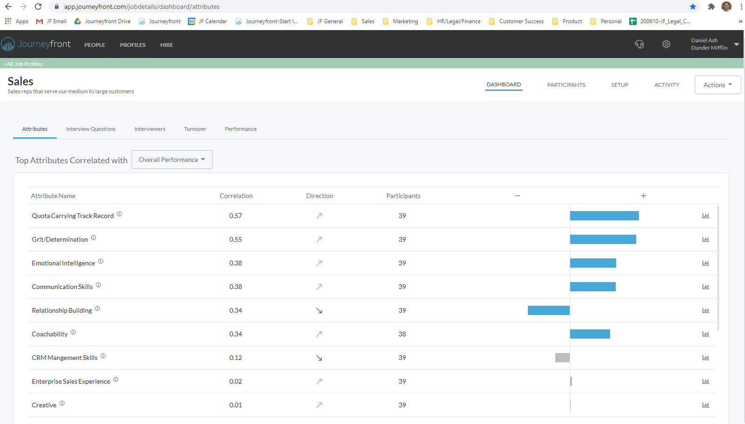
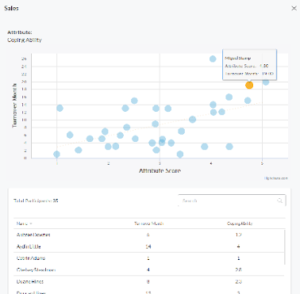

Optimize Your Unique Hiring Formula
Identify insights from your own employee data for how to improve post-hire outcomes – retention performance, etc.
Identify common drivers for those employees that stay longest, are most satisfied, meet performance expectations, etc.
Identify what employee attributes, interview questions, etc. correlate most strongly with retention – use those insights
Identify which attributes matter most, which hiring methods or interviewers are most effective, etc.

Slide 66
Continuously Improve Your Hiring Accuracy
The more you use Journeyfront, the more accurate your hiring process becomes.
That’s because the software automatically analyzes your hiring data against post-hire outcomes, which leads to continuous improvement over time.
Hiring Data
Assessments | Interviews | Etc.
Hiring Outcomes
Performance | Turnover | Diversity | Etc.

Slide 67
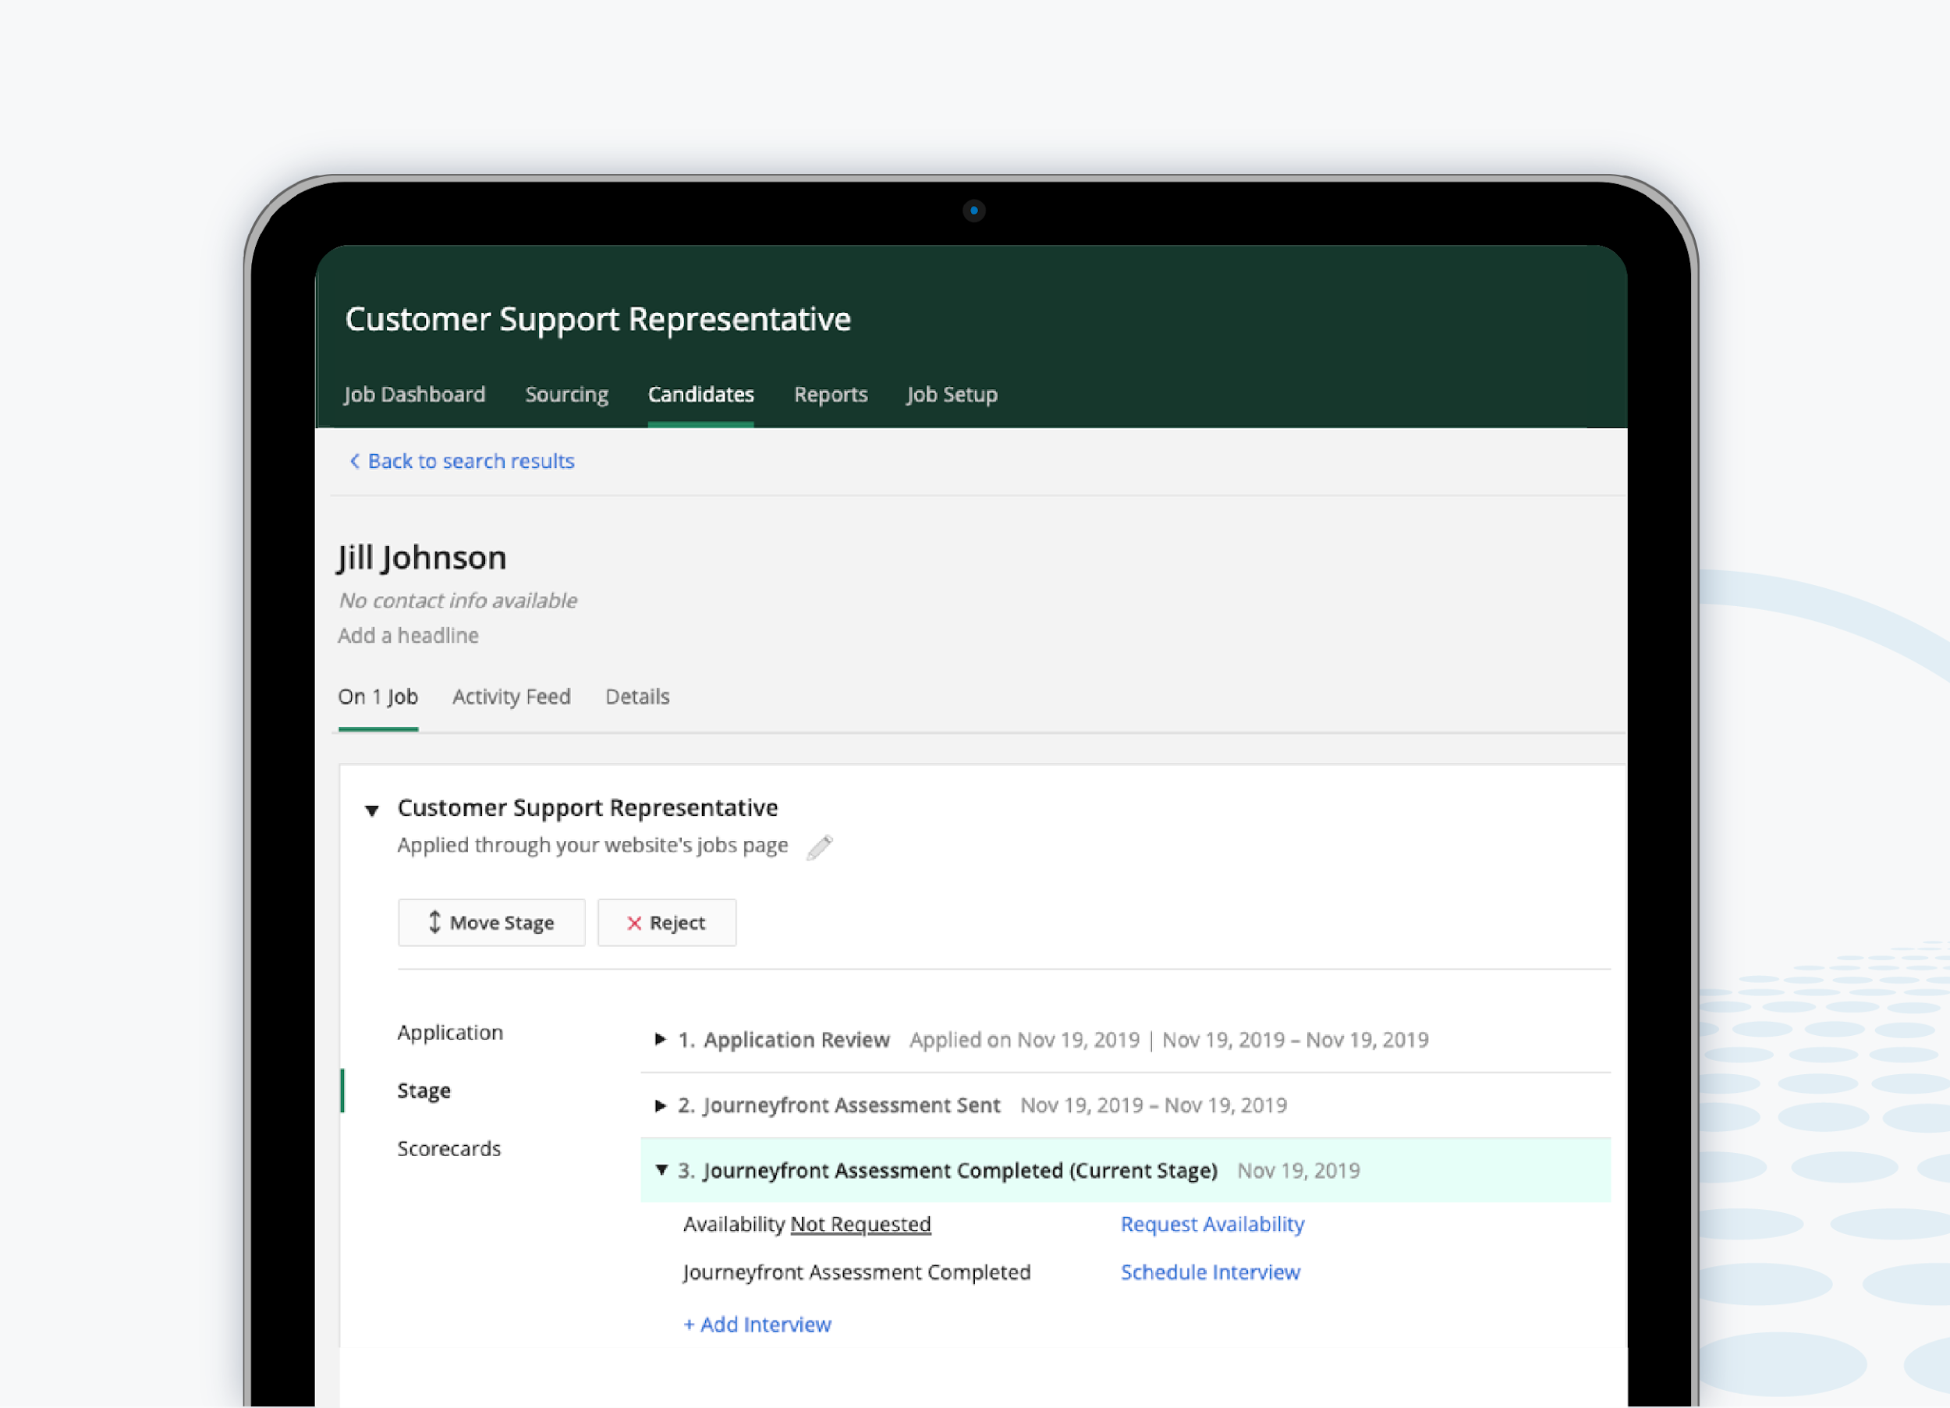
Add Logos if known
ATS Integration
Journeyfront integrates with all major ATS platforms or can be used as a standalone product.

Slide 68
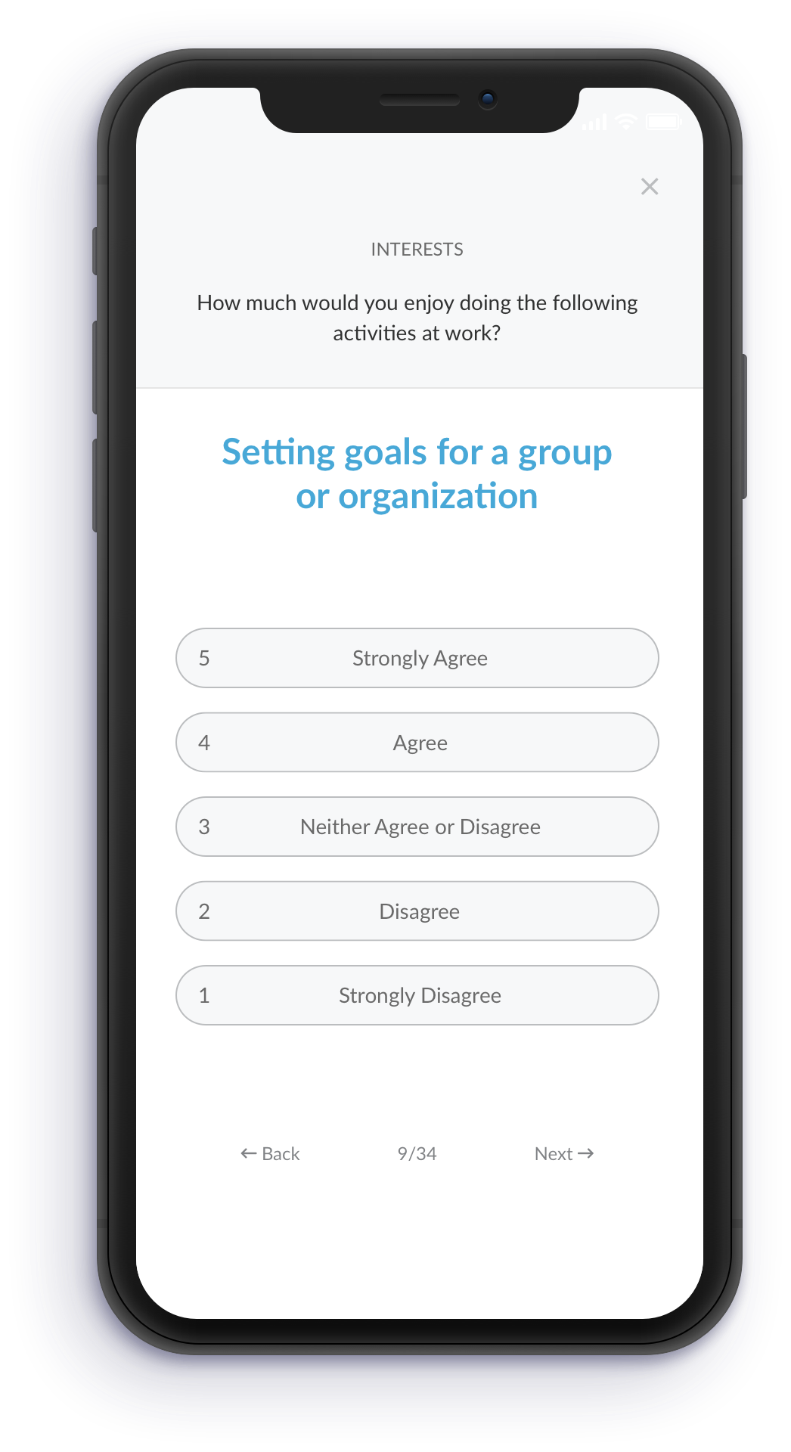
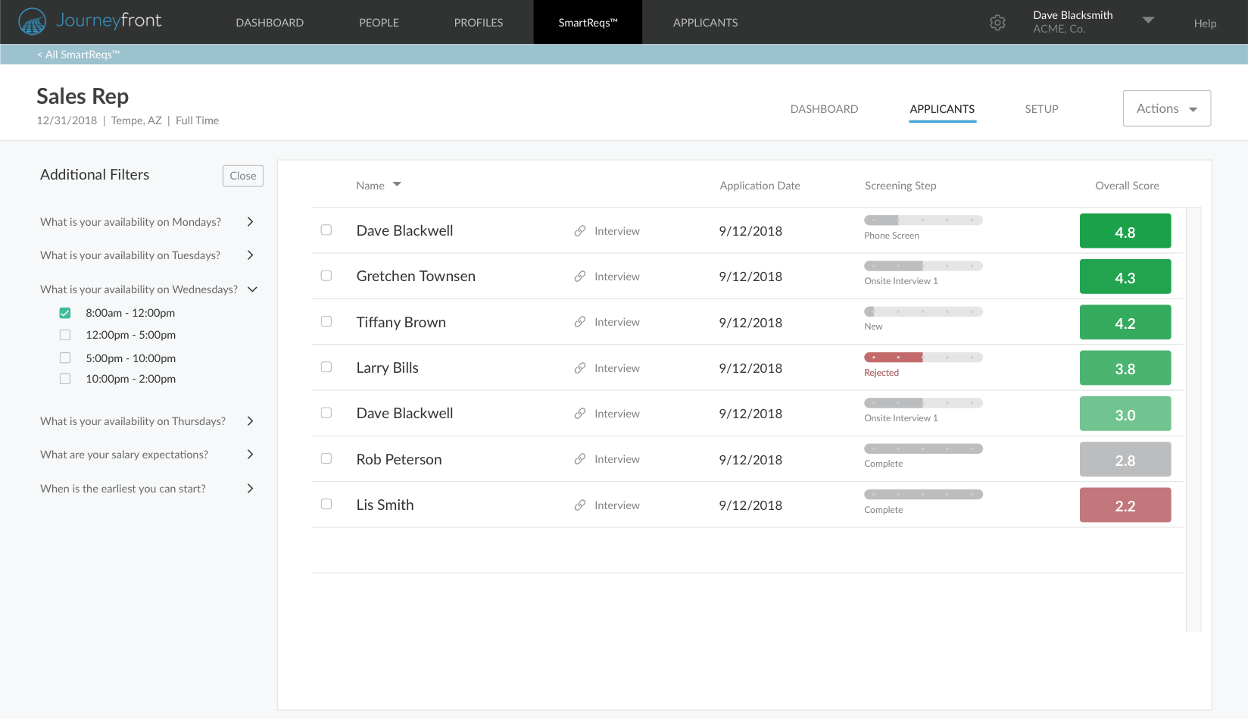

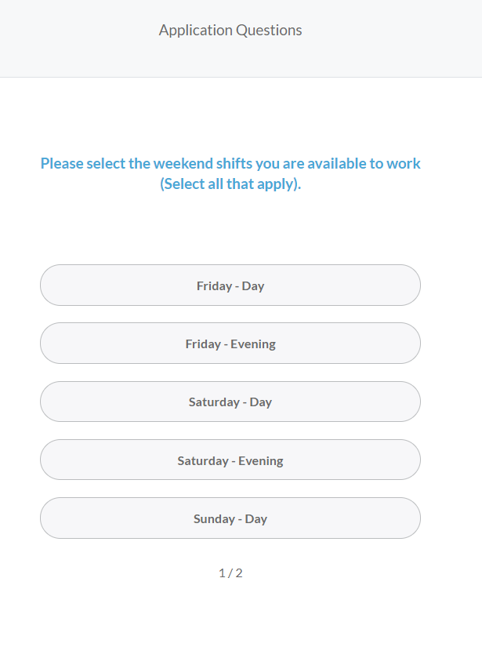
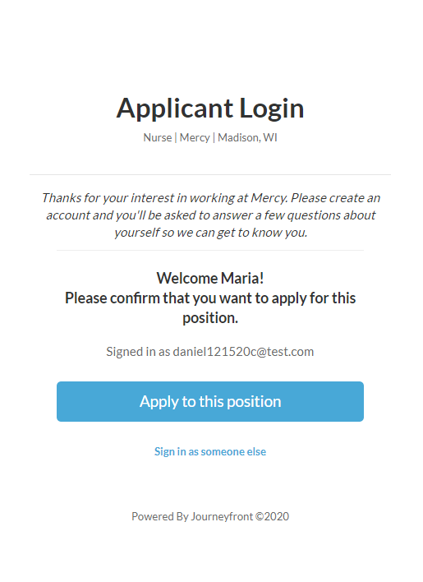
Journeyfront is the entire Hiring Accuracy toolkit
Candidate Application > Assessment > Job Simulation > Phone Screen > Interviews > Discussion & Selection > Track > Optimize
Step-by-step walk through of all application steps
Custom, auto-scoring screening questions
Auto-rank candidate by application qualifications, shift availability, etc.
Company Logo

Slide 69
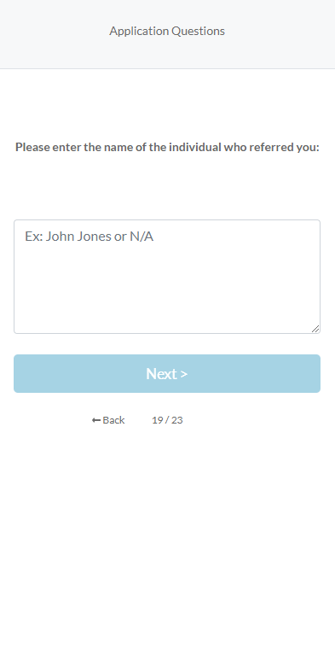
Journeyfront is the entire Hiring Accuracy toolkit
Candidate Application > Assessment > Job Simulation > Phone Screen > Interviews > Discussion & Selection > Track > Optimize
Assess interests, values, personality, and competencies
Collect customizable candidate insights
Assess interests, values, personality, and competencies
Predict candidate performance and satisfaction
Add values questions.. Or something
Have screens change vs. prior
Understand how candidates compare to your best employees

Slide 70
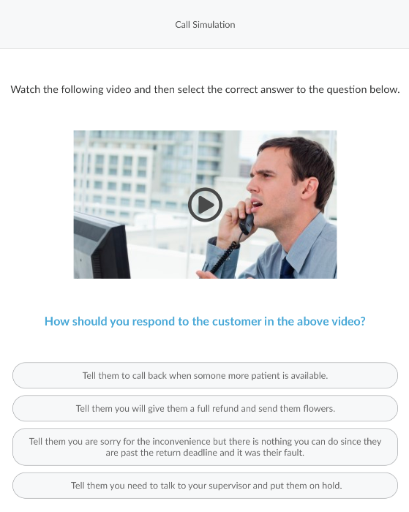
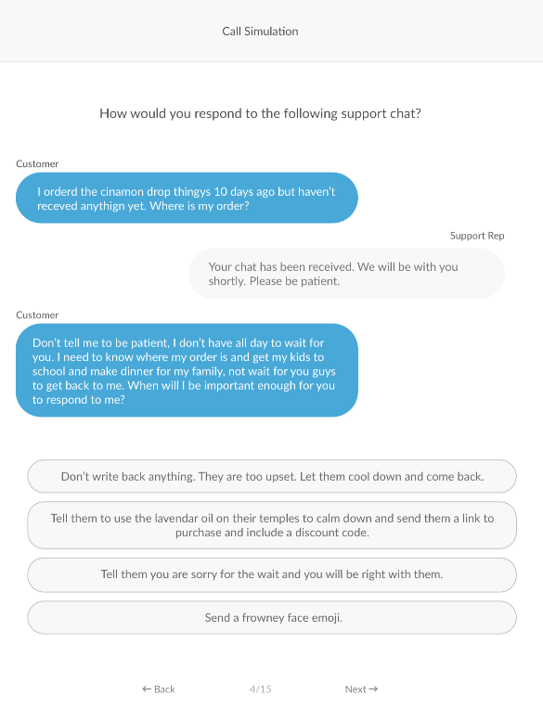
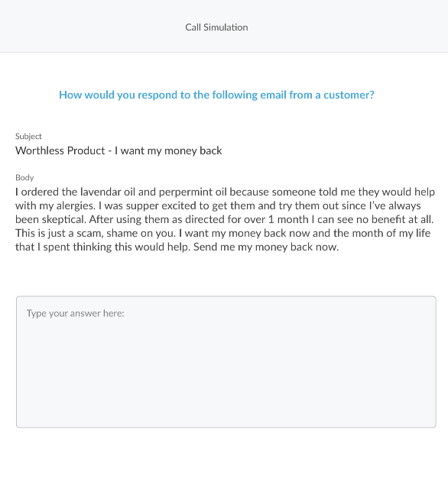
Journeyfront is the entire Hiring Accuracy toolkit
Candidate Application > Assessment > Job Simulation > Phone Screen > Interviews > Discussion & Selection > Track > Optimize
Measure situation judgment responding to customer chats
Measure writing ability responding to customer emails
Measure applicant situational judgment listening to real calls

Slide 71
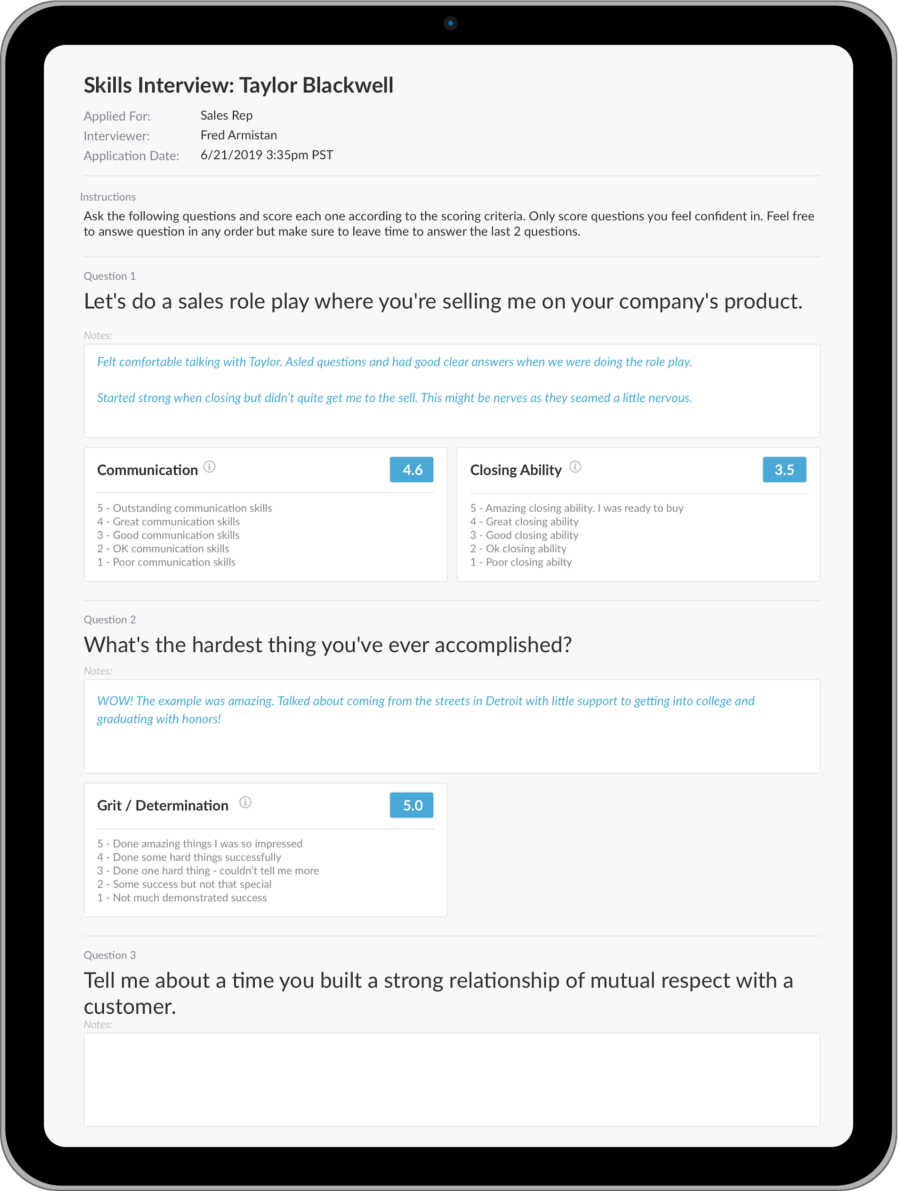
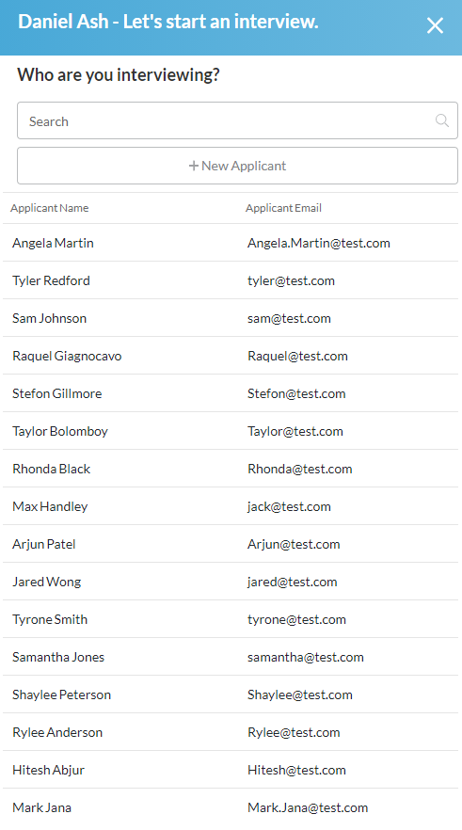
Journeyfront is the entire Hiring Accuracy toolkit
Candidate Application > Assessment > Job Simulation > Phone Screen > Interviews > Discussion & Selection > Track > Optimize
Customizable interviewer instructions
Access interview scoring guides from phone, tablet, or computer
Record interviewer notes
Score Attributes Using Standard or Customizable Rubrics

Slide 72
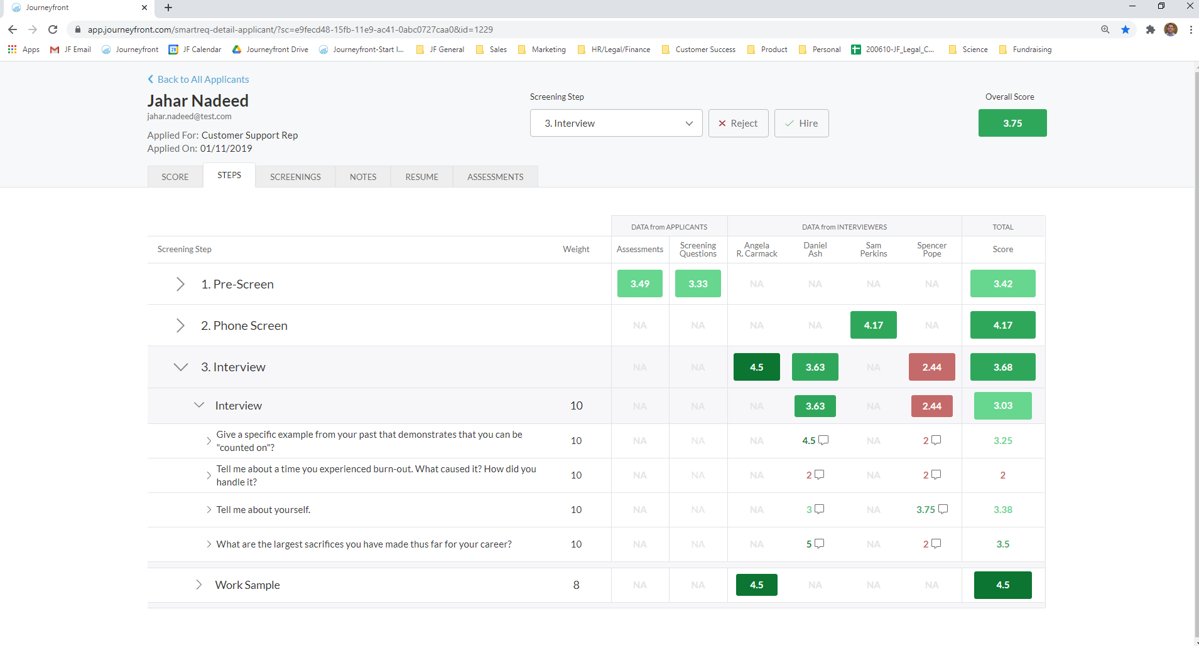
Journeyfront is the entire Hiring Accuracy toolkit
Candidate Application > Assessment > Job Simulation > Phone Screen > Interviews > Discussion & Selection > Track > Optimize
Aggregate all data collected into 1 score
Visualize how a candidate scored by steps (shown here) or by attributes (shown on the Score Tab)
Deep dive into question, attribute, or interviewer scores/notes.
Customize weighting of steps & attributes towards overall score

Slide 73
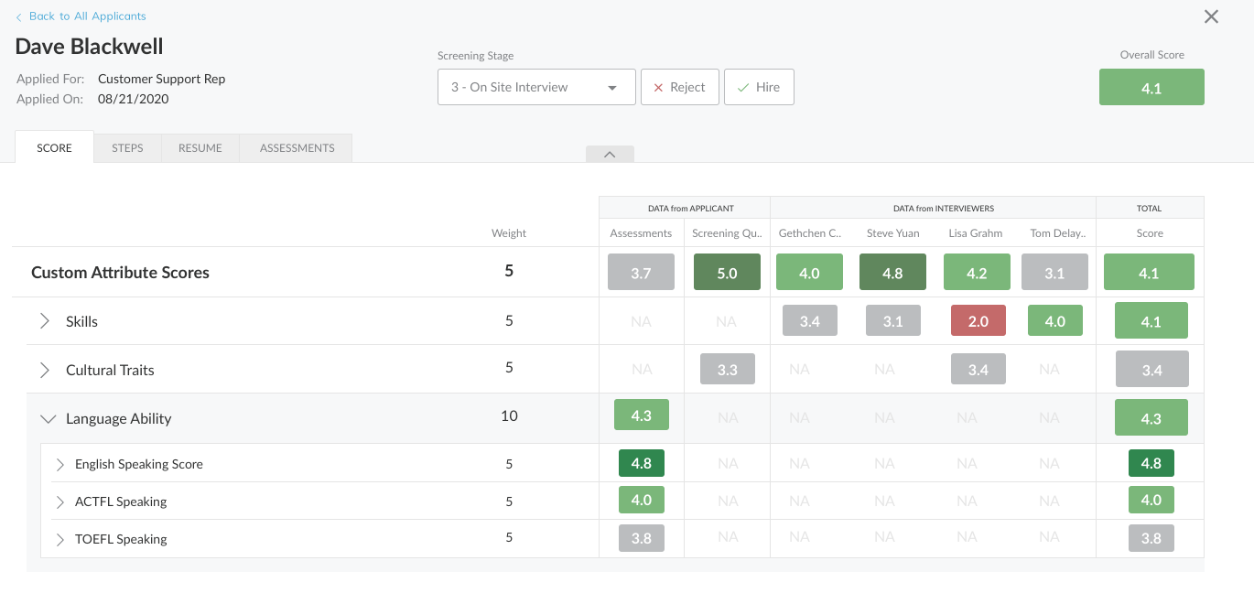
Journeyfront is the entire Hiring Accuracy toolkit
Candidate Application > Assessment > Job Simulation > Phone Screen > Interviews > Discussion & Selection > Track > Optimize
Aggregate all data collected into 1 score
Visualize how a candidate scored by steps (shown here) or by attributes (shown on the Score Tab)
Deep dive into question, attribute, or interviewer scores/notes.
Customize weighting of steps & attributes towards overall score

Slide 74
Journeyfront is the entire Hiring Accuracy toolkit
Candidate Application > Assessment > Job Simulation > Phone Screen > Interviews > Discussion & Selection > Track > Optimize
Aggregate all data collected into 1 score
Visualize how a candidate scored by steps (shown here) or by attributes (shown on the Score Tab)
Deep dive into question, attribute, or interviewer scores/notes.
Customize weighting of steps & attributes towards overall score

Slide 75
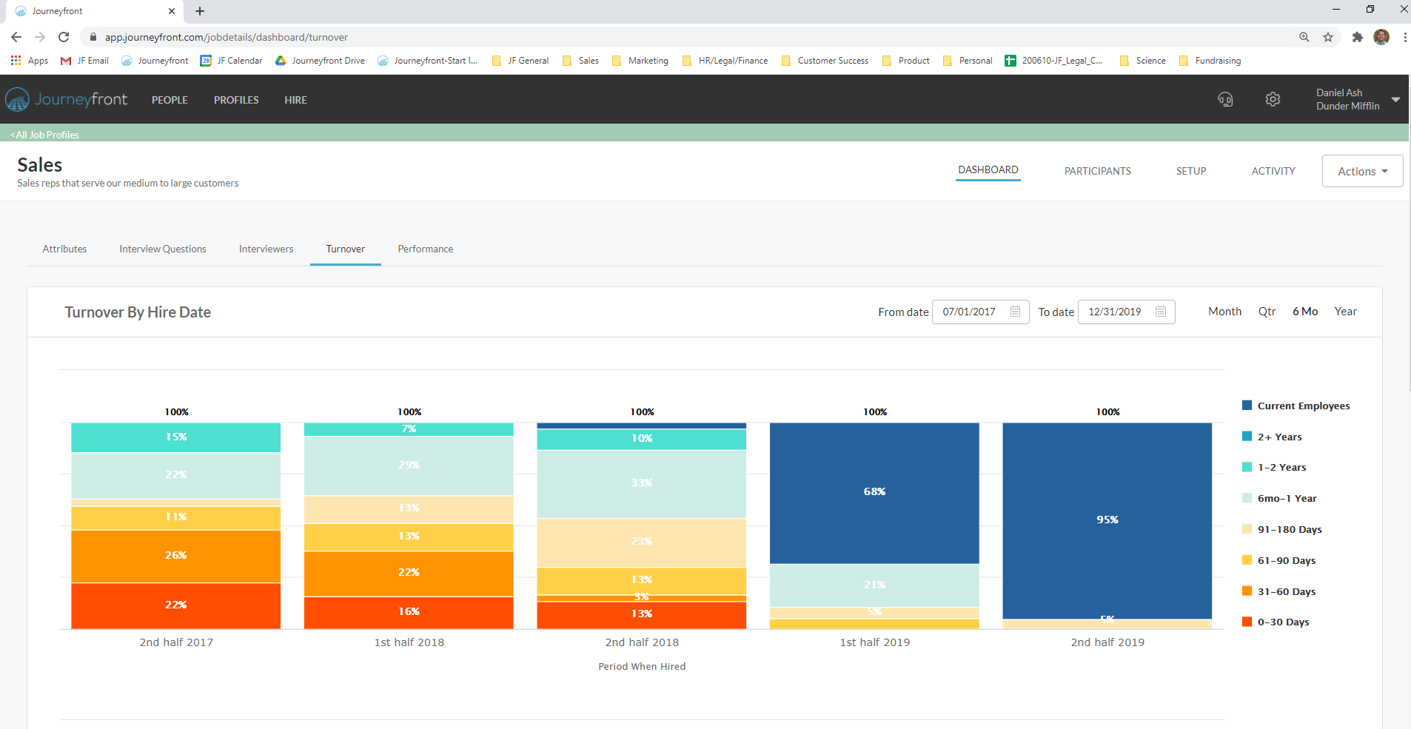
Journeyfront is the entire Hiring Accuracy toolkit
Candidate Application > Assessment > Job Simulation > Phone Screen > Interviews > Discussion & Selection > Track > Optimize
Identify from your own data which attributes, questions, etc. correlate most strongly with retention
You can’t improve what you can’t measure. Journeyfront helps companies track new hire turnover by hiring cohort.
This allows your company to identify whether different interventions (changes to the hiring process, onboarding, compensation, etc.) are having an impact on retention rates.
Just as important, the system shows you what to change in your hiring process in order to continuously improve the accuracy of your hiring process over time.
Track performance of new hires by hiring cohort - Quickly identify positive and negative turnover trends to pinpoint which interventions are working.
Turnover & performance bucketing based on your own data

Slide 76
Journeyfront is the entire Hiring Accuracy toolkit
Candidate Application > Assessment > Job Simulation > Phone Screen > Interviews > Discussion & Selection > Track > Optimize
Identify from your own data which attributes, questions, etc. correlate most strongly with retention
You can’t improve what you can’t measure. Journeyfront helps companies track new hire turnover by hiring cohort.
This allows your company to identify whether different interventions (changes to the hiring process, onboarding, compensation, etc.) are having an impact on retention rates.
Just as important, the system shows you what to change in your hiring process in order to continuously improve the accuracy of your hiring process over time.
Track performance of new hires by hiring cohort - Quickly identify positive and negative turnover trends to pinpoint which interventions are working.
Turnover & performance bucketing based on your own data

Slide 77
Journeyfront is the entire Hiring Accuracy toolkit
Candidate Application > Assessment > Job Simulation > Phone Screen > Interviews > Discussion & Selection > Track > Optimize
Identify from your own data which attributes, questions, etc. correlate most strongly with retention
You can’t improve what you can’t measure. Journeyfront helps companies track new hire turnover by hiring cohort.
This allows your company to identify whether different interventions (changes to the hiring process, onboarding, compensation, etc.) are having an impact on retention rates.
Just as important, the system shows you what to change in your hiring process in order to continuously improve the accuracy of your hiring process over time.
Track performance of new hires by hiring cohort - Quickly identify positive and negative turnover trends to pinpoint which interventions are working.
Turnover & performance bucketing based on your own data

Slide 78
Journeyfront is the entire Hiring Accuracy toolkit
Candidate Application > Assessment > Job Simulation > Phone Screen > Interviews > Discussion & Selection > Track > Optimize
Identify from your own data which attributes, questions, etc. correlate most strongly with performance (handle time, customer call ratings, etc.)
You can’t improve what you can’t measure. Journeyfront helps companies track new hire performance by hiring cohort.
This allows your company to identify whether different interventions (changes to the hiring process, onboarding, training, etc.) are having an impact on overall performance.
Just as important, the system shows you what to change in your hiring process in order to continuously improve the accuracy of your hiring process over time.
Track performance of new hires by hiring cohort - Quickly identify positive and negative performance trends to pinpoint which interventions are working.
Performance bucketing based on your own data

Slide 79
Journeyfront is the entire Hiring Accuracy toolkit
Candidate Application > Assessment > Job Simulation > Phone Screen > Interviews > Discussion & Selection > Track > Optimize
Identify common drivers for those employees that stay longest, are most satisfied, meet performance expectations, etc.
Identify most effective hiring methods and interviewer effectiveness
Use Journeyfront to identify the profile for those employees that are most successful

Slide 80
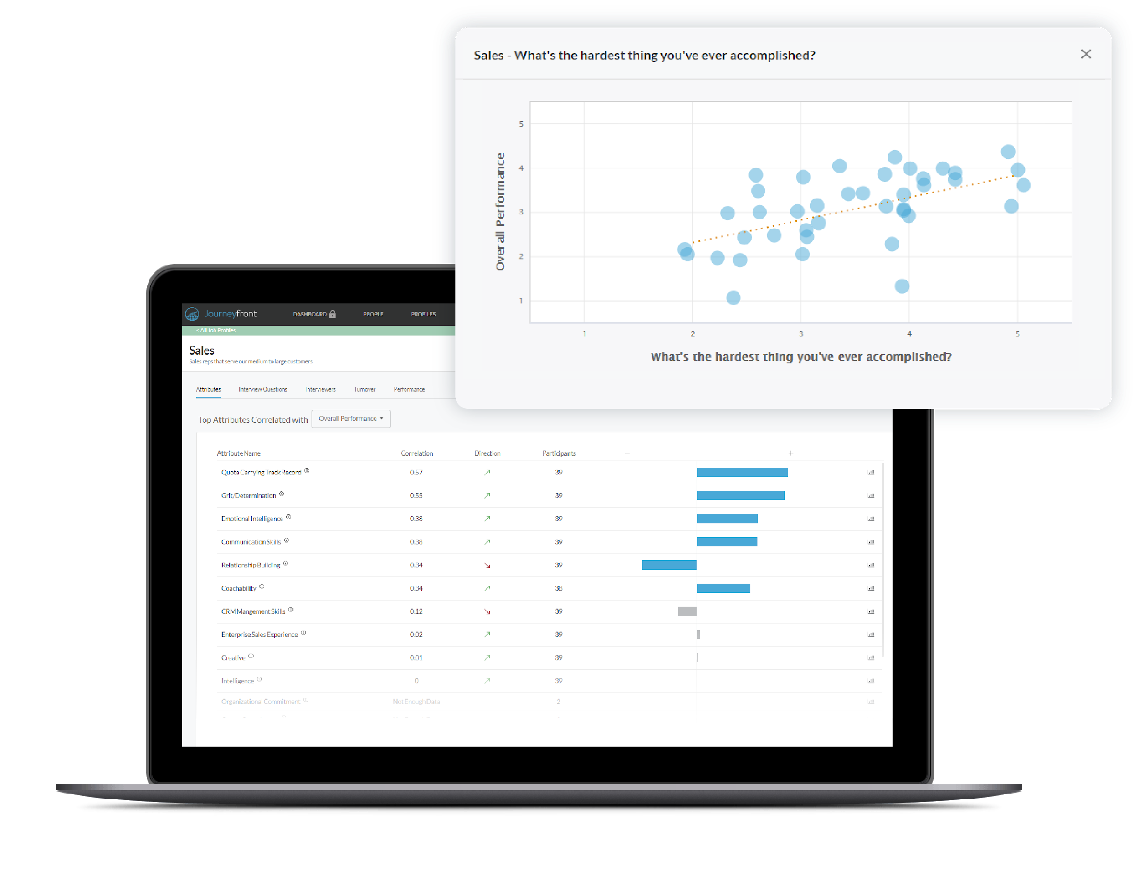
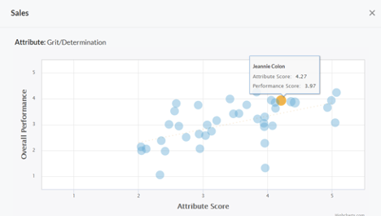
Identify insights from your own data on what traits separate your lowest and highest performers.

Slide 81


Auto-sorting Screening Questions
Prioritize which medical scribe candidates to pursue via automating, screening questions during the application phase
Step-by-step walk through of all application steps
Custom, auto-scoring screening questions
Auto-rank and sort candidates by work experience, job qualifications, etc.
Loan Processor l Summit Funding l Seattle, WA
Thanks for your interest in working at Summit Funding! Please apply below and you’ll be asked to answer a few questions so we can get to know you.

Slide 82
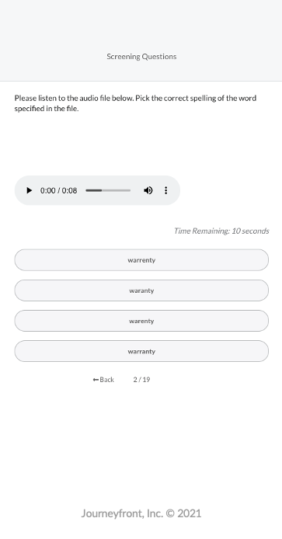
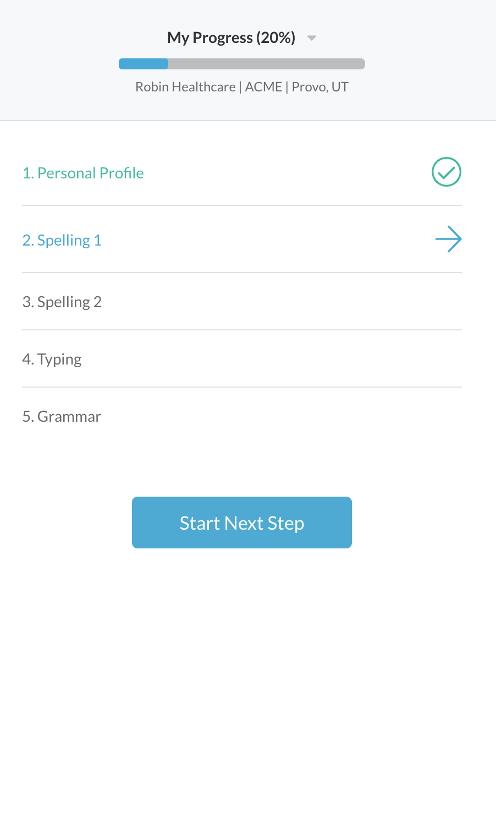
Skills Tests & Job Simulations
Test whether medical scribe candidates have the skills required for success.
Choose from our library of tests/simulations or let us build a customized test/ simulation just for you.
Spelling, grammar, typing, etc.
To what extent does the vision
Test an unlimited range of skills; can be taken on any device (mobile, tablet, computer) and timed or not timed.

Slide 83
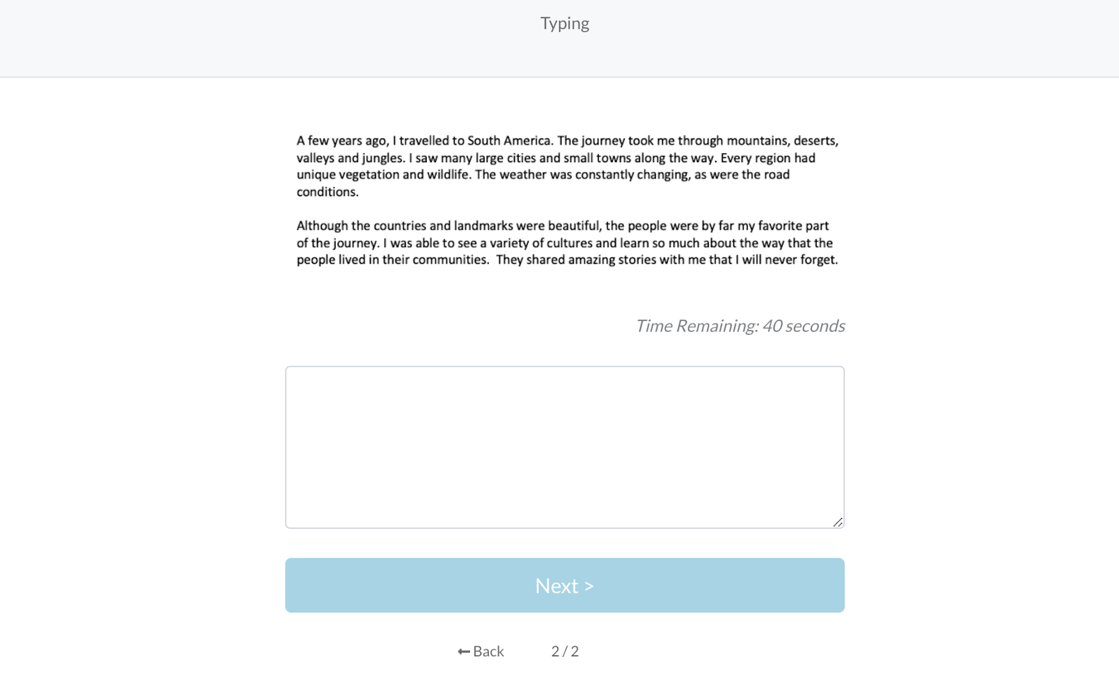
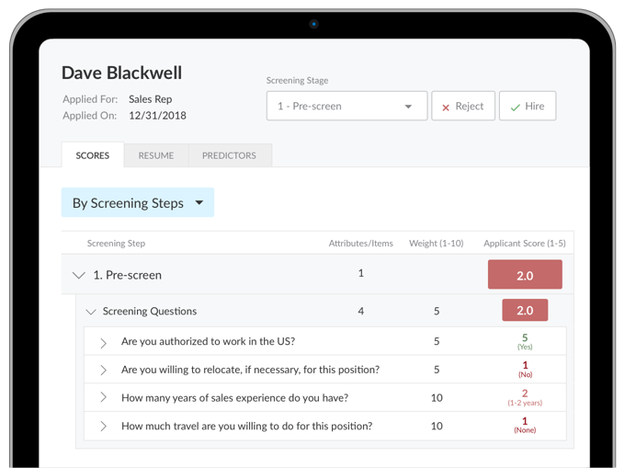
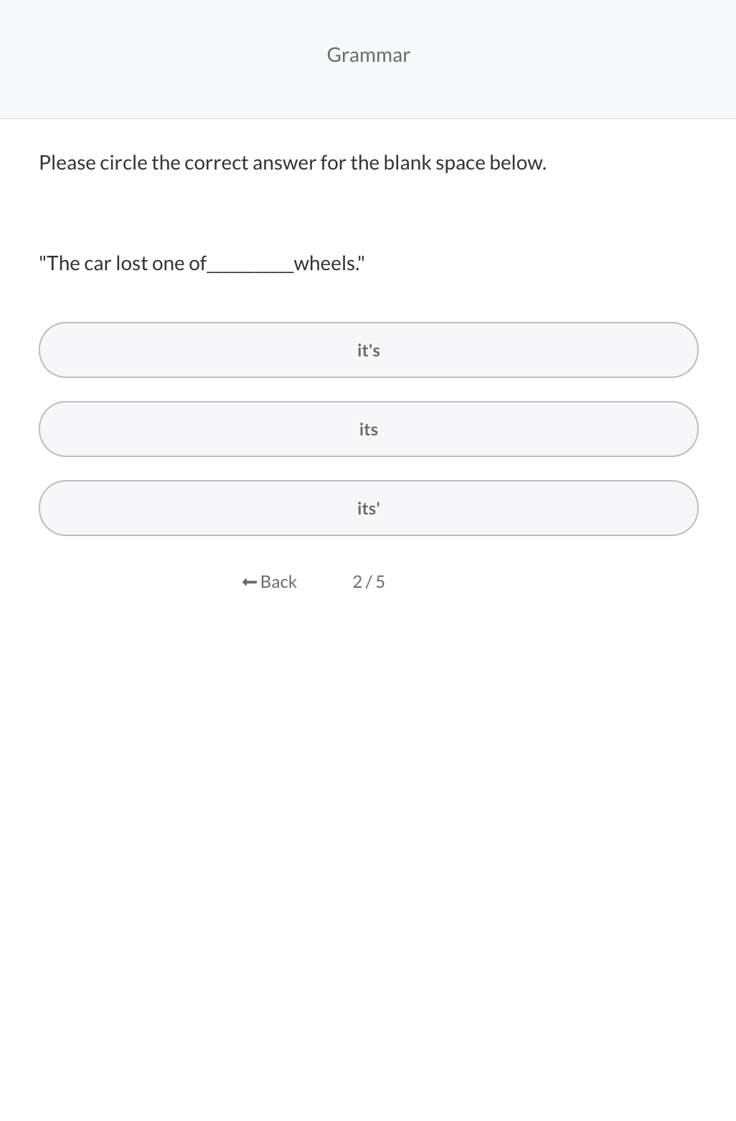
Skills Tests & Job Simulations
Test whether medical scribe candidates have the skills required for success.
Assess typing speed and accuracy, without bloating the application process.
Customize assessments to measure what matters, like grammar or syntax.

Slide 84
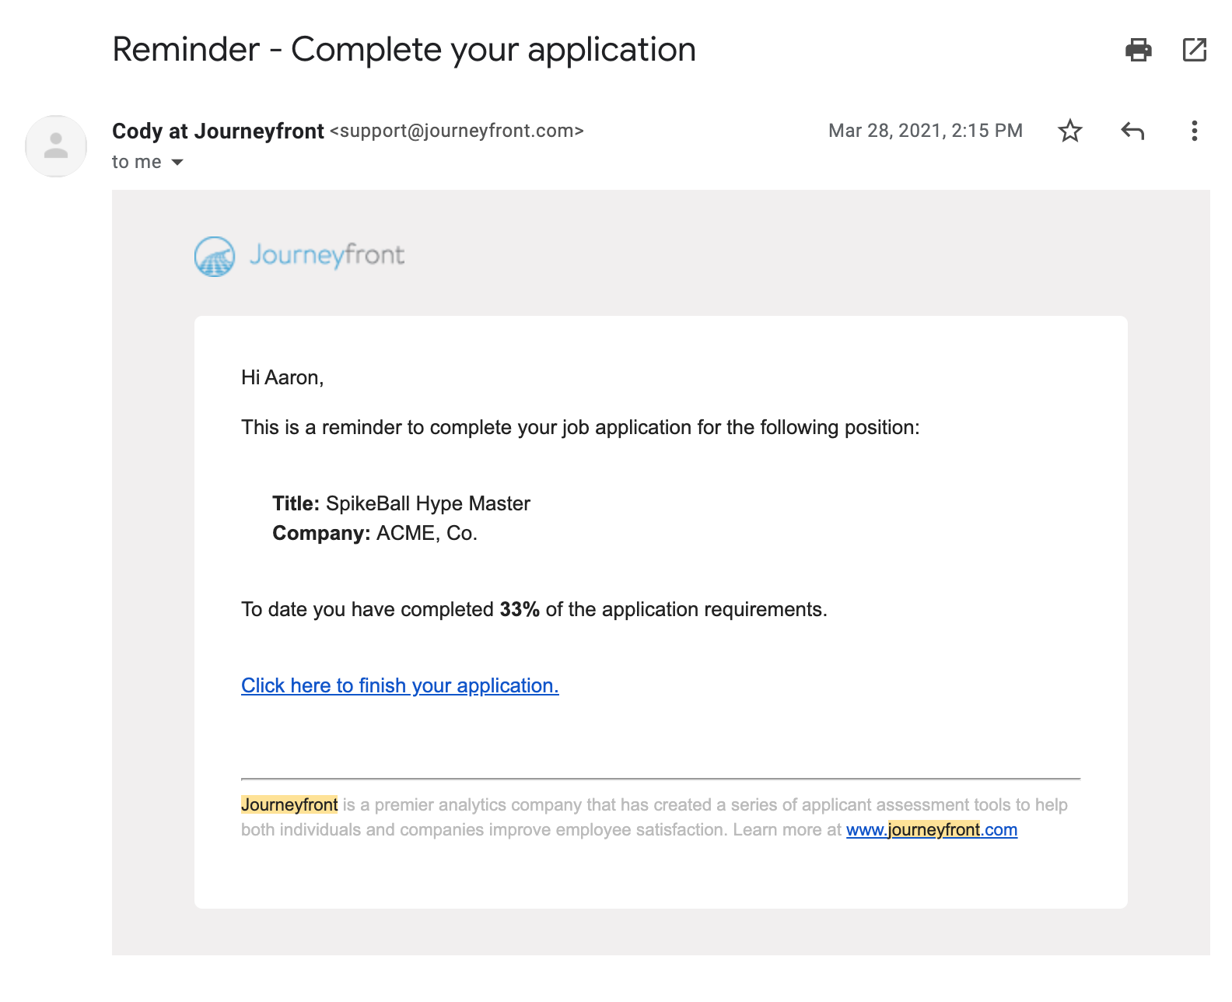
Automated Reminders and Seamless Transitions
Journeyfront customizes your process to improve the candidate experience and keep them in the hiring funnel.

Slide 85


Realistic Job Previews
Embed video job previews into application so candidates know what to expect from the role and company
Please watch the following video and answer the questions that follow.
Please watch the following video and answer the questions that follow.
How does the above opportunity align with your career goals?
After watching the above video, are you still interested?
Does not align
No
Somewhat aligns
Maybe, let’s talk
Aligns
Yes
Strongly aligns
For sure, Yes!

Slide 86
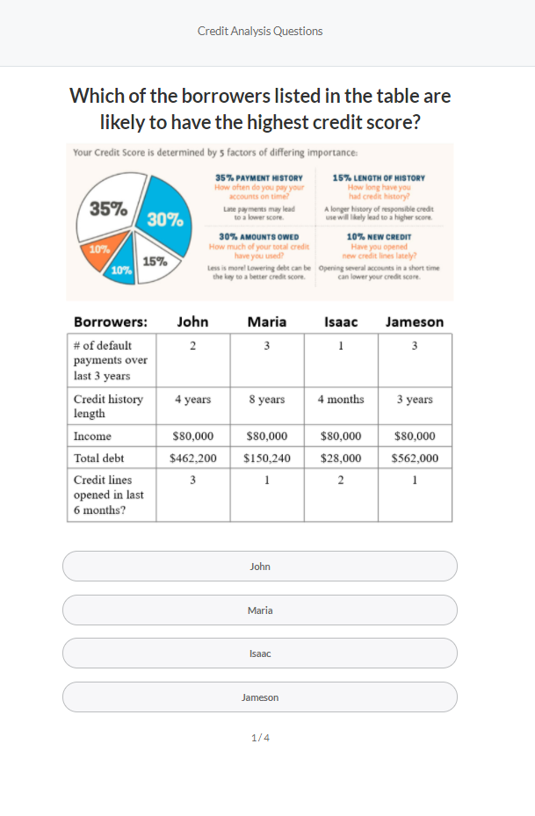
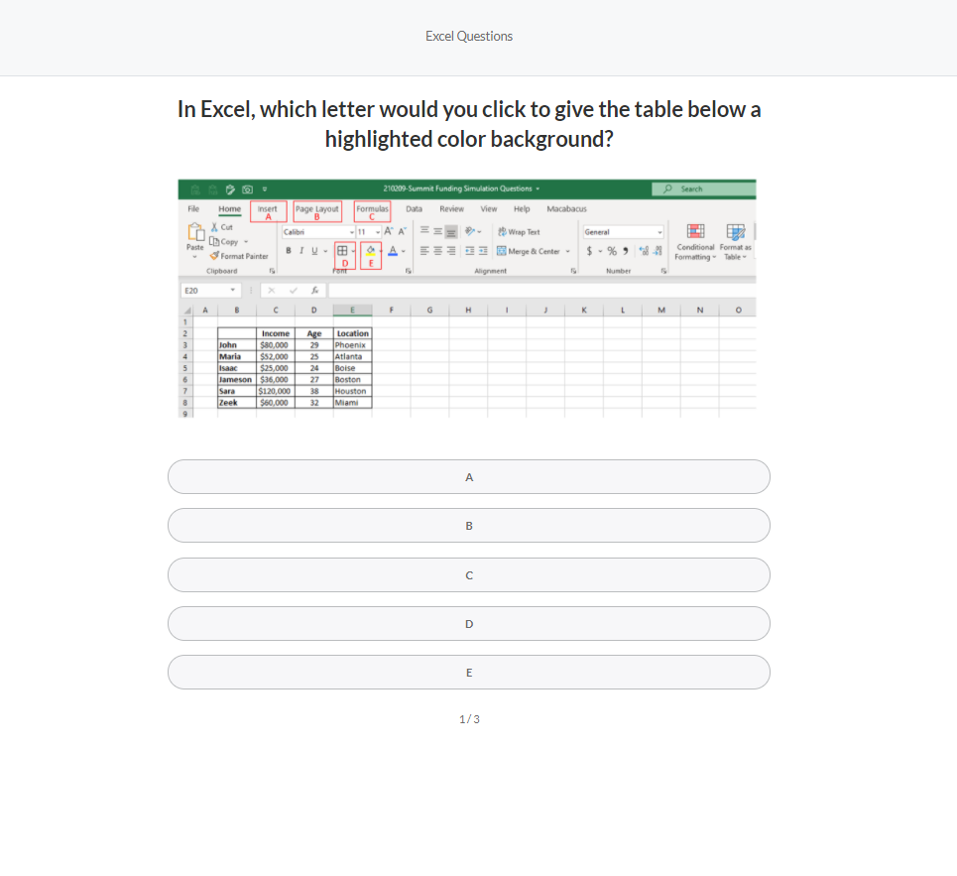
Custom Job Simulations
Test candidates’ ability to perform skills and tasks they’ll be responsible for in the job.
To what extent does the vision

Slide 87
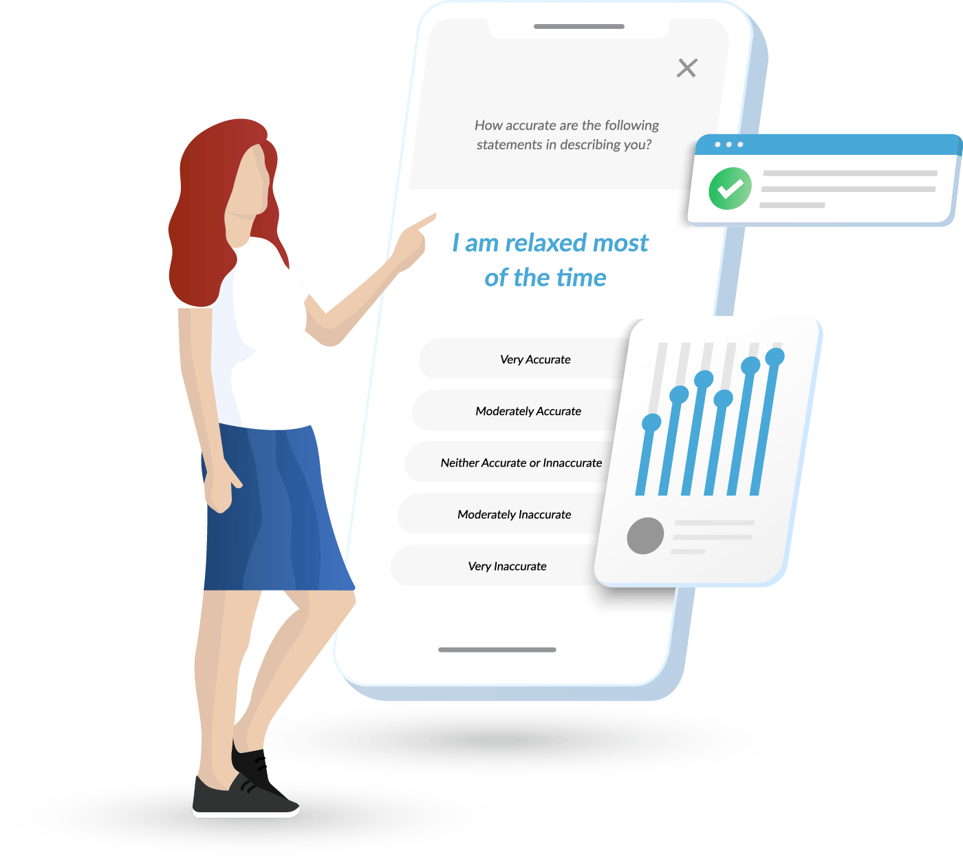
Custom Job Simulations - Examples
To illustrate, below are examples how what custom job simulations we’d build for specific SF roles
Loan Processor
-Have the candidate process a loan (process customer/loan information and capture crucial elements to follow a series of steps)
-Also tests candidates detail orientation, quantitative ability (if needed), typing / computer skills, etc.
HR Generalist
-Asks candidate to perform various activities related to HR role (send out employee emails, put together employee onboarding plan, etc.)
-Also tests candidate’s HR knowledge, grammar, computer/typing skills, PowerPoint/Excel skills, etc.

Slide 88
Custom Interview Tools & Scorecards
Capture interview feedback; Consolidate and visualize all candidate insights collected in aggregated candidate scorecards.

Slide 89
Custom Interview Tools & Scorecards
Capture interview feedback; Consolidate and visualize all candidate insights collected in aggregated candidate scorecards.

Slide 90
Track Hiring Accuracy by Hiring Cohorts
Journeyfront helps track hiring accuracy by hiring cohort to monitor progress and facilitate continual improvement.
Identify from your own data which attributes, questions, etc. correlate most strongly with performance
Track performance of new hires by hiring cohort - Quickly identify positive and negative performance trends to pinpoint which interventions are working.
Performance bucketing based on your own data

Slide 91
Track Hiring Accuracy by Hiring Cohorts
Journeyfront helps track hiring accuracy by hiring cohort to monitor progress and facilitate continual improvement.
Identify from your own data which attributes, questions, etc. correlate most strongly with retention
Track performance of new hires by hiring cohort - Quickly identify positive and negative turnover trends to pinpoint which interventions are working.
Turnover & performance bucketing based on your own data

Slide 92

Optimize Your Unique Hiring Formula
Identify insights from your own employee data for how to improve post-hire outcomes – retention, performance, etc.
Identify what employee attributes, interview questions, etc. correlate most strongly with retention – use those insights

