Slide 1

3 Month Review - KeHE
Prepared for : Blake @ KeHE
Prepared by : Cody & Ryan @ Journeyfront
Prepared on : May 25, 2023

Slide 2


Agenda
1. Review Partnership Goals & Objectives
2. Progress to Date
3. Data Review
4. Training Needs / Best Practices for Hiring Managers
5. Next Steps

Slide 3
Agenda
1. Review Partnership Goals & Objectives
2. Progress to Date
3. Data Review
4. Training Needs / Best Practices for Hiring Managers
5. Next Steps

Slide 4
Agenda
1. Review Partnership Goals & Objectives
2. Progress to Date
3. Data Review
4. Training Needs / Best Practices for Hiring Managers
5. Next Steps

Slide 5
Agenda
1. Review Partnership Goals & Objectives
2. Progress to Date
3. Data Review
4. Training Needs / Best Practices for Hiring Managers
5. Next Steps

Slide 6
Agenda
1. Review Partnership Goals & Objectives
2. Progress to Date
3. Data Review
4. Training Needs / Best Practices for Hiring Managers
5. Next Steps

Slide 7

The
HIRING ACCURACY Process
2
Identify What Attributes Matter
1
3
Define Desired Outcomes
Decide on Measurements
8
Currently We Are Here
4
Make Changes (Optimize)
Evaluate Applicants
7
5
Analyze the “Closed Loop”
Hire Based on Scores
6
Track Outcomes

Slide 8
Goals of Journeyfront / {Customer Name} Partnership
There are 2 new slides to replace this , keep scrolling
1
Help {Customer} reduce short-term turnover in high-volume hiring roles Journeyfront track record: 15-40% turnover reduction; Pays for itself after 2% reduction*
2
Help {Customer} execute a more effective, structured hiring process
“A structured hiring process is 5x more effective than an unstructured hiring process”, according to research
3
Give {Customer} data insights for how to improve the hiring process over time
Journeyfront helps track performance / turnover by hiring cohort and recommends ways to improve accuracy

Slide 9
Goals of Journeyfront / Summit Funding Partnership
NEW SLIDE
1
Help SF reduce short-term turnover in our high-volume hiring roles Journeyfront track record: 20-50% turnover reduction; Pays for itself after 2% reduction*
2
Help SF execute a more effective, structured hiring process
“A structured hiring process is 5x more effective than an unstructured hiring process”, according to research
3
Give SF data insights for how to improve the hiring process over time
Journeyfront helps track performance / turnover by hiring cohort and recommends ways to improve accuracy
*Includes hiring efficiency savings also calculated from SF data; worst 1st year turnover reduction to date across all JF clients has been 5%

Slide 10
Key Benefits of BCI + Journeyfront Partnership
NEW SLIDE
1
Reporting/Analytics Opportunities + Automation of Reporting (Funnel metrics, turnover data, etc.)
2
Optimize Candidate Selection to Predict for “Preferred Tenure”
3
Optimize Candidate Selection to Predict for High Performance, Speed to Performance, etc.
4
Achieve 60-day Time-to-Fill Goal through Data-Focused, Consistent, Hiring Process
5
Reveal Attribute Insights to Inform Training and Onboarding

Slide 11

Goal: Short Term Turnover
Before:
Since Sept. Launch:
Annually 20.8% left within 90 days
14.5% left
within 90 days
** Note: this # likely to be higher depending on Feb./March term imports
Notes:
Why is it important to use your own data – every co is different
More data is better
Gets better over time- we use more data

Slide 12
Progress To Date
Jan 2023
Feb 2023
Mar 2023
Apr 2023
May 2023
JF Actions
JF Actions
JF Actions
JF Actions
JF Actions
onec risus dolor porta
Pharetra luctus felis
Proin vel tellus in felis
Molestie nec amet cum
onec risus dolor porta
Pharetra luctus felis
Proin vel tellus in felis
Molestie nec amet cum
onec risus dolor porta
Pharetra luctus felis
Proin vel tellus in felis
Molestie nec amet cum
onec risus dolor porta
Pharetra luctus felis
Proin vel tellus in felis
Molestie nec amet cum
onec risus dolor porta
Pharetra luctus felis
Proin vel tellus in felis
Molestie nec amet cum
Customer Actions
Customer Actions
Customer Actions
Customer Actions
Customer Actions
JF Actions
JF Actions
JF Actions
JF Actions
JF Actions
onec risus dolor porta
Pharetra luctus felis
Proin vel tellus in felis
Molestie nec amet cum
onec risus dolor porta
Pharetra luctus felis
Proin vel tellus in felis
Molestie nec amet cum
onec risus dolor porta
Pharetra luctus felis
Proin vel tellus in felis
Molestie nec amet cum
onec risus dolor porta
Pharetra luctus felis
Proin vel tellus in felis
Molestie nec amet cum
onec risus dolor porta
Pharetra luctus felis
Proin vel tellus in felis
Molestie nec amet cum

Slide 13
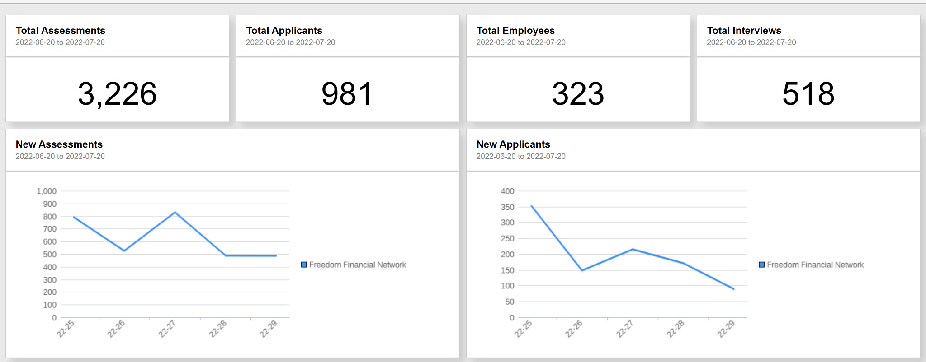
Data Usage

Slide 14


Applicant Flow Allows {Customer} To Be Selective In Hiring
There is a new slide next page
Applications
1119
61% were interviewed
Interviews
726
29% were hired
212
Hired
18% hiring rate
(a 22% increase after JF)

Slide 15
Applicant Flow Allows {Customer} To Be Selective In Hiring
855
Applications
702
Screening
61% were interviewed
212
Phone Interview
57
In-person Interview
29% were hired
32
Hired
18% hiring rate
(22% increase after JF)

Slide 16
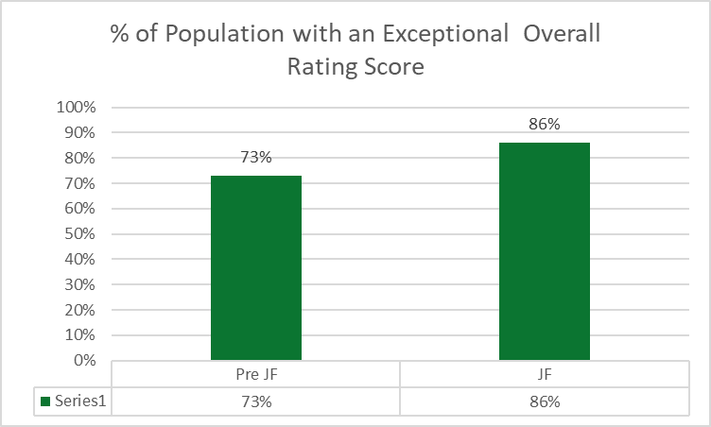
18% increase in new hires with Exceptional Overall Rating Score
There is a new slide next page
Example Data

Slide 17

18% increase in new hires with Exceptional Overall Rating Score
Small details about the stats here
86%
17.8%
73%
Increase in Overall Rating Score
Before Journeyfront
After Journeyfront
% of Population with an Exceptional Overall Rating Score

Slide 18
Training Needs
There is a new slide next page
1
Example
Example
Example
Data Entry
2
Example
Example
Example
Scoring Question
3
Example
Example
Example
End User
4
Example
Example
Example
Closed Loop Data Points
5
Example
Example
Example
Other

Slide 19
Training Needs
1. Data Entry
2. Scoring Questions
3. End User
4. Closed Loop Data Points
5. Other
Example
Example
Example
Example
Example
onec risus dolor porta
Pharetra luctus felis
Proin vel tellus in felis
Molestie nec amet cum
onec risus dolor porta
Pharetra luctus felis
Proin vel tellus in felis
Molestie nec amet cum
onec risus dolor porta
Pharetra luctus felis
Proin vel tellus in felis
Molestie nec amet cum
onec risus dolor porta
Pharetra luctus felis
Proin vel tellus in felis
Molestie nec amet cum
onec risus dolor porta
Pharetra luctus felis
Proin vel tellus in felis
Molestie nec amet cum
Example
Example
Example
Example
Example
onec risus dolor porta
Proin vel tellus in felis
Molestie nec amet cum
onec risus dolor porta
Proin vel tellus in felis
Molestie nec amet cum
onec risus dolor porta
Pharetra luctus felis
Molestie nec amet cum
onec risus dolor porta
Pharetra luctus felis
Proin vel tellus in felis
onec risus dolor porta
Pharetra luctus felis
nec amet cum
Example
Example
Example
Example
Example
onec risus dolor porta
Proin vel tellus in felis
Molestie nec amet cum
onec risus dolor porta
Proin vel tellus in felis
Molestie nec amet cum
onec risus dolor porta
Pharetra luctus felis
Molestie nec amet cum
onec risus dolor porta
Pharetra luctus felis
Proin vel tellus in felis
onec risus dolor porta
Pharetra luctus felis
nec amet cum

Slide 20


Best Practices For Hiring Managers
Plan Ahead
Review the applicant’s scorecard and intended interview questions prior to meeting with the applicant.
Consistency
Ensure all hiring team members are using the same interviews and the same questions, and that they understand the scoring criteria.
Follow Through
Mark applicants “Hired” or “Fired” in the Journeyfront system.

Slide 21
Next Steps
1
Hiring plans for the coming Q/H-include tools available for use
2
Imports
Who will get us the imports and how often
3
Timelines the rest of the year
Setting up a regular check-in
Key meetings
4
How will the Journeyfront renewal be handled at {Customer Name}

Slide 22

Technical Support
(The First Place You Turn When Something Doesn’t Seem Quite Right)
General Support for Applicants & Company Users:
  Email: Support@SimpleNexus.com
  Chat: Available at journeyfront.com
  Available M-F, 8 am to 5:30 pm (MST)
Contact Your CSM If:
Weekend Coverage
Escalation for Urgent Matters
Need Additional Help

Slide 23
Questions?

Slide 24
APPENDIX

Slide 25
2
The
HIRING ACCURACY Process
Identify What Attributes Matter
1
3
Define Desired Outcomes
Decide on Measurements
8
Currently We Are Here
4
Make Changes (Optimize)
Evaluate Applicants
7
5
Analyze the “Closed Loop”
Hire Based on Scores
6
Track Outcomes

Slide 26
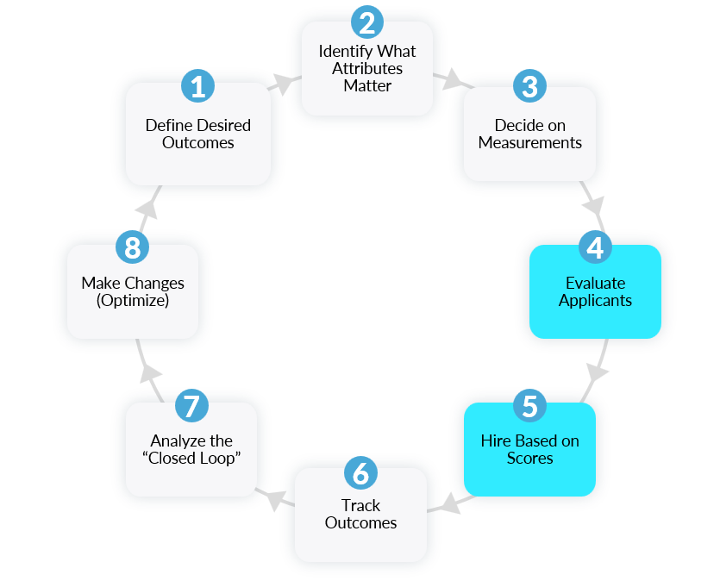
2023 Strategy: Planned Next Steps
3 Months
Initiative 1
Initiative 2
Initiative 3
Based on similar companies we expect to see “x goal” improve by “x” in the next 6 months

Slide 27
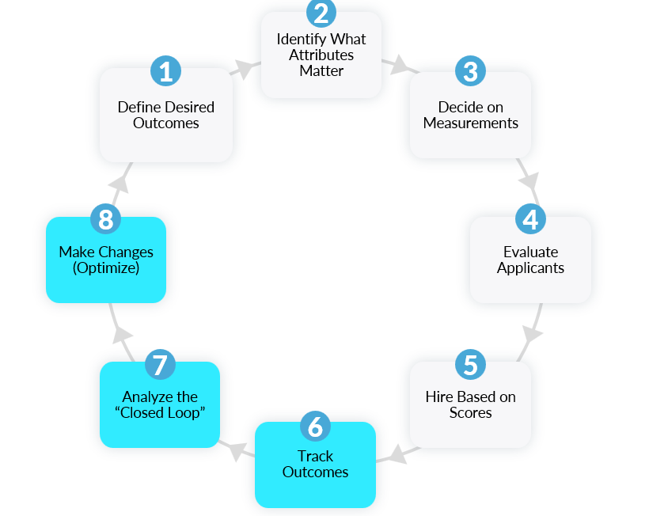
2023 Strategy: Planned Next Steps
6 Months
Initiative 1
Initiative 2
Initiative 3
Based on similar companies we expect to see “x goal” improve by “x” in the next 6 months

Slide 28
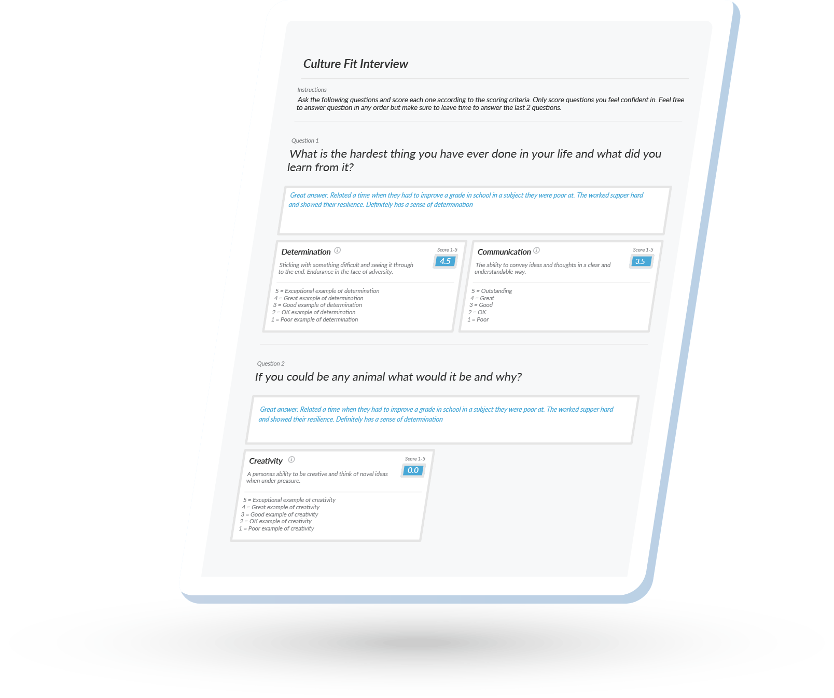
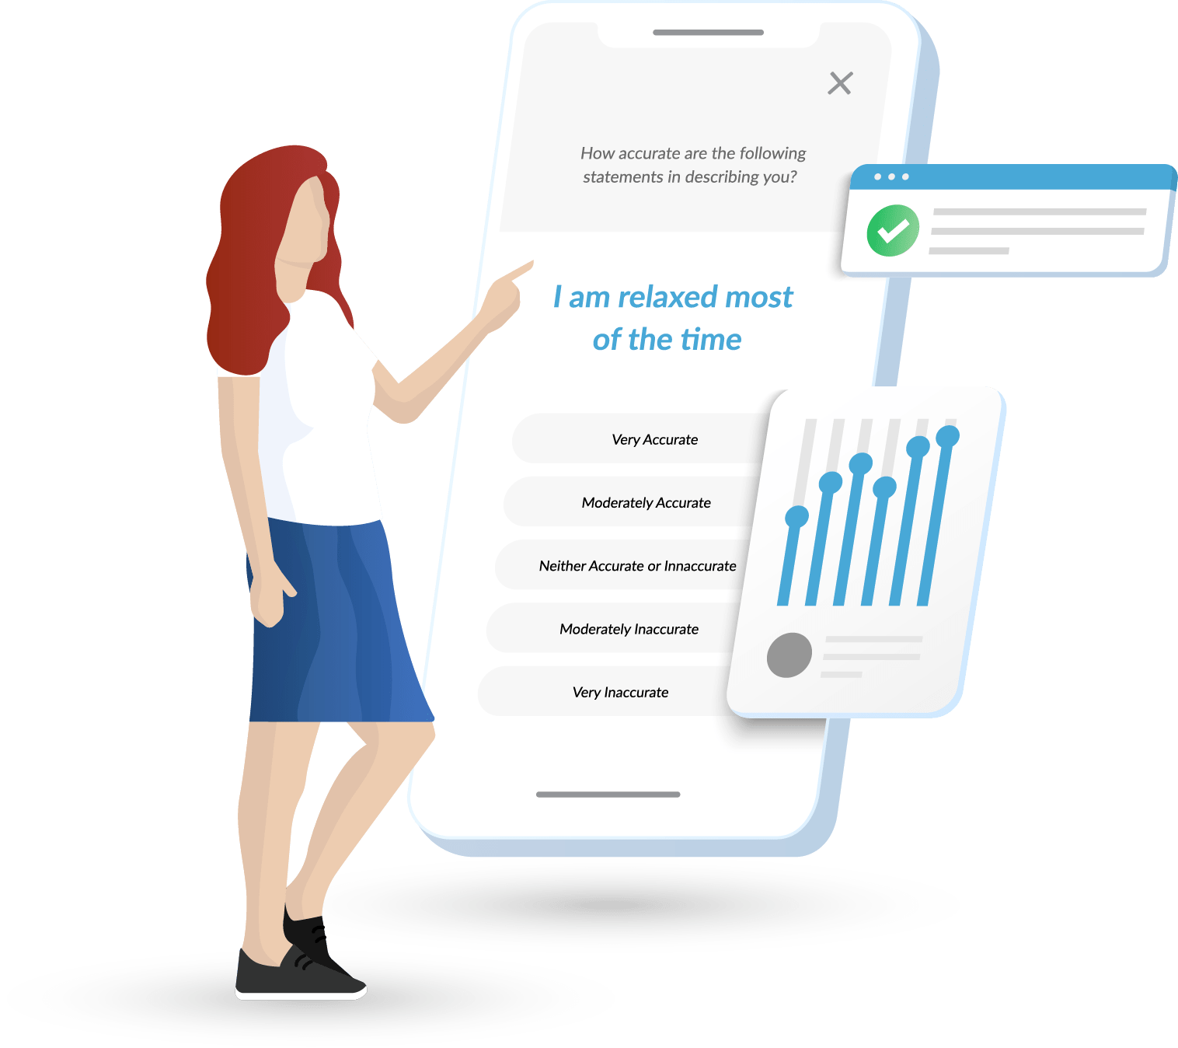

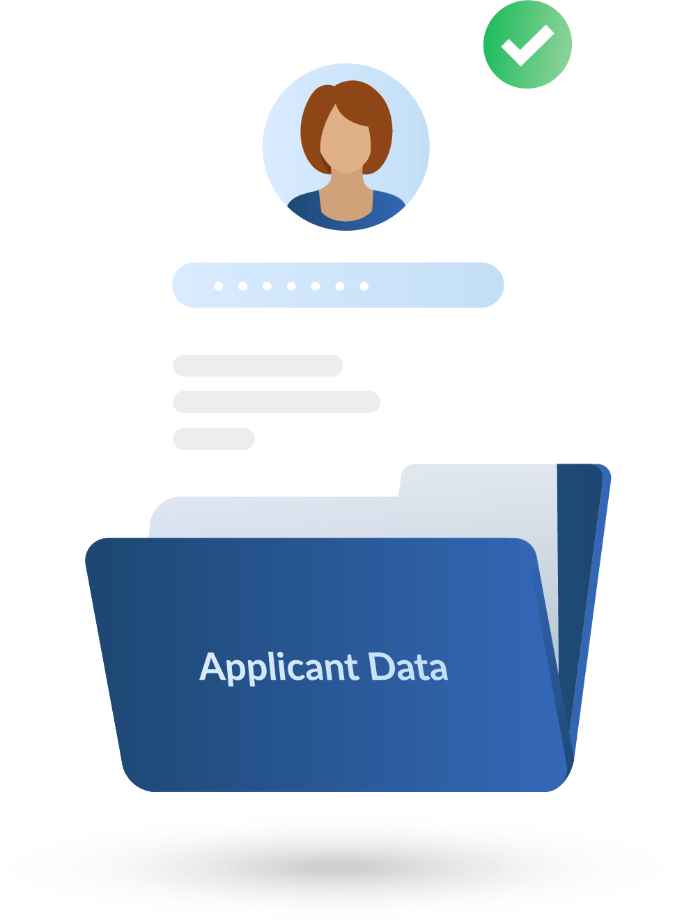

Behavioral Assessments
Powered by Predictive Analytics
3
Candidates take assessments
1
2
4
How it Works
Assess
employees
OPTIMIZE
predictive models
Predict
outcomes
5
Track outcomes
+Job Satisfaction
+Job Performance
+Job Retention

Slide 29

Partnership Focus / ROI Areas
Sourcing Efficiency
Hiring Efficiency
New Hire Retention
New Hire Performance
Improve Hiring Efficiency
Improve Hiring Accuracy

Slide 30

Journeyfront ROI
Pre-Hire Data
Assessments | Interviews | Etc.
Post-Hire Outcomes
Performance | Turnover | Etc.

Slide 31
What Journeyfront Does
Design And Implement A Custom Hiring Accuracy Solution to Your Problem
Continuously Monitor and Optimize for Results

Slide 32














Results Achieved
95%
Of customers saw
improvements in year 1
29%
Average reduction in
turnover in year 1
33%
Average performance improvement in year 1
*Results from customers that implemented the solution and optimizations as required.

Slide 33
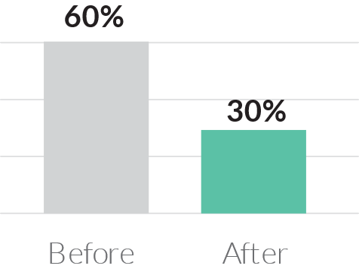
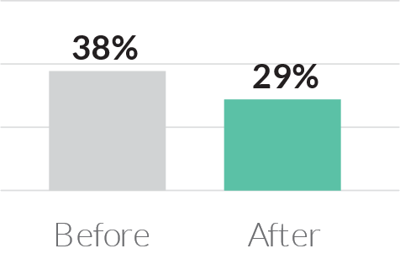
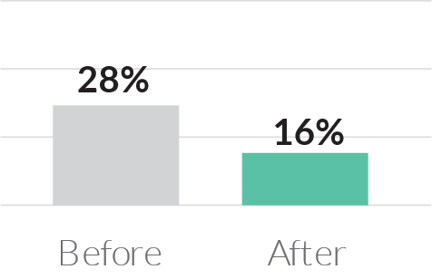
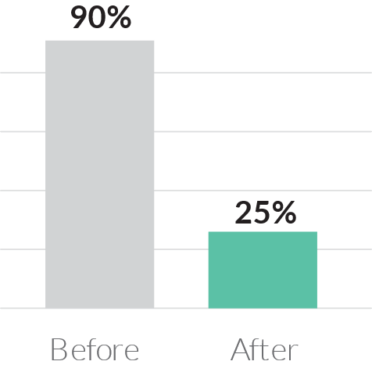
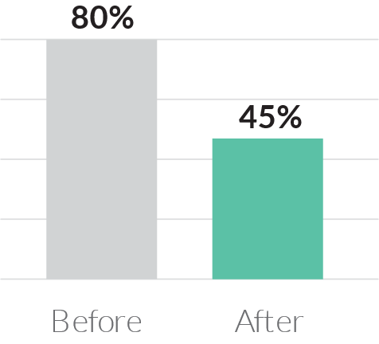
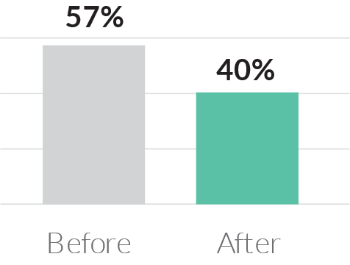
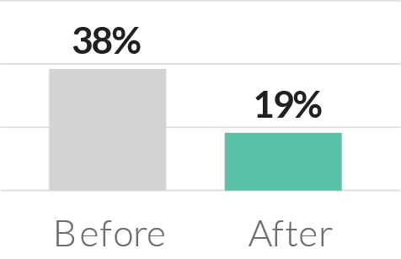
Case Studies - Turnover Reduction at Call Centers
29%
Average reduction in
turnover in year 1 across all customers
Financial Services
(Loan Processing Agents)
24% Reduction
Financial Services
(Customer Support)
50% Reduction
Financial Services
(Sales)
50% Reduction
Telecommunications
(Virtual Receptionists)
72% Reduction
Health & Nutrition
(Customer Support)
49% Reduction
Aviation
(Logistics Coordinator)
30% Reduction
Health Care
(Technical Support)
44% Reduction

Slide 34
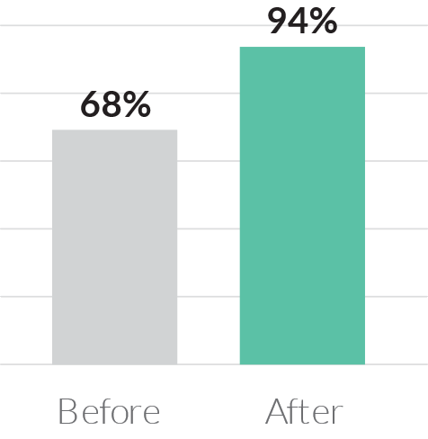
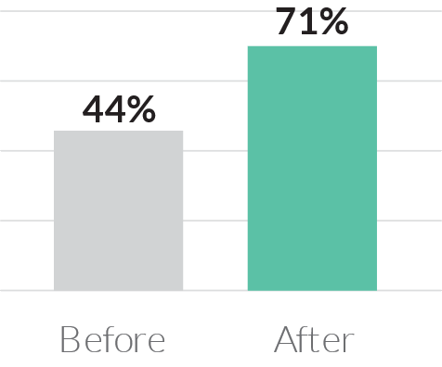
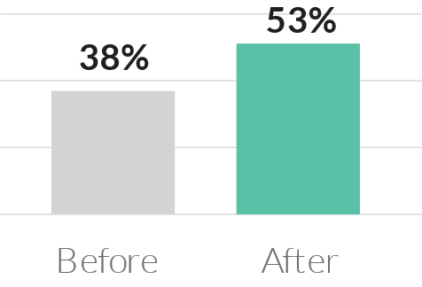
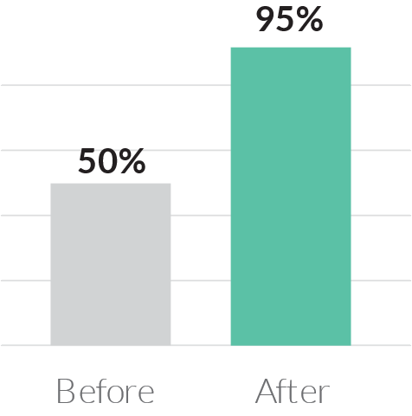
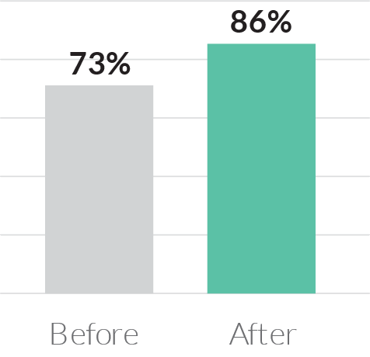
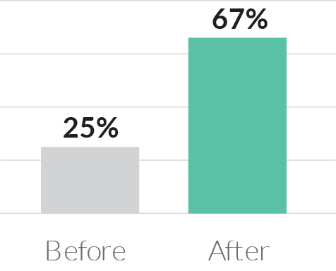
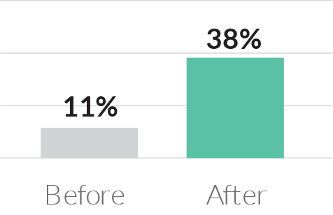


Case Studies – Performance Improvement at Call Centers
33%
Average reduction in
turnover in year 1 across all customers
Financial Services
(Loan Processing Agents)
61% Increase
Financial Services
(Customer Support)
38% Increase
Financial Services
(Sales)
39% Increase
Call Center
(Virtual Receptionists)
90% Increase
Call Center
(Customer Support)
168% Increase
Software
(Sales)
245% Increase
Health & Nutrition
(Customer Support)
18% Increase

Slide 35
Overall Performance
% of hires with great or exceptional overall performance increased by 168% since beginning of partnership.
CASE STUDY
168%
67%
67%
Increase in Overall Performance
50%
50%
50%
45%
43%
7%
50%
43%
17%
41%
33%
38%
45%
14%
29%
33%
5%
36%
29%
27%
38%
29%
25%
4%
29%
18%
13%
9%
13%
Q1
2019
Q2
2019
Q3
2019
Q4
2019
Q1
2020
Q1
2020
Q4
2020
Q2
2021
Q3
2021
Q4
2021
Q1
2022
Q2
2022
Period When Hired
Exceptional
Great

Slide 36
Compliance QA Scores
% of hires with good or higher Compliance QA Scores has increased by 41% across new hires
CASE STUDY
41%
90%
Increase in hires with good or higher compliance QA score
73%
59%
2019
2020
2021
Period When Hired

Slide 37
Performance Improvement Year Over Year
CASE STUDY
Schedule Adherence
Compliance QA Score
Coachable Survey
Call to Booking
% of hires with exceptional Schedule Adherence have increased by 92% across new hires
% of hires with good or higher Compliance QA scores has increased by 41% across new hires
% of hires with good or higher Coachable Scores has increased by 14%
Call to booking rates have increased by 32% across new hires over life of partnership
90%
90%
84%
85%
78%
50%
73%
8%
51%
17%
38%
59%
28%
39%
41%
38%
35%
31%
30%
Exceptional
Great
Good
22%
12%
24%
38%
37%
40%
7%
29%
20%
14%
12%
33%
24%
24%
22%
17%
14%
10%
10%
3%
5%
2020
2021
2022
2020
2021
2022
2020
2021
2022
2019
2020
2021
2022
Period When Hired
Period When Hired
Period When Hired
Period When Hired

Slide 38
Graphic Elements

Slide 39
















1
2
3
4
5
in appendix, give them red cross & green checks
And / or a graphic icon pack
You can change the colors of these

Slide 40











Headshot of everyone

Slide 41
JF Colors
2023-06
20E0B2
3CB1E5
D62CFF
F21D8D
00C9CB
8C68F2
ED00C7

Slide 42
Dot patterns

Slide 43



Slide 45


