Slide 1

Business Review
Prepared for : Blake @ KeHE
Prepared by : Cody & Ryan @ Journeyfront
Prepared on : May 25, 2023

Slide 2

ACME
Prepared for : Blake @ KeHE
Prepared by : Cody & Ryan @ Journeyfront
Prepared on : May 25, 2023

Slide 3
Key Objectives Today
Looking forward to today’s conversation. The goal of today’s call is to align on our partnership to date, and discuss some of the highlights we’ve seen in our work together. Then, we will talk through the next steps for our partnership, and what we’d like to achieve with you over the next {Quarter/Year}, as well as some trends we’re seeing from your peers. If everything looks good, we can then discuss next steps. Does that sound good?
This will be a talking point to the customer with a bullet point or 2 providing callouts

Slide 4



Agenda
1. Partnership Summary
2. Progress to Date
3. Data Review and Highlights
4. 2023 Strategy
5. Next Steps

Slide 5
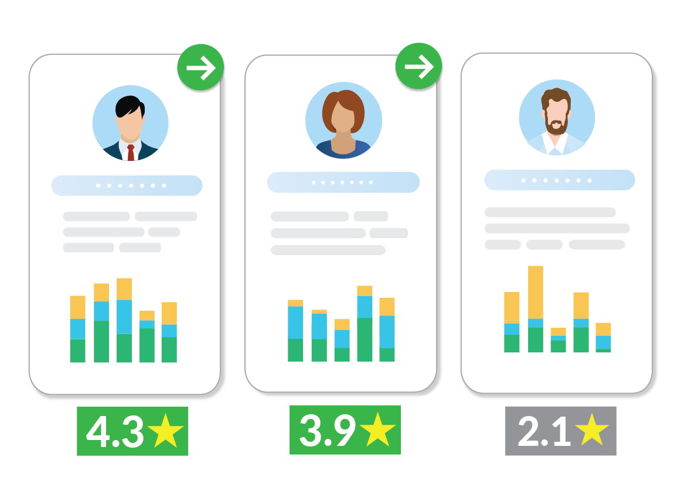

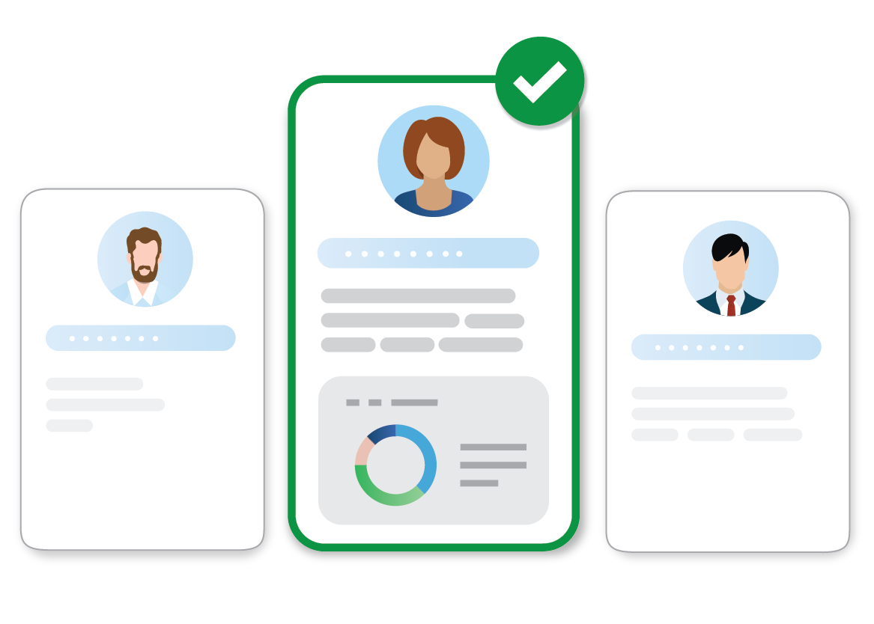
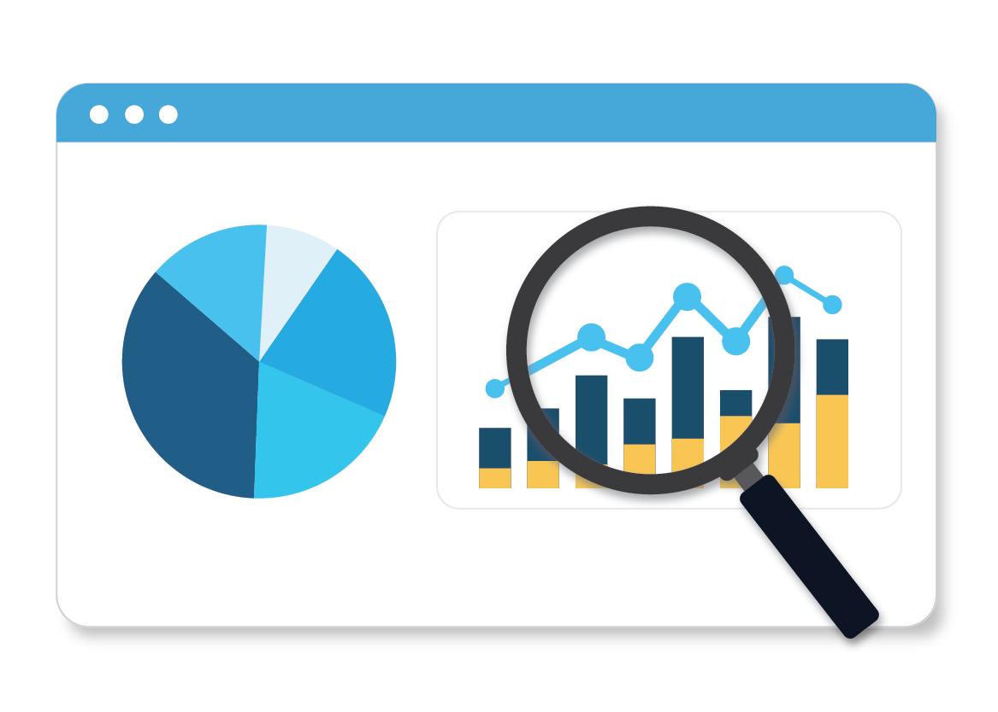

Optimize The Entirety Of Your Hiring Process
Automated Screening
Digital Interviewing
Hiring Scorecards
Tracking & Optimization
Screening Questions
Video Interview
Job Previews
Predictive Assessments
Job Simulations
Skills Tests
Language Proficiency Tests
Interview Guides
Scoring Rubrics
Question Library
Interview Templates
Aggregate Candidate Scorecards
Advanced Candidate Filtering & Sorting
Hiring Funnel Reporting & Analytics
Turnover/Performance, Collection, Reporting & Analytics
Hiring Optimization Reporting & Analytics

Slide 6
JOURNEYFRONT OFFERING
Software Tools & Professional Services

Slide 7


STANDARD OFFERING
OPTIONAL ADD-ONS
SOFTWARE TOOLS
SOFTWARE TOOLS
SCREENING QUESTIONS
Efficiently screen and filter applicants based on job requirements using candidate screening questions.
VIDEO INTERVIEW
Record candidate audio or video responses to key questions during the application and score later at your convenience.
EMBEDDED COMPANY/JOB PREVIEWS
Embed video into the application process that shows candidates a preview of what they can expect from the job and self-select in or out based on perceived job fit.
DIGITAL INTERVIEW GUIDES
Build and use structured, digital interview guides to maximize interviewer effectiveness. Guide interviewers with topics to cover, example questions, scoring rubrics, and a place to leave notes and scores.
DIGITAL SCORECARDS
Aggregate all candidate insights into easy-to-use, customizable scorecards to increase the speed and accuracy of your hiring decisions.
ADVANCED CANDIDATE SORTING/FILTERING
Auto-filter and sort all applicants based on insights collected across the steps of the hiring process
HIRING FUNNEL REPORTING & ANALYTICS
All your hiring funnel data displayed across numerous dashboards to gather insights about your hiring funnel.
PERFORMANCE/TURNOVER TRACKING, REPORTING & ANALYTICS
Collect or import employee performance and turnover data and track patterns over time, including predictive insights.
HIRING OPTIMIZATION REPORTING & ANALYTICS
All your hiring data analyzed and reported against key post-hire outcomes (performance/turnover) to facilitate continuous data-driven improvements.
PREDICTIVE BEHAVIORAL ASSESSMENTS
Behavioral assessments designed to predict candidate job performance and retention based on insights continually found in employee/candidate data.
JOB SIMULATIONS
Measure candidate ability using job-relevant off the shelf or custom skills tests.
SKILLS TESTS
Measure candidate ability using job-relevant off the shelf or custom skills tests.
LANGUAGE PROFICIENCY TESTS
Evaluate speaking and writing proficiency skills in 10+ languages via automated language assessments; basic language assessments also available in other languages.
CAREER PATHWAYS TOOL
Match employees or candidates to job and career pathways within your company, improving job matching and internal mobility / retention.
ATS INTEGRATION
Integrate Journeyfront with your ATS for a seamless candidate and hiring team experience.
HRIS INTEGRATION
Integrate Journeyfront with your HRIS for candidate employee performance and turnover data collection.
SINGLE SIGN ON
Collect or import employee performance and turnover Integrate Journeyfront with your SSO provider to increase security and simplify system and user management.
PROFESSIONAL SERVICES
PROFESSIONAL SERVICES
DEDICATED CUSTOMER SUCCESS MANAGER
A dedicated Customer Success Manager to work with you from implementation on to ensure you're getting the most from the Journeyfront partnership.
ONGOING SUPPORT
Structured guidance and assistance in setting up your account and getting started with Journeyfront.
ONBOARDING
Dedicated account manager will provide structured guidance and assistance in setting up your account and getting started with Journeyfront.
LIVE TRAINING
Live trainings for your team on how to use and get the most value from the product, including client best practices.
SCREENING PLAN / INTERVIEW MIGRATION
A dedicated team to migrate your pre-existing screening plans (found in other systems, google docs, etc.) into your Journeyfront account for you.
CANDIDATE EVALUATION PLAN CREATION SERVICE
A team of Journeyfront experts to build screening plans on your behalf, based on your needs as well as hiring best practices and extensive client experience.
JOB PREVIEW VIDEO CREATION
A film crew to create video-based job previews on your behalf that help candidates know what to expect in the job. Includes scoping, filming and editing.
DATA IMPORTS & MANAGEMENT
Journeyfront data experts to manage data imports on your behalf to maintain key dashboards within your account from external systems if needed.
INSTRUMENT MONITORING & IMPROVEMENTS
A team of experts to monitor the effectiveness of your measurement tool(s) and improve measures as needed to drive key outcomes.
CUSTOM DASHBOARD CREATION SERVICES
A team of business intelligence experts and data engineers to build and add custom dashboards to your Journeyfront account to fit your unique needs.
CUSTOM ANALYSIS
A team of data experts to analyze your data and build reports and/or presentation(s) of findings, helping you tackle your unique hiring challenges or opportunities.
EXPERT GUIDANCE & CONSULTING
Extra help addressing your most significant hiring challenges or opportunities from our team of hiring and data experts. Includes custom analytics if/when needed.
Journeyfront, Inc. © 2023
Notes:
TURNOVER > SOFTWARE: Behavioral Assessment Pro, Realistic Job Preview Pro, Job Simulation Pro, Interview Pro, Screening Questions Pro, Integration Pro
PERFORMANCE > SOFTWARE: Skills Test Pro, Job Simulation Pro, Behavioral Assessment Pro, Interview Pro, Screening Questions Pro, Integration Pro
STRUCTURE/AUTOMATION > SOFTWARE: Interview Pro, Screening Questions Pro, Behavioral Assessments Pro, Integration Pro
STANDARD: PROFESSIONAL SERVICES: Set-up Pro, Job Analysis Pro, Data Management Pro, Customer Analytics Pro, Integration Pro, Real Time Monitoring
Available Add-ons:SOFTWARE > Language Test Pro, Realistic Job Preview Pro (Amanda - I know this is duplicative with what’s above. it’s fine, just add it and I’ll change later)
SERVICES> Customer Measurement Creation - A La Carte
AMANDA - IN STANDARD SOFTWARE - PLEASE ADD ‘Advanced Scorecards’, ‘Predictive Analytics’.

Slide 8
STANDARD OFFERING
Software Tools & Professional Services

Slide 9
STANDARD OFFERING
1
SOFTWARE TOOLS
SCREENING QUESTIONS
Efficiently screen and filter applicants based on job requirements using candidate screening questions.
VIDEO INTERVIEW
Record candidate audio or video responses to key questions during the application and score later at your convenience.
EMBEDDED COMPANY/JOB PREVIEWS
Embed video into the application process that shows candidates a preview of what they can expect from the job and self-select in or out based on perceived job fit.
DIGITAL INTERVIEW GUIDES
Build and use structured, digital interview guides to maximize interviewer effectiveness. Guide interviewers with topics to cover, example questions, scoring rubrics, and a place to leave notes and scores.
DIGITAL SCORECARDS
Aggregate all candidate insights into easy-to-use, customizable scorecards to increase the speed and accuracy of your hiring decisions.
ADVANCED CANDIDATE SORTING/FILTERING
Auto-filter and sort all applicants based on insights collected across the steps of the hiring process
HIRING FUNNEL REPORTING & ANALYTICS
All your hiring funnel data displayed across numerous dashboards to gather insights about your hiring funnel.
PERFORMANCE/TURNOVER TRACKING, REPORTING & ANALYTICS
Collect or import employee performance and turnover data and track patterns over time, including predictive insights.
HIRING OPTIMIZATION REPORTING & ANALYTICS
All your hiring data analyzed and reported against key post-hire outcomes (performance/turnover) to facilitate continuous data-driven improvements.
Notes:
TURNOVER > SOFTWARE: Behavioral Assessment Pro, Realistic Job Preview Pro, Job Simulation Pro, Interview Pro, Screening Questions Pro, Integration Pro
PERFORMANCE > SOFTWARE: Skills Test Pro, Job Simulation Pro, Behavioral Assessment Pro, Interview Pro, Screening Questions Pro, Integration Pro
STRUCTURE/AUTOMATION > SOFTWARE: Interview Pro, Screening Questions Pro, Behavioral Assessments Pro, Integration Pro
STANDARD: PROFESSIONAL SERVICES: Set-up Pro, Job Analysis Pro, Data Management Pro, Customer Analytics Pro, Integration Pro, Real Time Monitoring
Available Add-ons:SOFTWARE > Language Test Pro, Realistic Job Preview Pro (Amanda - I know this is duplicative with what’s above. it’s fine, just add it and I’ll change later)
SERVICES> Customer Measurement Creation - A La Carte
AMANDA - IN STANDARD SOFTWARE - PLEASE ADD ‘Advanced Scorecards’, ‘Predictive Analytics’.

Slide 10


STANDARD OFFERING
2
PROFESSIONAL SERVICES
DEDICATED CUSTOMER SUCCESS MANAGER
A dedicated Customer Success Manager to work with you from implementation on to ensure you're getting the most from the Journeyfront partnership.
ONBOARDING
Dedicated account manager will provide structured guidance and assistance in setting up your account and getting started with Journeyfront.
LIVE TRAINING
Live trainings for your team on how to use and get the most value from the product, including client best practices.
ONGOING SUPPORT
Structured guidance and assistance in setting up your account and getting started with Journeyfront.
Notes:
TURNOVER > SOFTWARE: Behavioral Assessment Pro, Realistic Job Preview Pro, Job Simulation Pro, Interview Pro, Screening Questions Pro, Integration Pro
PERFORMANCE > SOFTWARE: Skills Test Pro, Job Simulation Pro, Behavioral Assessment Pro, Interview Pro, Screening Questions Pro, Integration Pro
STRUCTURE/AUTOMATION > SOFTWARE: Interview Pro, Screening Questions Pro, Behavioral Assessments Pro, Integration Pro
STANDARD: PROFESSIONAL SERVICES: Set-up Pro, Job Analysis Pro, Data Management Pro, Customer Analytics Pro, Integration Pro, Real Time Monitoring
Available Add-ons:SOFTWARE > Language Test Pro, Realistic Job Preview Pro (Amanda - I know this is duplicative with what’s above. it’s fine, just add it and I’ll change later)
SERVICES> Customer Measurement Creation - A La Carte
AMANDA - IN STANDARD SOFTWARE - PLEASE ADD ‘Advanced Scorecards’, ‘Predictive Analytics’.

Slide 11
OPTIONAL ADD-ONS

Slide 12
OPTIONAL ADD-ONS
1
SOFTWARE TOOLS
PREDICTIVE BEHAVIORAL ASSESSMENTS
Behavioral assessments designed to predict candidate job performance and retention based on insights continually found in employee/candidate data.
JOB SIMULATIONS
Measure candidate ability using job-relevant off the shelf or custom skills tests.
SKILLS TESTS
Measure candidate ability using job-relevant off the shelf or custom skills tests.
LANGUAGE PROFICIENCY TESTS
Evaluate speaking and writing proficiency skills in 10+ languages via automated language assessments; basic language assessments also available in other languages.
CAREER PATHWAYS TOOL
Match employees or candidates to job and career pathways within your company, improving job matching and internal mobility / retention.
ATS INTEGRATION
Integrate Journeyfront with your ATS for a seamless candidate and hiring team experience.
HRIS INTEGRATION
Integrate Journeyfront with your HRIS for candidate employee performance and turnover data collection.
SINGLE SIGN ON
Collect or import employee performance and turnover Integrate Journeyfront with your SSO provider to increase security and simplify system and user management.
Notes:
TURNOVER > SOFTWARE: Behavioral Assessment Pro, Realistic Job Preview Pro, Job Simulation Pro, Interview Pro, Screening Questions Pro, Integration Pro
PERFORMANCE > SOFTWARE: Skills Test Pro, Job Simulation Pro, Behavioral Assessment Pro, Interview Pro, Screening Questions Pro, Integration Pro
STRUCTURE/AUTOMATION > SOFTWARE: Interview Pro, Screening Questions Pro, Behavioral Assessments Pro, Integration Pro
STANDARD: PROFESSIONAL SERVICES: Set-up Pro, Job Analysis Pro, Data Management Pro, Customer Analytics Pro, Integration Pro, Real Time Monitoring
Available Add-ons:SOFTWARE > Language Test Pro, Realistic Job Preview Pro (Amanda - I know this is duplicative with what’s above. it’s fine, just add it and I’ll change later)
SERVICES> Customer Measurement Creation - A La Carte
AMANDA - IN STANDARD SOFTWARE - PLEASE ADD ‘Advanced Scorecards’, ‘Predictive Analytics’.

Slide 13
OPTIONAL ADD-ONS
2
PROFESSIONAL SERVICES
SCREENING PLAN / INTERVIEW MIGRATION
A dedicated team to migrate your pre-existing screening plans (found in other systems, google docs, etc.) into your Journeyfront account for you.
CANDIDATE EVALUATION PLAN CREATION SERVICE
A team of Journeyfront experts to build screening plans on your behalf, based on your needs as well as hiring best practices and extensive client experience.
JOB PREVIEW VIDEO CREATION
A film crew to create video-based job previews on your behalf that help candidates know what to expect in the job. Includes scoping, filming and editing.
DATA IMPORTS & MANAGEMENT
Journeyfront data experts to manage data imports on your behalf to maintain key dashboards within your account from external systems if needed.
INSTRUMENT MONITORING & IMPROVEMENTS
A team of experts to monitor the effectiveness of your measurement tool(s) and improve measures as needed to drive key outcomes.
CUSTOM DASHBOARD CREATION SERVICES
A team of business intelligence experts and data engineers to build and add custom dashboards to your Journeyfront account to fit your unique needs.
CUSTOM ANALYSIS
A team of data experts to analyze your data and build reports and/or presentation(s) of findings, helping you tackle your unique hiring challenges or opportunities.
EXPERT GUIDANCE & CONSULTING
Extra help addressing your most significant hiring challenges or opportunities from our team of hiring and data experts. Includes custom analytics if/when needed.
Notes:
TURNOVER > SOFTWARE: Behavioral Assessment Pro, Realistic Job Preview Pro, Job Simulation Pro, Interview Pro, Screening Questions Pro, Integration Pro
PERFORMANCE > SOFTWARE: Skills Test Pro, Job Simulation Pro, Behavioral Assessment Pro, Interview Pro, Screening Questions Pro, Integration Pro
STRUCTURE/AUTOMATION > SOFTWARE: Interview Pro, Screening Questions Pro, Behavioral Assessments Pro, Integration Pro
STANDARD: PROFESSIONAL SERVICES: Set-up Pro, Job Analysis Pro, Data Management Pro, Customer Analytics Pro, Integration Pro, Real Time Monitoring
Available Add-ons:SOFTWARE > Language Test Pro, Realistic Job Preview Pro (Amanda - I know this is duplicative with what’s above. it’s fine, just add it and I’ll change later)
SERVICES> Customer Measurement Creation - A La Carte
AMANDA - IN STANDARD SOFTWARE - PLEASE ADD ‘Advanced Scorecards’, ‘Predictive Analytics’.

Slide 14
The
HIRING ACCURACY Process
2
Identify What Attributes Matter
1
3
Define Desired Outcomes
Decide on Measurements
8
Currently We Are Here
4
Make Changes (Optimize)
Evaluate Applicants
7
5
Analyze the “Closed Loop”
Hire Based on Scores
6
Track Outcomes

Slide 15
Executive Partnership Summary
Initial Goals
Our focus when we kicked off our partnership
Objective A:
Objective B:
Objective C:
Objective D:
Objective E:
Accomplished to Date
Since then, we’ve (state top 2 - 3 deliverables and goals achieved. Ex: Increased conversion on 3x, implemented internal campaign with a 36-hr concept to launch timeline, and contributed to 15% increase in ratings.
Next Phase
As we look ahead to [Q3], and [2023], our focus will be on x, y, and z.

Slide 16
2022 History of the Virtual Receptionist
February 2022
April 2022
June 2022
July 2022
Oct/Nov 2022
Jan 2023
1st Adjustment
2nd Adjustment
3rd Adjustment
4th Adjustment
5th Adjustment
6th Adjustment
JF Recommended
Replaced:
Performance Model
Pre-screen Ambition question to Video Response
Updated scoring criteria in interviews
PATLive Requested Changes
Removed:
6 Interview questions
Added:
4 Interview questions: Coping ability, Employee quote, Integrity, Real Job Preview
PATLive Requested Changes
Replaced:
Phone interview and Video interview were combined
Removed:
1 Pre-screen question
1 Interview question: disrespectful customers
Added:
Created Kickoff Step in stages
JF Recommended:
Separated Pre-Screen and Job Preview into 2 different activities
Removed:
Question about min hours per day available to work
Added:
Attribute questions targeting Increased Conflict Tolerance & Reduced Conflict Tolerance
JF Recommended:
Recombined the Pre-screen and Job Preview into 1 activity
PATLive Requested:
Removed interview question that was optional if applicant had issues hearing or recording their pre-screen questions.
JF Recommended:
Added the new 30-day turnover model
Removed Satisfaction Model
PATLive Requested:
Changed the video response to an audio response
JF Recommended:
Added the new 30-day turnover model
Removed Satisfaction Model
PATLive Requested:
Changed the video response to an audio response
Notes:
Before we dive into our suggestions we want to first review what initiatives we’ve done and how they have helped us.

Slide 17
Goals of Journeyfront / {Customer Name} Partnership
1
Help {Customer} reduce short-term turnover in high-volume hiring roles Journeyfront track record: 15-40% turnover reduction; Pays for itself after 2% reduction*
2
Help {Customer} execute a more effective, structured hiring process
“A structured hiring process is 5x more effective than an unstructured hiring process”, according to research
3
Give {Customer} data insights for how to improve the hiring process over time
Journeyfront helps track performance / turnover by hiring cohort and recommends ways to improve accuracy

Slide 18
Agenda
1. Partnership Summary
2. Progress to Date
3. Data Review and Highlights
4. 2023 Strategy
5. Next Steps

Slide 19
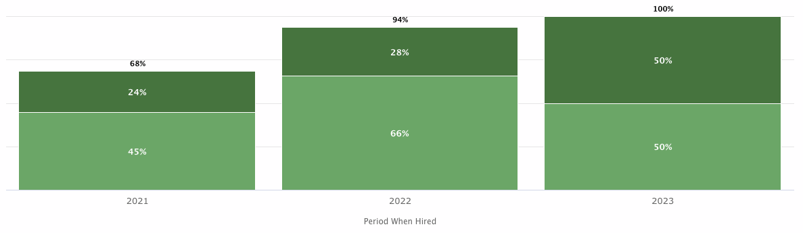
Objective 1: Improve New Hire Performance
% of Great or above hires has increased by 47% since 2021, 6% since 2022
Note: Great = 3.5-4.2; Exceptional = 4.3-5.0
N-sizes: 2021 = 26/38; 2022 = 180/192; 2023 YTD = 12/12
Source: Above data is based on Achieve CS performance reports: GPA BETA

Slide 20
Objective 2: Reduce 90 Days Turnover
The chart & text are the same here, need to change them?`
% of Great or above hires has increased by 47% since 2021, 6% since 2022
Note: Great = 3.5-4.2; Exceptional = 4.3-5.0
N-sizes: 2021 = 26/38; 2022 = 180/192; 2023 YTD = 12/12
Source: Above data is based on Achieve CS performance reports: GPA BETA

Slide 21
Agenda
1. Partnership Summary
2. Progress to Date
3. Data Review and Highlights
4. 2023 Strategy
5. Next Steps

Slide 22
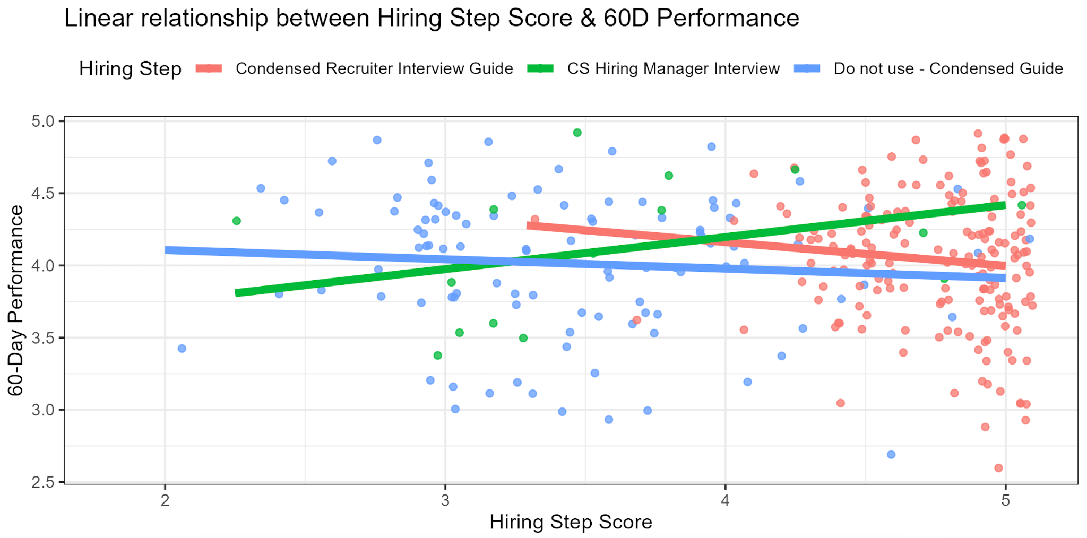
CS Hiring Step vs. 60-Day Performance
New hiring manager interview guide working better than the old one at predicting performance
60-Day Performance
Recommend we dive deeper into why the Recruiter Interview guide isn’t predicting 60-day performance
Hiring Step Score

Slide 23
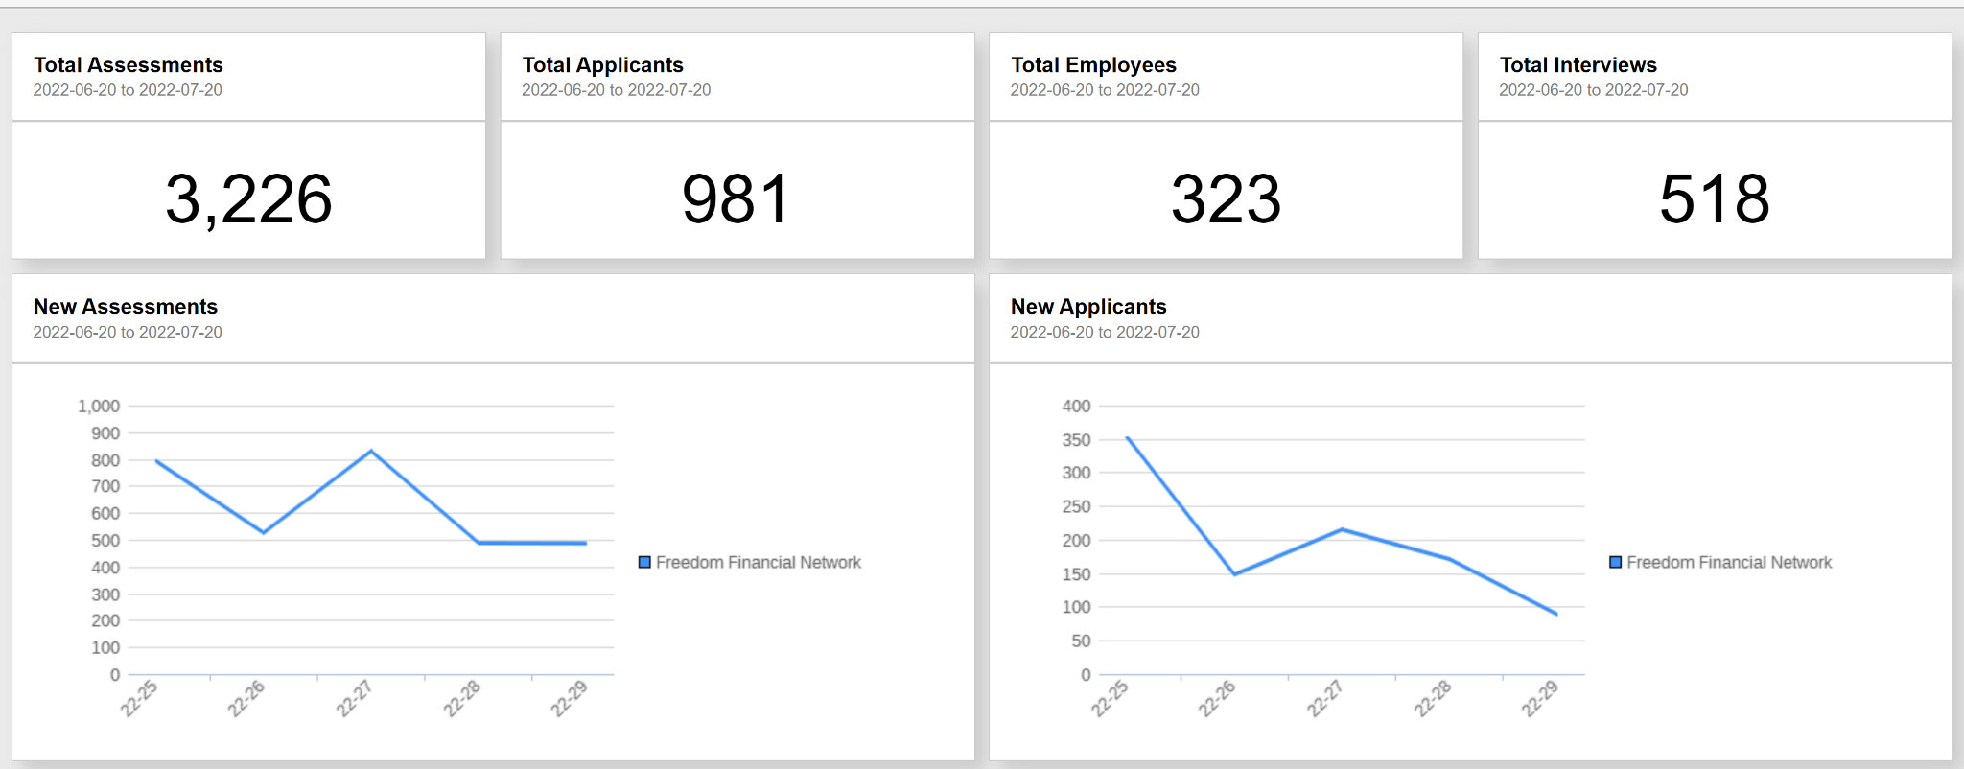
Data Usage

Slide 24
Partnership Adoption Overview
I can spend more time to update this slide if you want me to. I am trying to go quick as Nick asked.
Assessment+
Simulation and Skills Testing+
Interview+
Virtual Receptionist
Customer Service Agent
Virtual Assistant
Agent Contract
Total Applicants: 5,658
New Hires: 323
Job Req (new/edits): 14
Tools Used:
Assessment+
Simulation and Skills Testing
Interview+
Applicant score data
Current Employee assessment data
Predictive Models
Total Applicants: 198
New Hires: 11
Job Req (new/edits): 5
Tools Used:
Assessment+
Simulation and Skills Testing
Interview+
Applicant score data
Current Employee assessment data
Predictive Models
Total Applicants: 1
Job Req (new/edits): 1
Tools Used:
Assessment+
Applicant score data
Current Employee assessment data
Predictive Models
Total Applicants: 3,660
New Hires: 41
Job Req (new/edits): 1
Tools Used:
Assessment+
Simulation and Skills Testing
Interview+
Applicant score data
Predictive Models
Notes:
Kudos to team- a ton of usage coming through the product.

Slide 25


Screening ?’s Example: Transitioning from Reactive to Proactive Recruiting
Newer version slide in the next slide
Data below is illustrative (from an anonymous Journeyfront customer, NOT Achieve data)
Most productive hires came from specific Food Distribution employers
1
Least productive were NOT from non-traditional industries, but select warehouses

Slide 26

Productivity at 60 Days also varies significantly based on where DC workers work prior to KeHE
Warehouse Hires Based on Prior Employer & 60-Day Productivity
Least productive are NOT from non-traditional industries, but select warehouses
Most productive hires come from specific Food Distribution employers
This is an cleaner slide from a recent sales deck
Note: Above data is for ALL DC hires (selectors, forklift, loaders, receivers; Performance data is LMS % Productivity, normalized on1-5 scale
Notes:
We see that productivity also varies significantly based on where DC workers come from.
But here, our most productive warehouse workers come from specific food distribution companies.
And our least productive come from warehouse.
Note that they don’t come from Other non-traditional industries. Many of these non-traditional sectors perform quite well compared to their peers.
We’ll use this data to get strategic in where we target our recruiting efforts.

Slide 27
Example Screening Question Data: Source of Hire
Hires who are referred from current employees have 24% higher retention
Hires who are referred from current employees have 11% higher performance
Data below is illustrative (from an anonymous Journeyfront customer, NOT Achieve data)

Slide 28
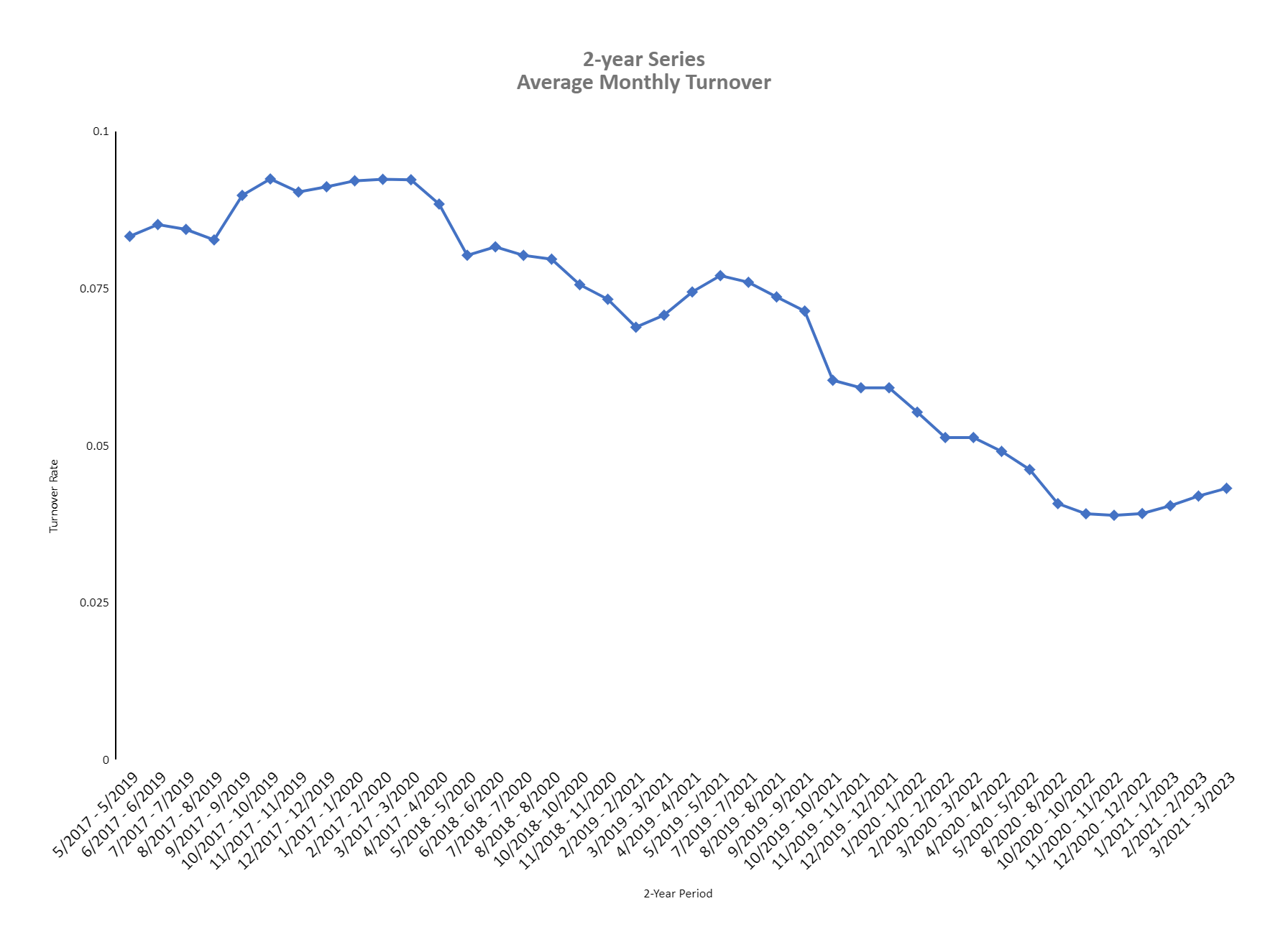
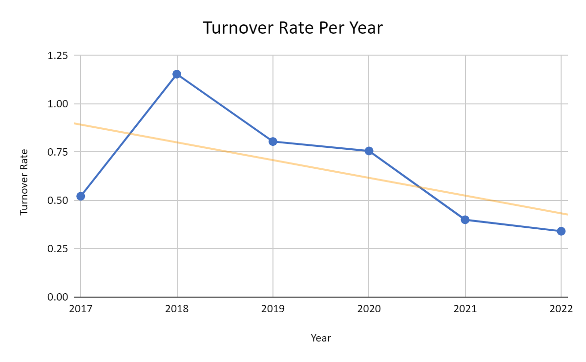
Steep Decline in Turnover Trend Over Time
2-Year Series Average Monthly Turnover
Turnover Rate Per Year
Notes:
explain what the graphs are showing before explaining the take-a-way. go from year to month. “Props to this partnership for these results”

Slide 29
2022 Turnover Trendline
Making it exciting in the next slide
2021 Turnover Rate: 300%
2022 Turnover Rate: 290%
Decreasing trendline throughout 2022
Make this slide more EXCITING!!
Notes:
This is what we’re focused on-we know this is still the central focus for your team. Let’s talk about what we’ve done to date, what’s working, what we want to do next.

Slide 30
2022 Turnover Trendline
50%
45%
40%
40%
40%
35%
300%
290%
36%
30%
Turnover Rate
29%
2021 Turnover Rate
2022 Turnover Rate
25%
20%
21%
22%
22%
18%
20%
20%
15%
16%
Decreasing Trendline Throughout 2022
10%
10%
Add other more details here
5%
0%
JAN
FEB
MAR
APR
MAY
JUN
JUL
AUG
SEP
OCT
NOV
DEC
Month in 2022
Notes:
This is what we’re focused on-we know this is still the central focus for your team. Let’s talk about what we’ve done to date, what’s working, what we want to do next.

Slide 31
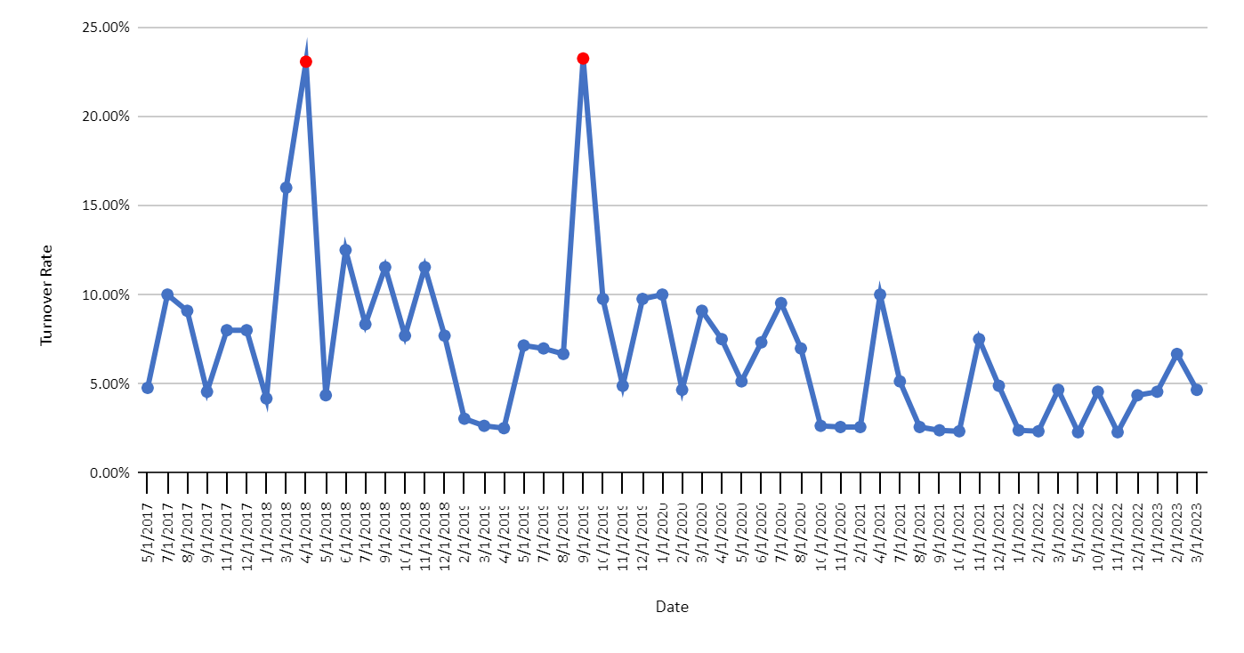
Less Extremes & Reduced Overall Monthly turnover Rate
Monthly Turnover Rate
Extreme Values Compared to Average Monthly Turnover
Notes:
Make the monthly text bigger so it’s easier to see. remove double decimal. How does this benefit “me”? - We’re talking about this now is to understand where we’re at today with turnover. While there’s a strong decrease overall, we see the upward trend recently and we’re here to discuss how to address that moving forward. Let’s get strategic here to prevent it from getting worse.

Slide 32
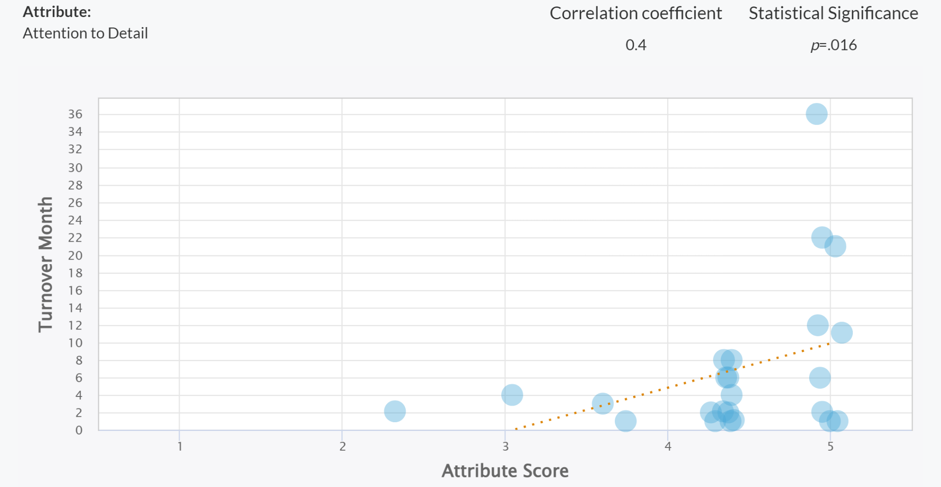
From Simulation: “Attention to Detail” measurement is leading to longer tenure
N Size = 24

Slide 33
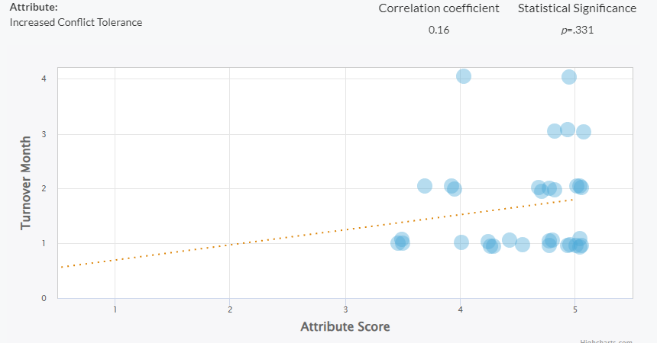
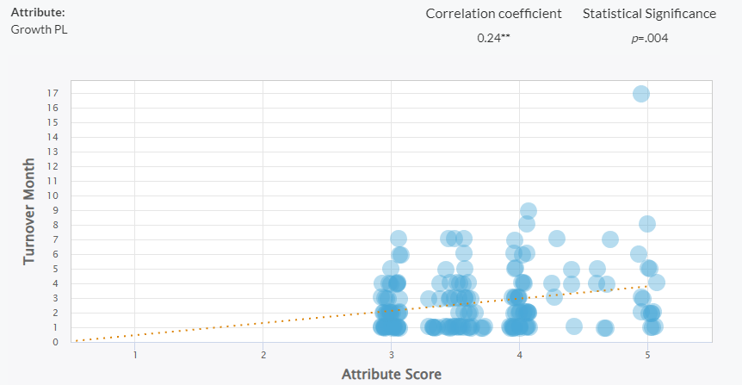
Prior Optimizations To Both Screening Questions And Interviews Are Showing Correlation With Short Term Turnover
Notes:
These optimizations are beginning to align in the effort to reduce turnover

Slide 34
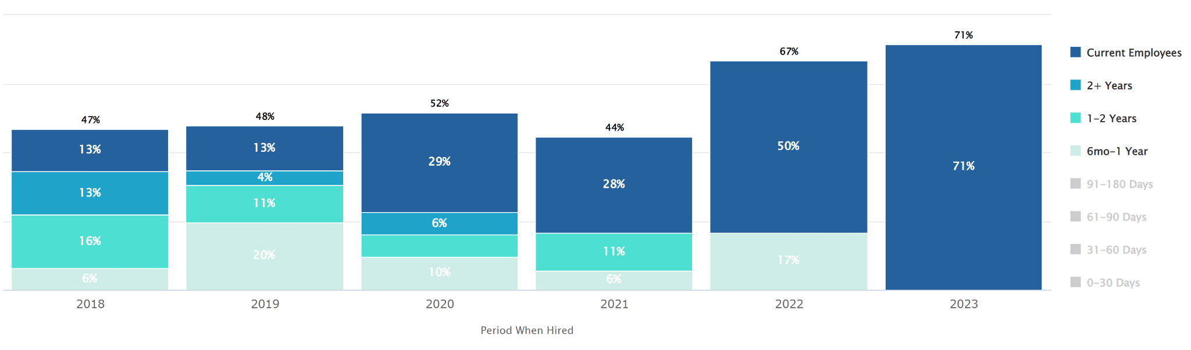
By June 67% Of Hires In 2022 Will Have Made It To The 6+ Months Of Tenure.
6/9 employees still employed have already achieved 6+ months of tenure.

Slide 35
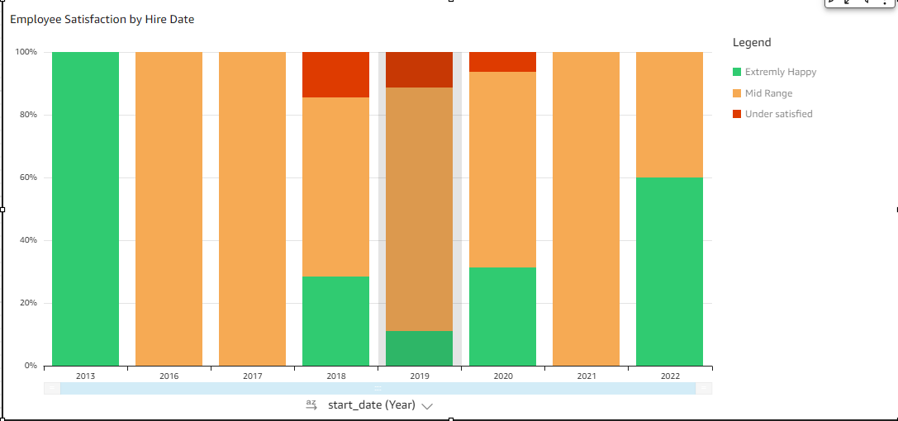
Satisfaction Tracking
Under Satisfied Employees have reduced since 2020
1
4
1
7
8
16
8
5
Collecting updated Satisfaction data can help us focus our efforts in reducing turnover

Slide 36
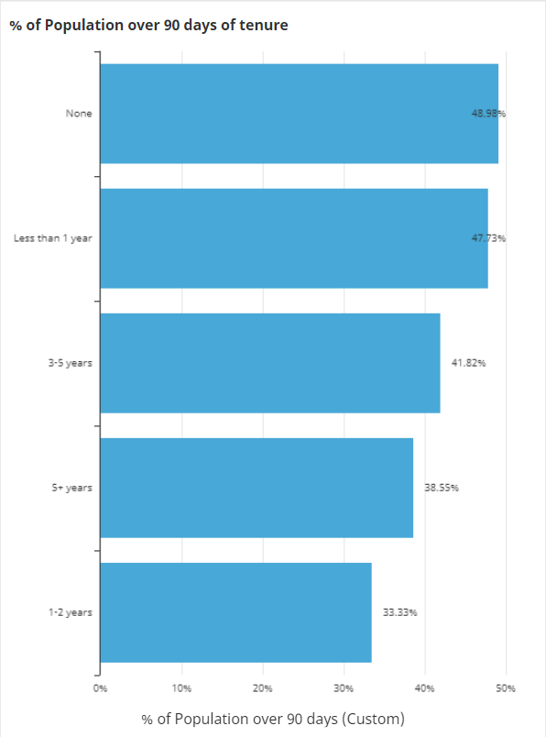
Call Center Experience Does Not Play Into Employee Tenure
Population =24
Population =21
We have discovered that employees who selected “None” or “Less than 1 year” made it to 90 days of tenure at higher rates than those who had more experience.
Population =23
Population =32
Population =22

Slide 37
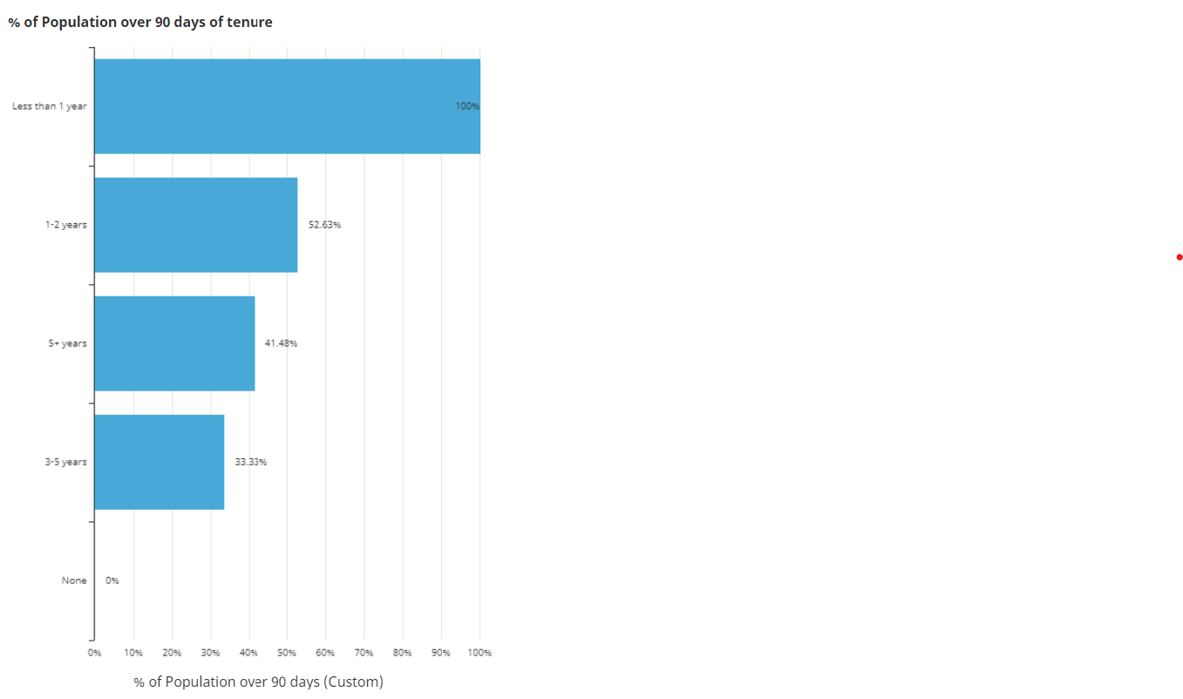
People With Less Customer Service Experience Tend To Stay Longer Than Those Who Have Higher
Population =10
Population =95
The more experience someone has in Customer Service, it increases their tenure
Population =15

Slide 38
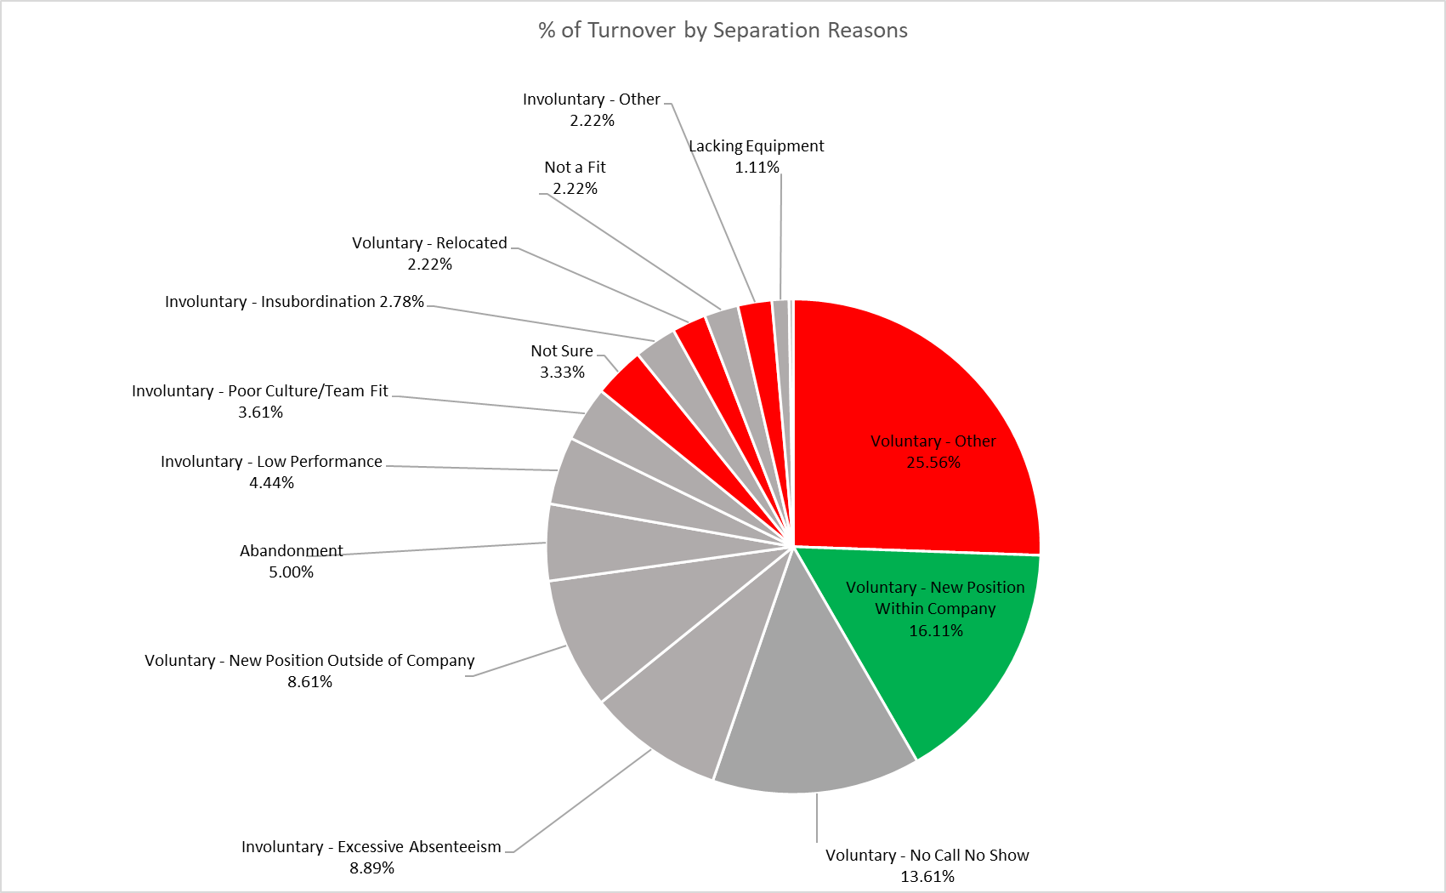
Hyper Focus on the big 3 (Excessive Absenteeism, No Call No Show, New Position)

Slide 39
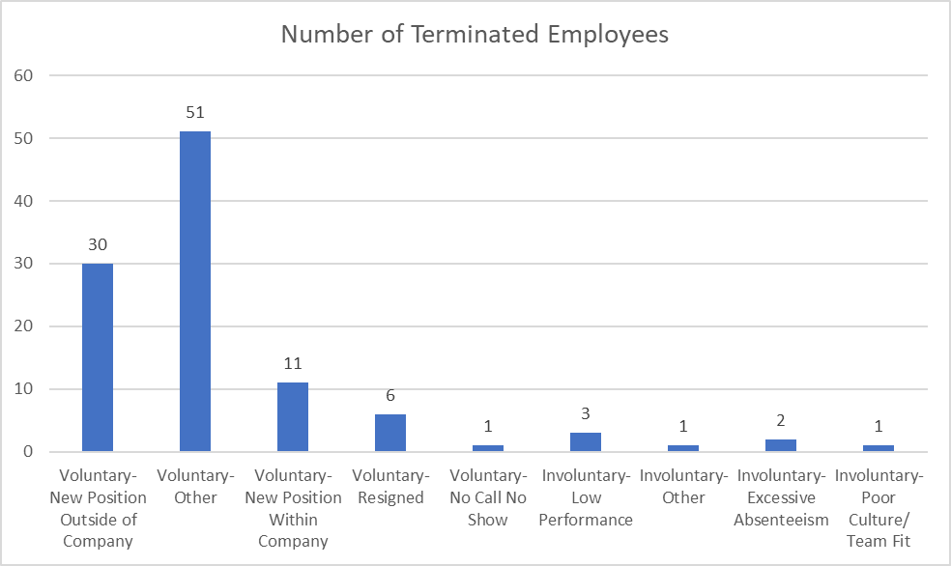
Customize Separation Reasons
More defined & customized separation reasons need to be recorded in order for us to target types of turnover more accurately.

Slide 40
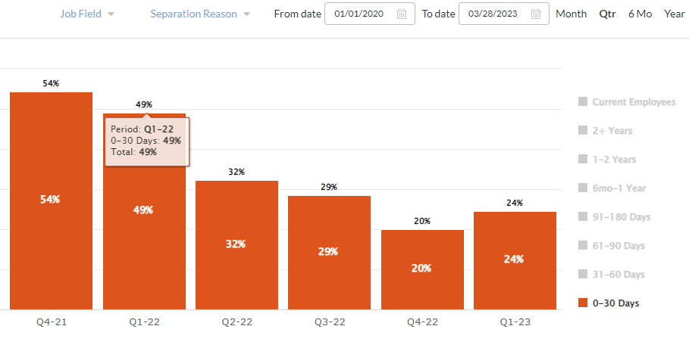
A Big Drop In 30-Day Turnover Since Launch
Notes:
Here’s the success of the turnover model so far. Caveat that these numbers might change some in April when we update data

Slide 41
Agenda
1. Partnership Summary
2. Progress to Date
3. Data Review and Highlights
4. 2023 Strategy
5. Next Steps

Slide 42
2
Duplicate Slide? I updated the style anyway.
- Yin
The
HIRING ACCURACY Process
Identify What Attributes Matter
1
3
Define Desired Outcomes
Decide on Measurements
8
4
Make Changes (Optimize)
Evaluate Applicants
7
5
Analyze the “Closed Loop”
Hire Based on Scores
6
Track Outcomes

Slide 43
Duplicate Slide?
Optimize The Entirety Of Your Hiring Process
Automated Screening
Digital Interviewing
Hiring Scorecards
Tracking & Optimization
Screening Questions
Video Interview
Job Previews
Predictive Assessments
Job Simulations
Skills Tests
Language Proficiency Tests
Interview Guides
Scoring Rubrics
Question Library
Interview Templates
Aggregate Candidate Scorecards
Advanced Candidate Filtering & Sorting
Hiring Funnel Reporting & Analytics
Turnover/Performance, Collection, Reporting & Analytics
Hiring Optimization Reporting & Analytics

Slide 44
2023 Strategy
As we look ahead to the rest of this year, and next, we see an opportunity to extend this impact at {CUSTOMER}.
What we are hearing more and more from our {industry} clients is that {Insert relevant insight}.
To address this, you need to be able to {Insert key capabilities}. Our plan is to {Insert how you solve for this/address these capabilities}.

Slide 45
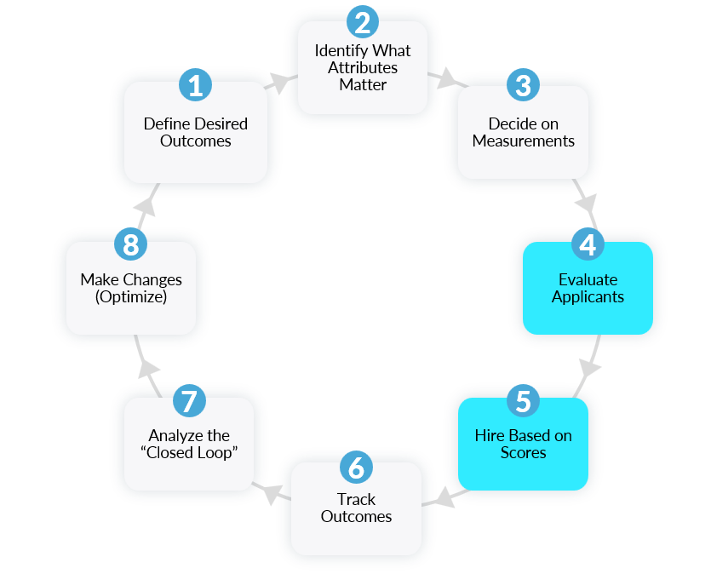
2023 Strategy: Planned Next Steps
3 Months
Initiative 1
Initiative 2
Initiative 3
Based on similar companies we expect to see “x goal” improve by “x” in the next 6 months

Slide 46
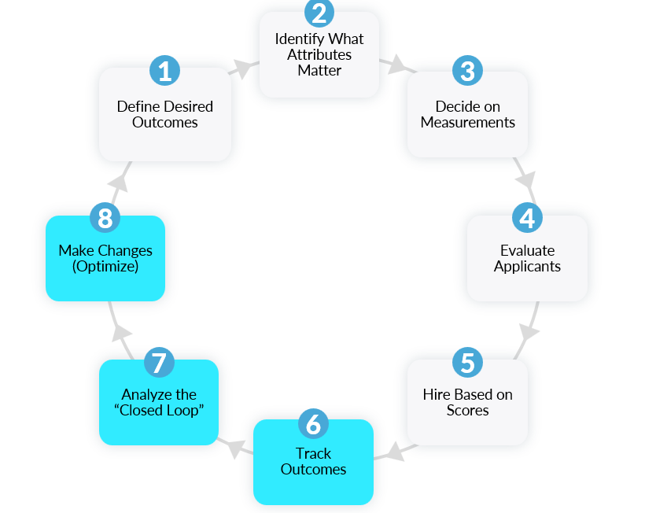
2023 Strategy: Planned Next Steps
6 Months
Initiative 1
Initiative 2
Initiative 3
Based on similar companies we expect to see “x goal” improve by “x” in the next 6 months

Slide 47
2023 Strategy: Planned Next Steps
3 Months
Initiative 1
Initiative 2
Initiative 3
6 Months
Initiative 1
Initiative 2
Initiative 3
Based on similar companies we expect to see “x goal” improve by “x” in the next 6 months

Slide 48
2023 Strategy Recommendation
Plan Ahead
Review the applicant’s scorecard and intended interview questions prior to meeting with the applicant.
Consistency
Ensure all hiring team members are using the same interviews and the same questions, and that they understand the scoring criteria.
Follow Through
Continue to introduce change management plan

Slide 49
Agenda
1. Partnership Summary
2. Progress to Date
3. Data Review and Highlights
4. 2023 Strategy
5. Next Steps

Slide 50
Next Steps
1
EOD we’ll do “X”
2
EOW we’ll do “x”
3
EOW we’ll do “x”
4
EOW we’ll do “x”

Slide 51
Next Steps
As we look ahead to the rest of this year, and next, we see an opportunity to extend this impact at {customer}{. What we are hearing more and more from our {industry} clients is that {insert relevant insights}.
To address this, you need to be able to {insert key capabilities}
Our plan is to {insert how you solve for this/address these capabilities}.
What initiatives are you currently working on that you see this aligning with?

Slide 52
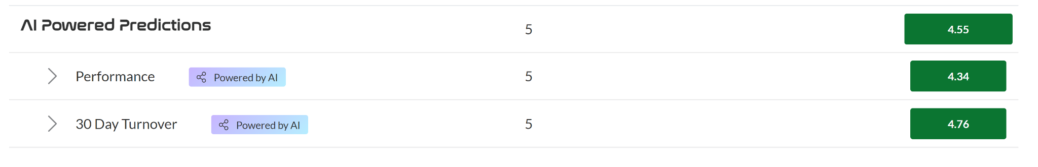
Creating a TURNOVER Model
We can create a turnover model that is specific to 6 mo-2+ years of tenure. When we can create it depends on what your target is.
We need just a few more data points before we create this model to ensure it’s confidence.
JF will assess internally each month to determine when we can create this model

Slide 53
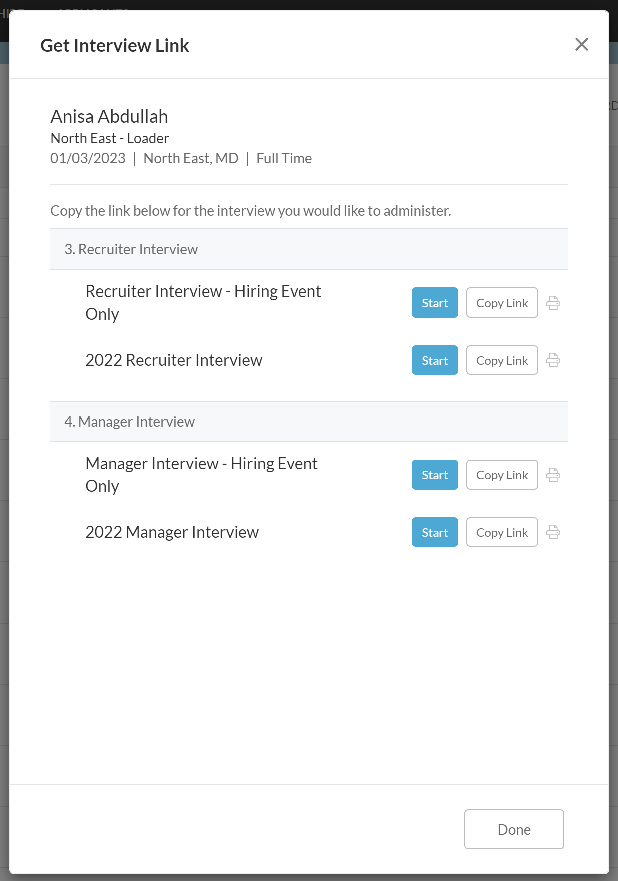
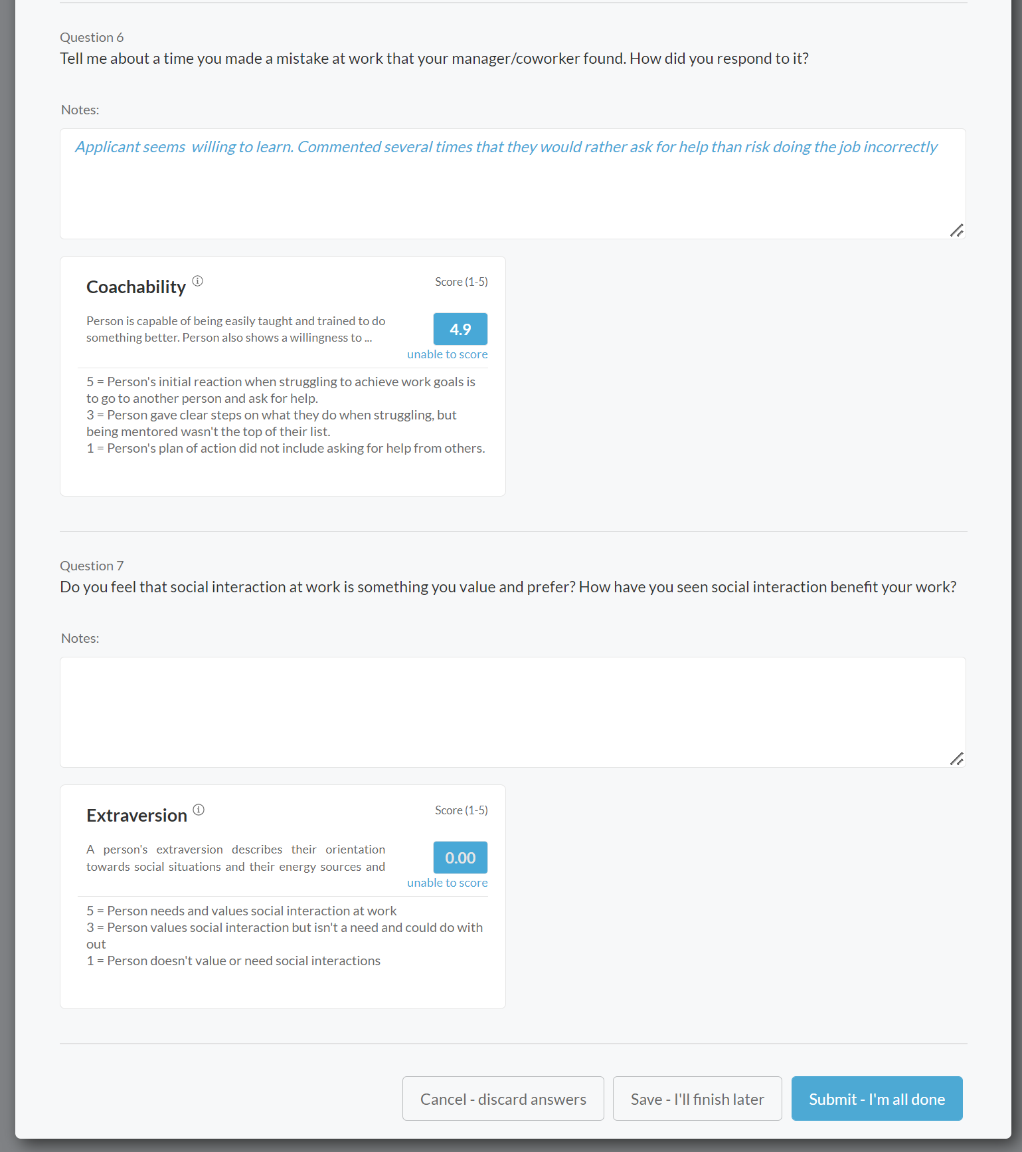
Driving Value using Interview Guides
Create structured processes to be followed while still allowing for branch specific customization
Customize how many interviews are created
Customize questions and target specific attributes
Customize interview types (phone, manager, recruiting event, etc.)
Track interviewer effectiveness
Improve efficiency –which questions correlate to longer tenure/ better performance, monitor time spent on interviews.

Slide 54
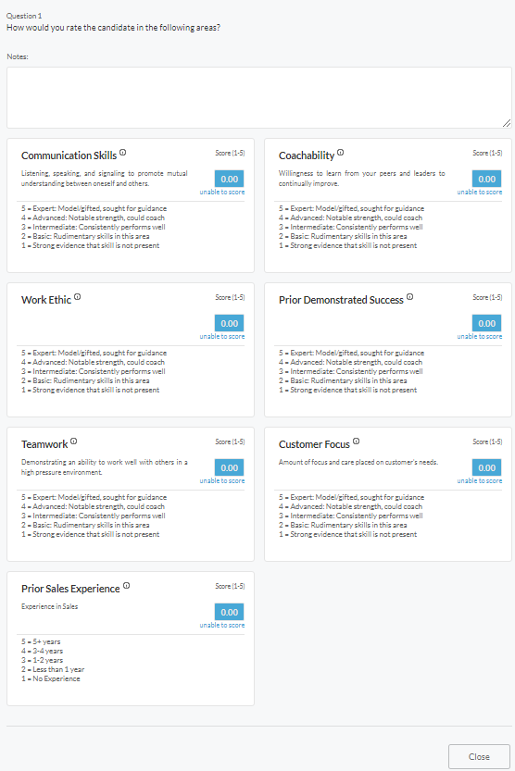
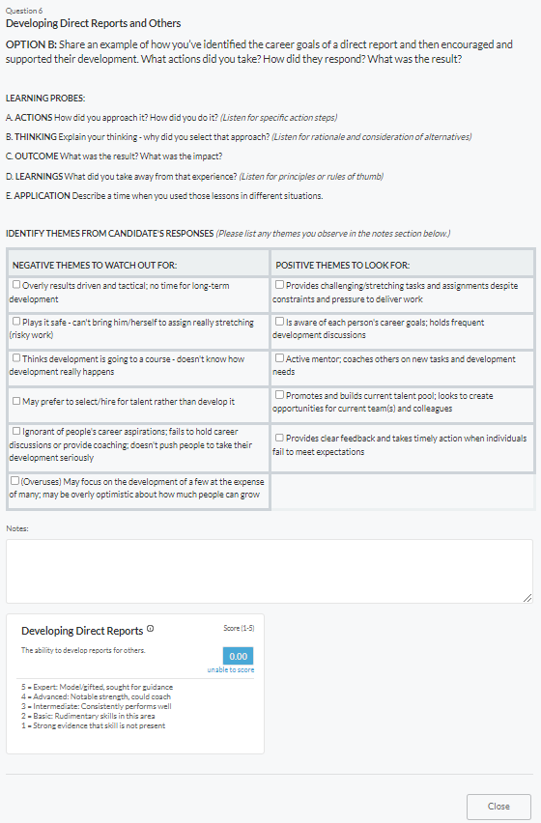
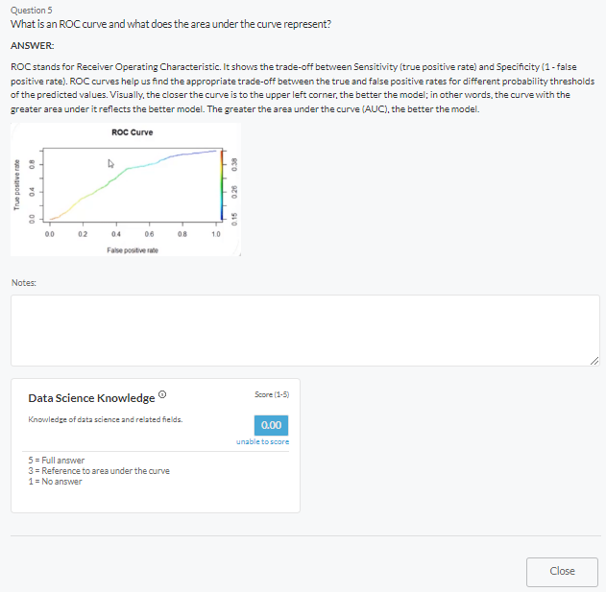
Interviews can be as simple or complex as you need
Easy
In-depth
Moderate

Slide 55
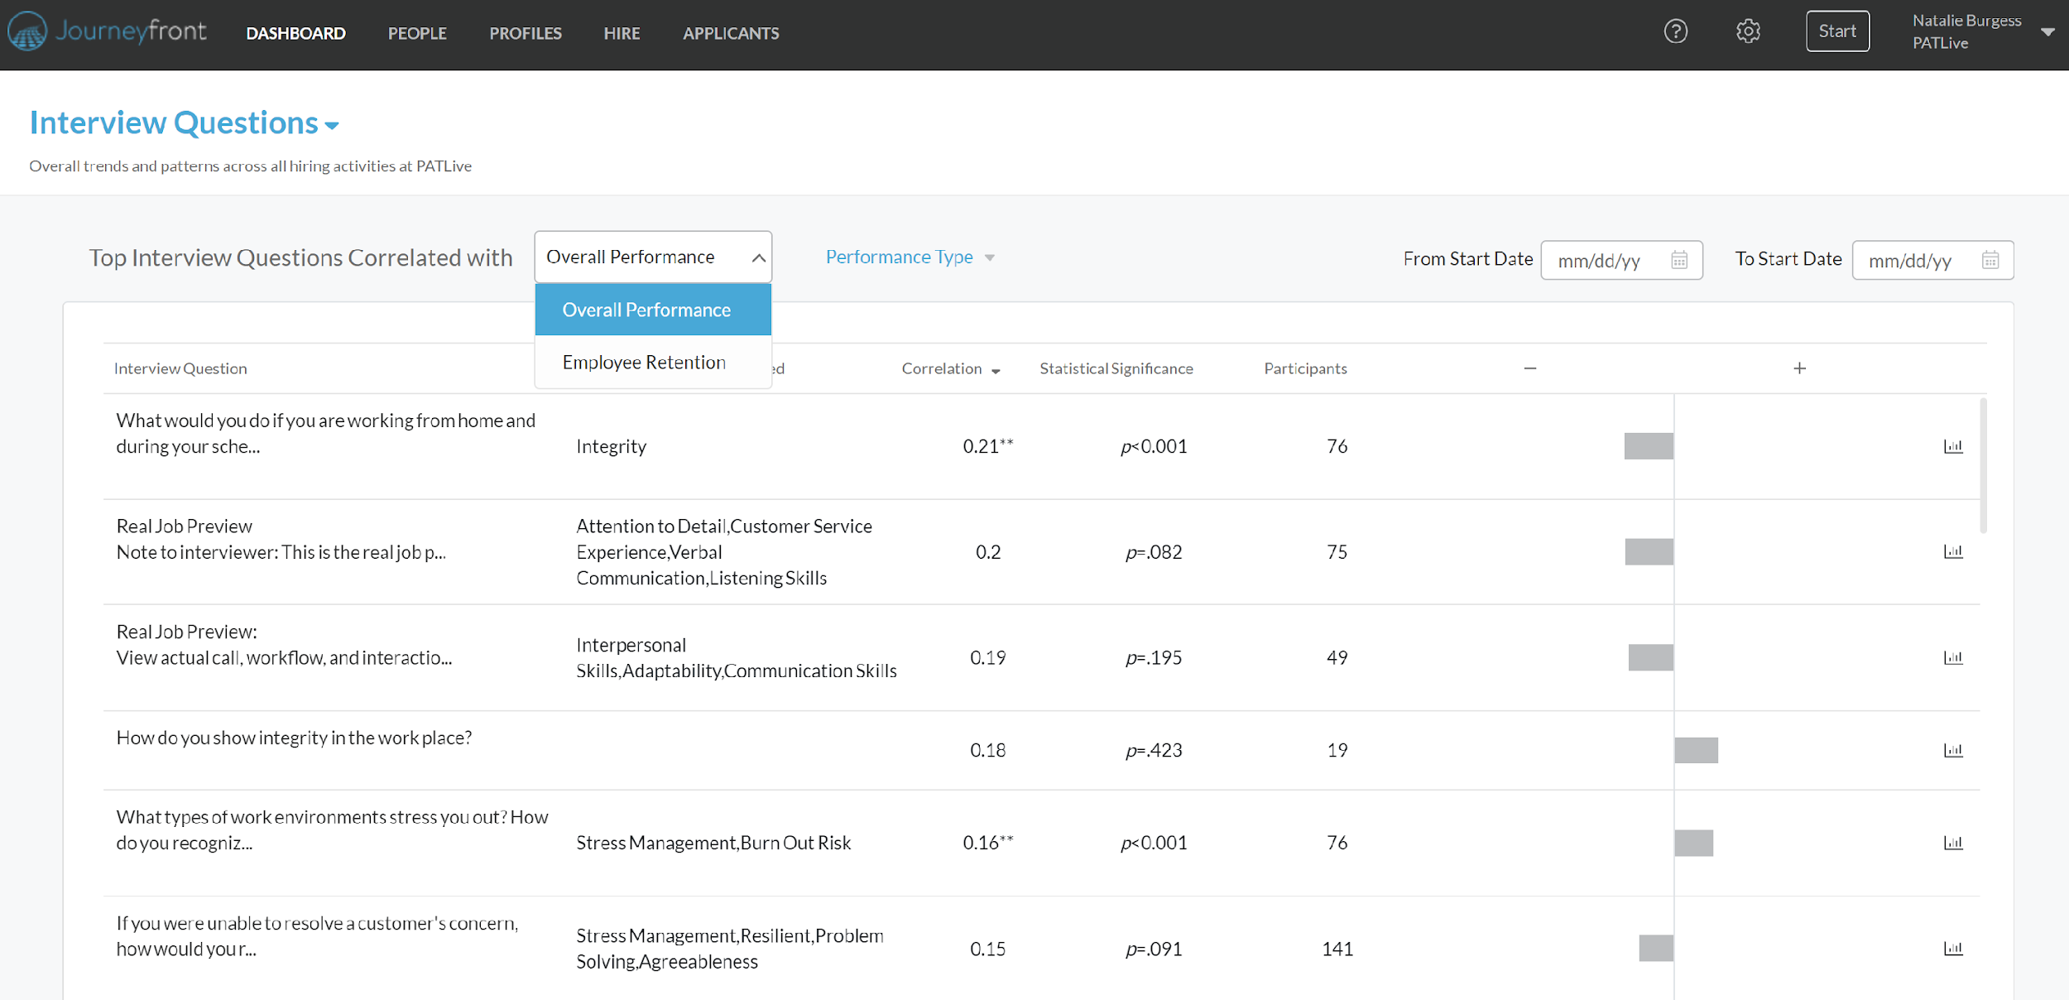
Track if an interview question is correlated to performance or retention and the strength of the correlation

Slide 56
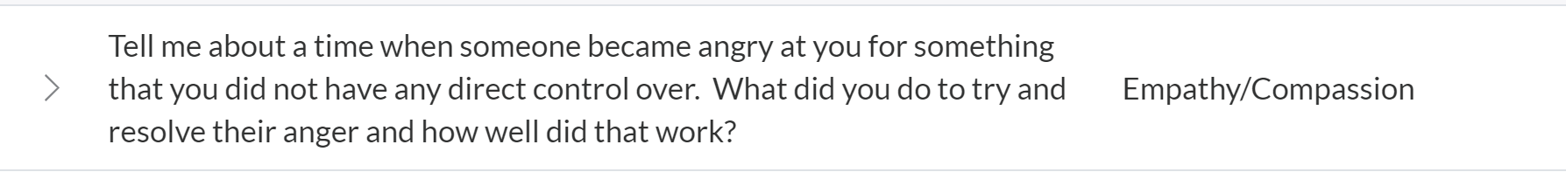
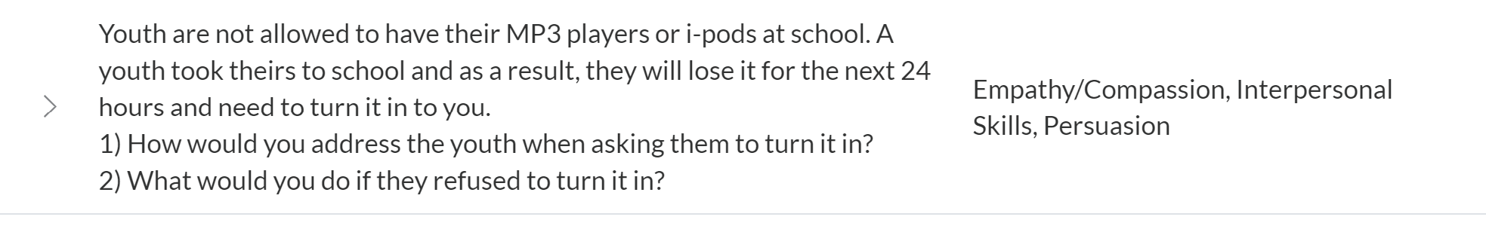
Example of how we can address turnover: Optimizing data to improve interview and screening questions

Slide 57
Duplicate Slide?
Agenda
Agenda/ Partnership Summary
Objectives
Data Review and Highlights
2023-2024 Strategy
Recommendations/Next Steps

Slide 58
Duplicate Slide?
Here’s what we have planned/recommend we execute over the next 3-6 months.
3 months:
Initiative 1
Initiative 2
Initiative 3
Based on our work with similar companies, here is what we expect to see in 6 months
Initiative 1
Initiative 2
Initiative 3
1 Year:
etc…

Slide 59
Next Steps & Recommendations for 2023 Turnover Focus
Duplicate Slide?
Continued focus on reducing turnover
  Re-analyze turnover model in Aug- include data from Jan-June 2023
Care in Communication
  Monthly sync with Debbie & Mallory
  Quarterly data collection from Mallory: Performance and Turnover
    After each import, JF will send a confirmation email to team with Monthly Headcount and the updated list of current employees
Additional Pain Points we can address:

Slide 60
Next Steps & Recommendations for 2023 Turnover Focus
Duplicate Slide?
Clean up records and tracking to improve optimizations and 2023’s focus
  Review Rejection Reasons- Customize
  Review Separation Reasons- Customize
  Add in Hiring criteria- “Contracted/ Not Contracted”
  Add in Screening Plan Steps- “Extended Job Offer”
Focus on biggest turnover reasons within our control - tailor modeling, tracking, and screening plans.
  Pulse Survey - do you have it/can we collect
  Survey long term employees to see why they have stayed.

Slide 61
Duplicate Slide?
As a next step, I’ll synthesize all this into a final plan and proposal. Let’s set up a time to review with (Decision Maker), Thursday this week.
Is there anyone else we need to loop in?
What times work for you?
Is there anything else you need from our side? Looking forward to continuing our work with you!

Slide 62
Reduced Conflict Tolerance &
Increased Conflict Tolerance Questions
Duplicate Slide?
1
2
Recommendations
Recommendations
Remove the 2 questions that have shown limited answer patterns.
Change question measurement from “Reduced” to “Increased” Conflict Tolerance.
If I answer a phone call and the caller is angry, it is likely that they are just a difficult person to deal with. (Reduced Conflict Tolerance)
When someone is angry, I am comfortable listening to their point of view before providing my own. (Increased Conflict Tolerance)
I often come across people who, to be honest, are just difficult and angry people.

Slide 63
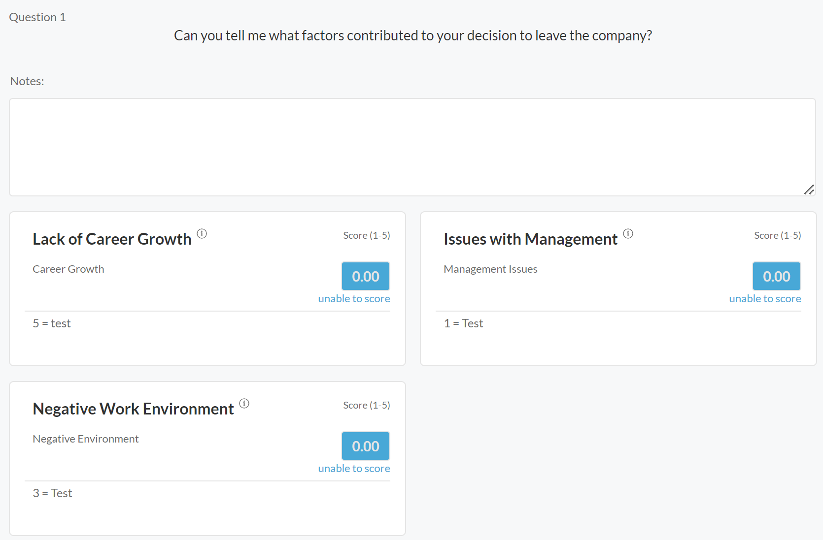
Exit Interviews Done By JF OR Send Us The Exit Interview Data
It can be difficult for employees to be honest during their exit interviews. Having a 3rd party conduct those interviews may lead to deeper insights and understanding of turnover.
All insights gathered will be analyzed and reviewed with the CEC Team.

Slide 64
APPENDIX

Slide 65
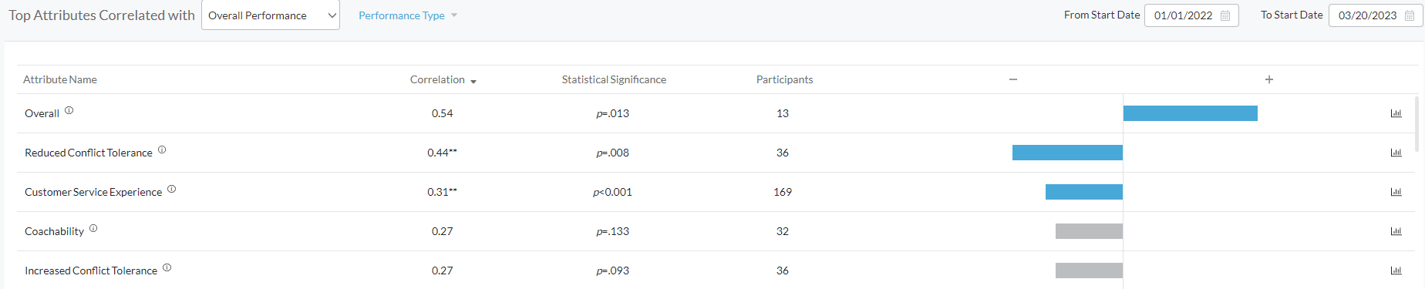
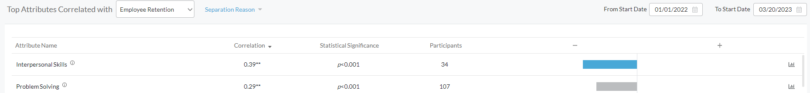
Attributes

